Slide 1
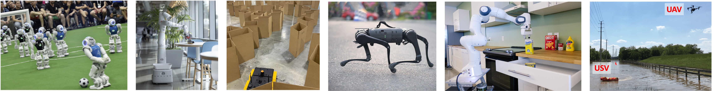
CS 485 Autonomous Robotics
Motion Planning I
Prof. Xuesu Xiao
George Mason University
Slides Credits: Gregory Stein

Slide 2
Logistics
The BARN Challenge:
  Team formation finished
  Setting up BARN (should be) finished
  Get familiar with the ROS infrastructure
  move_base navigation stack should work out of the box
Assignment 1 due next week before class on Monday
  Turn in paper copy or email the instructor and TA

Slide 3
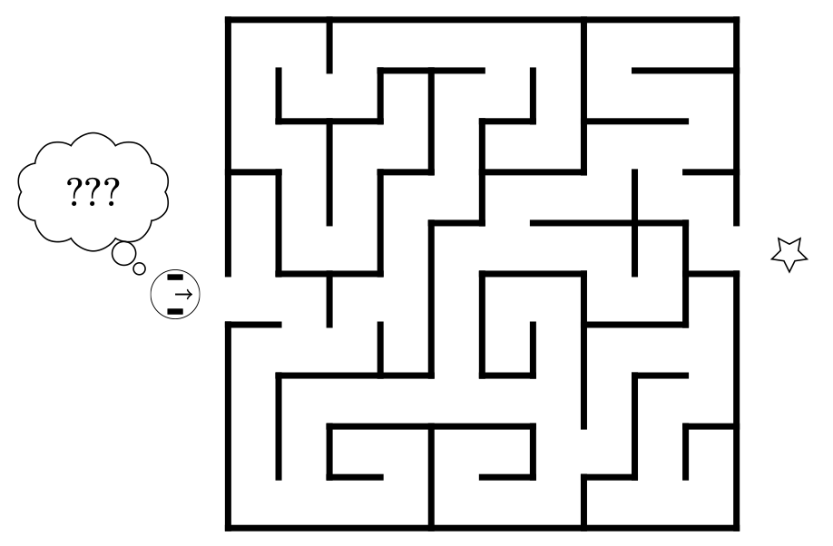
So that’s control (in a nutshell)
What can’t we do with a controller?
What about this?
For this we’ll need planning.
From: https://w3.cs.jmu.edu/molloykp/teaching/cs354/cs354_2021Fall/resources/pid.pdf

Slide 4
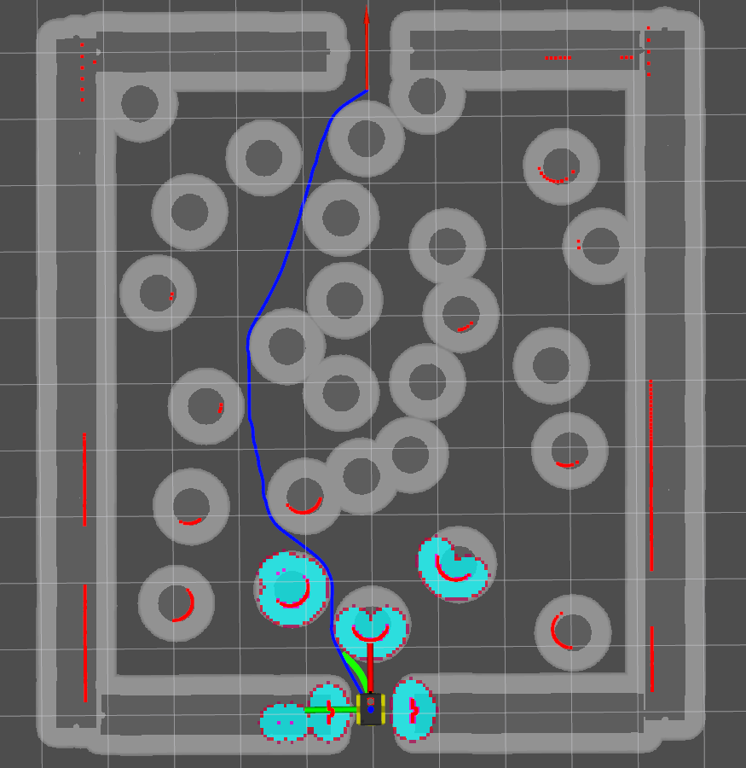
The classical navigation problem: moving a robot from one point to another without collision with any obstacle
Global Goal
Global Representation
Global Path
Local Goal
Perceptual Input
Local Representation
Motion Commands
[Xiao et al., AuRo22]
Robot (Parameters, Planners, Models)

Slide 5
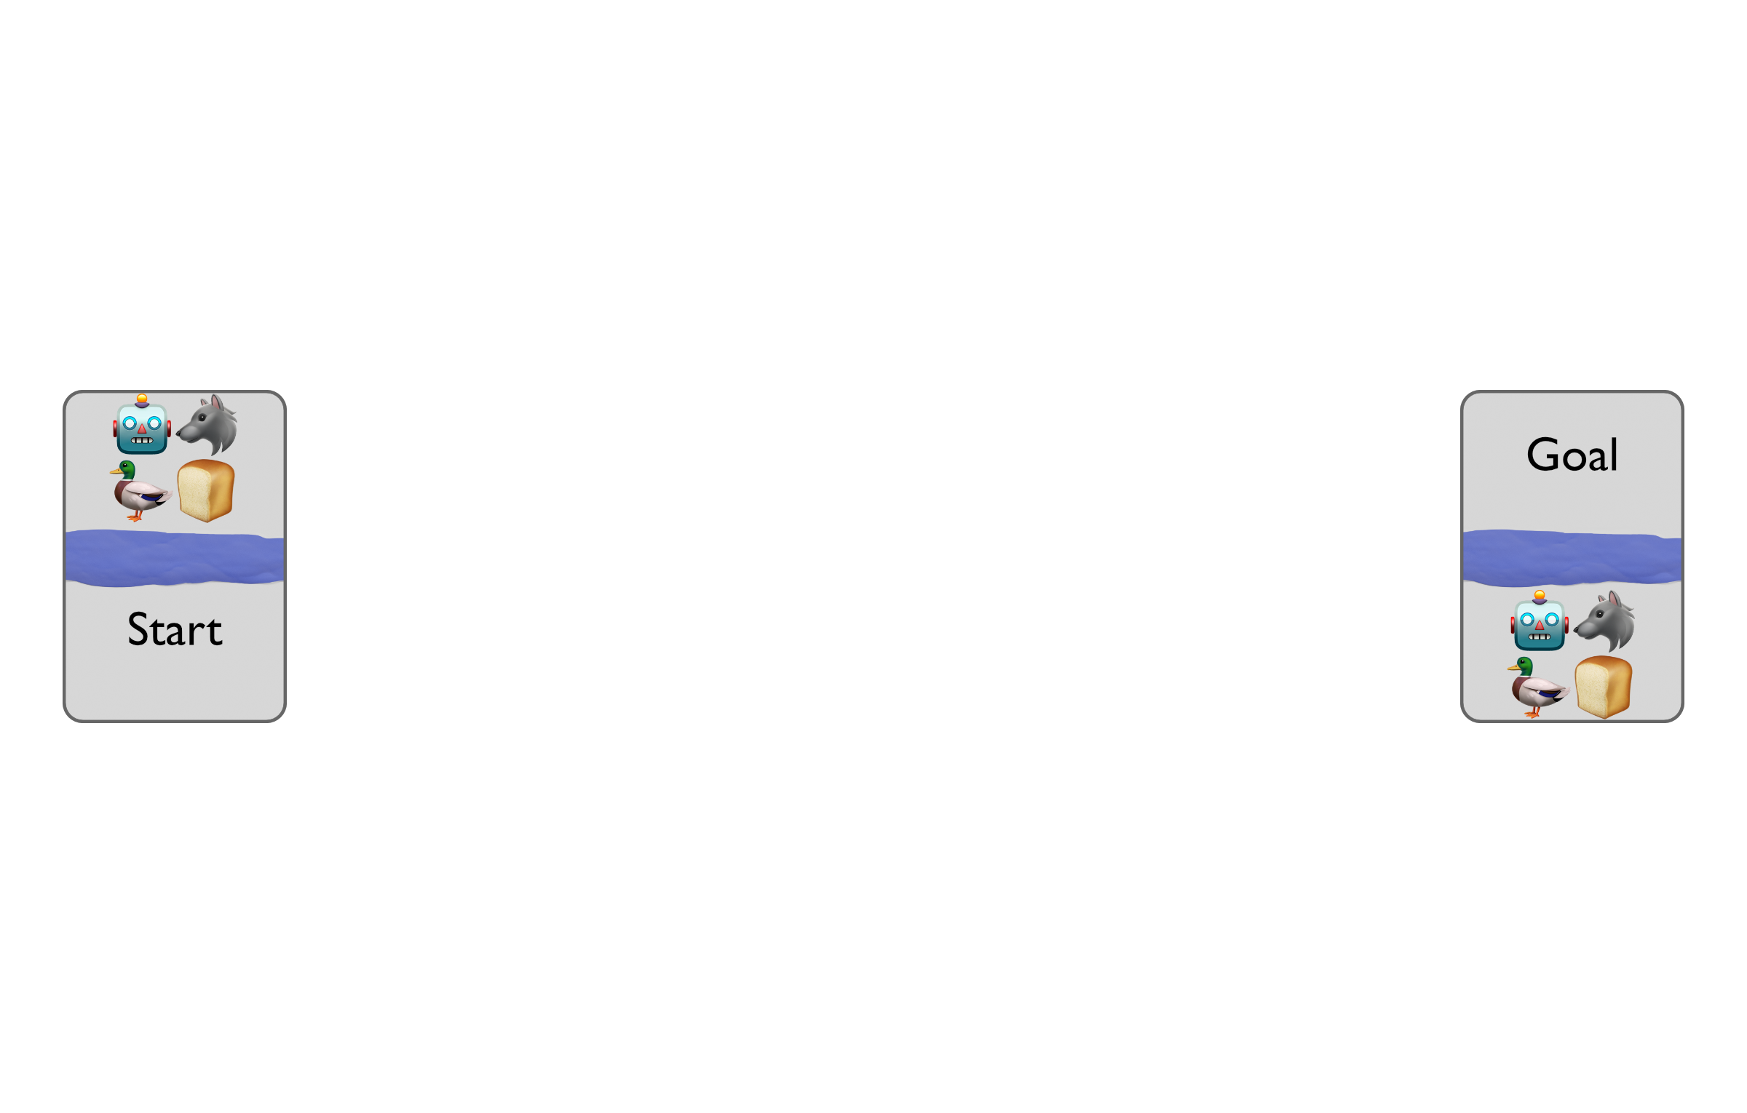
Motivation: Crossing a River …with Constraints
Our intrepid robot wants to get across a river, bringing with it (1) a wolf, (2) a duck, and (3) some bread.
Easy? Not so fast:
The boat to cross is small and the robot can only take 1 at a time (or nothing)
If left alone with the bread, the duck will eat the bread.
If left alone with the duck, the wolf will eat the duck.

Slide 6
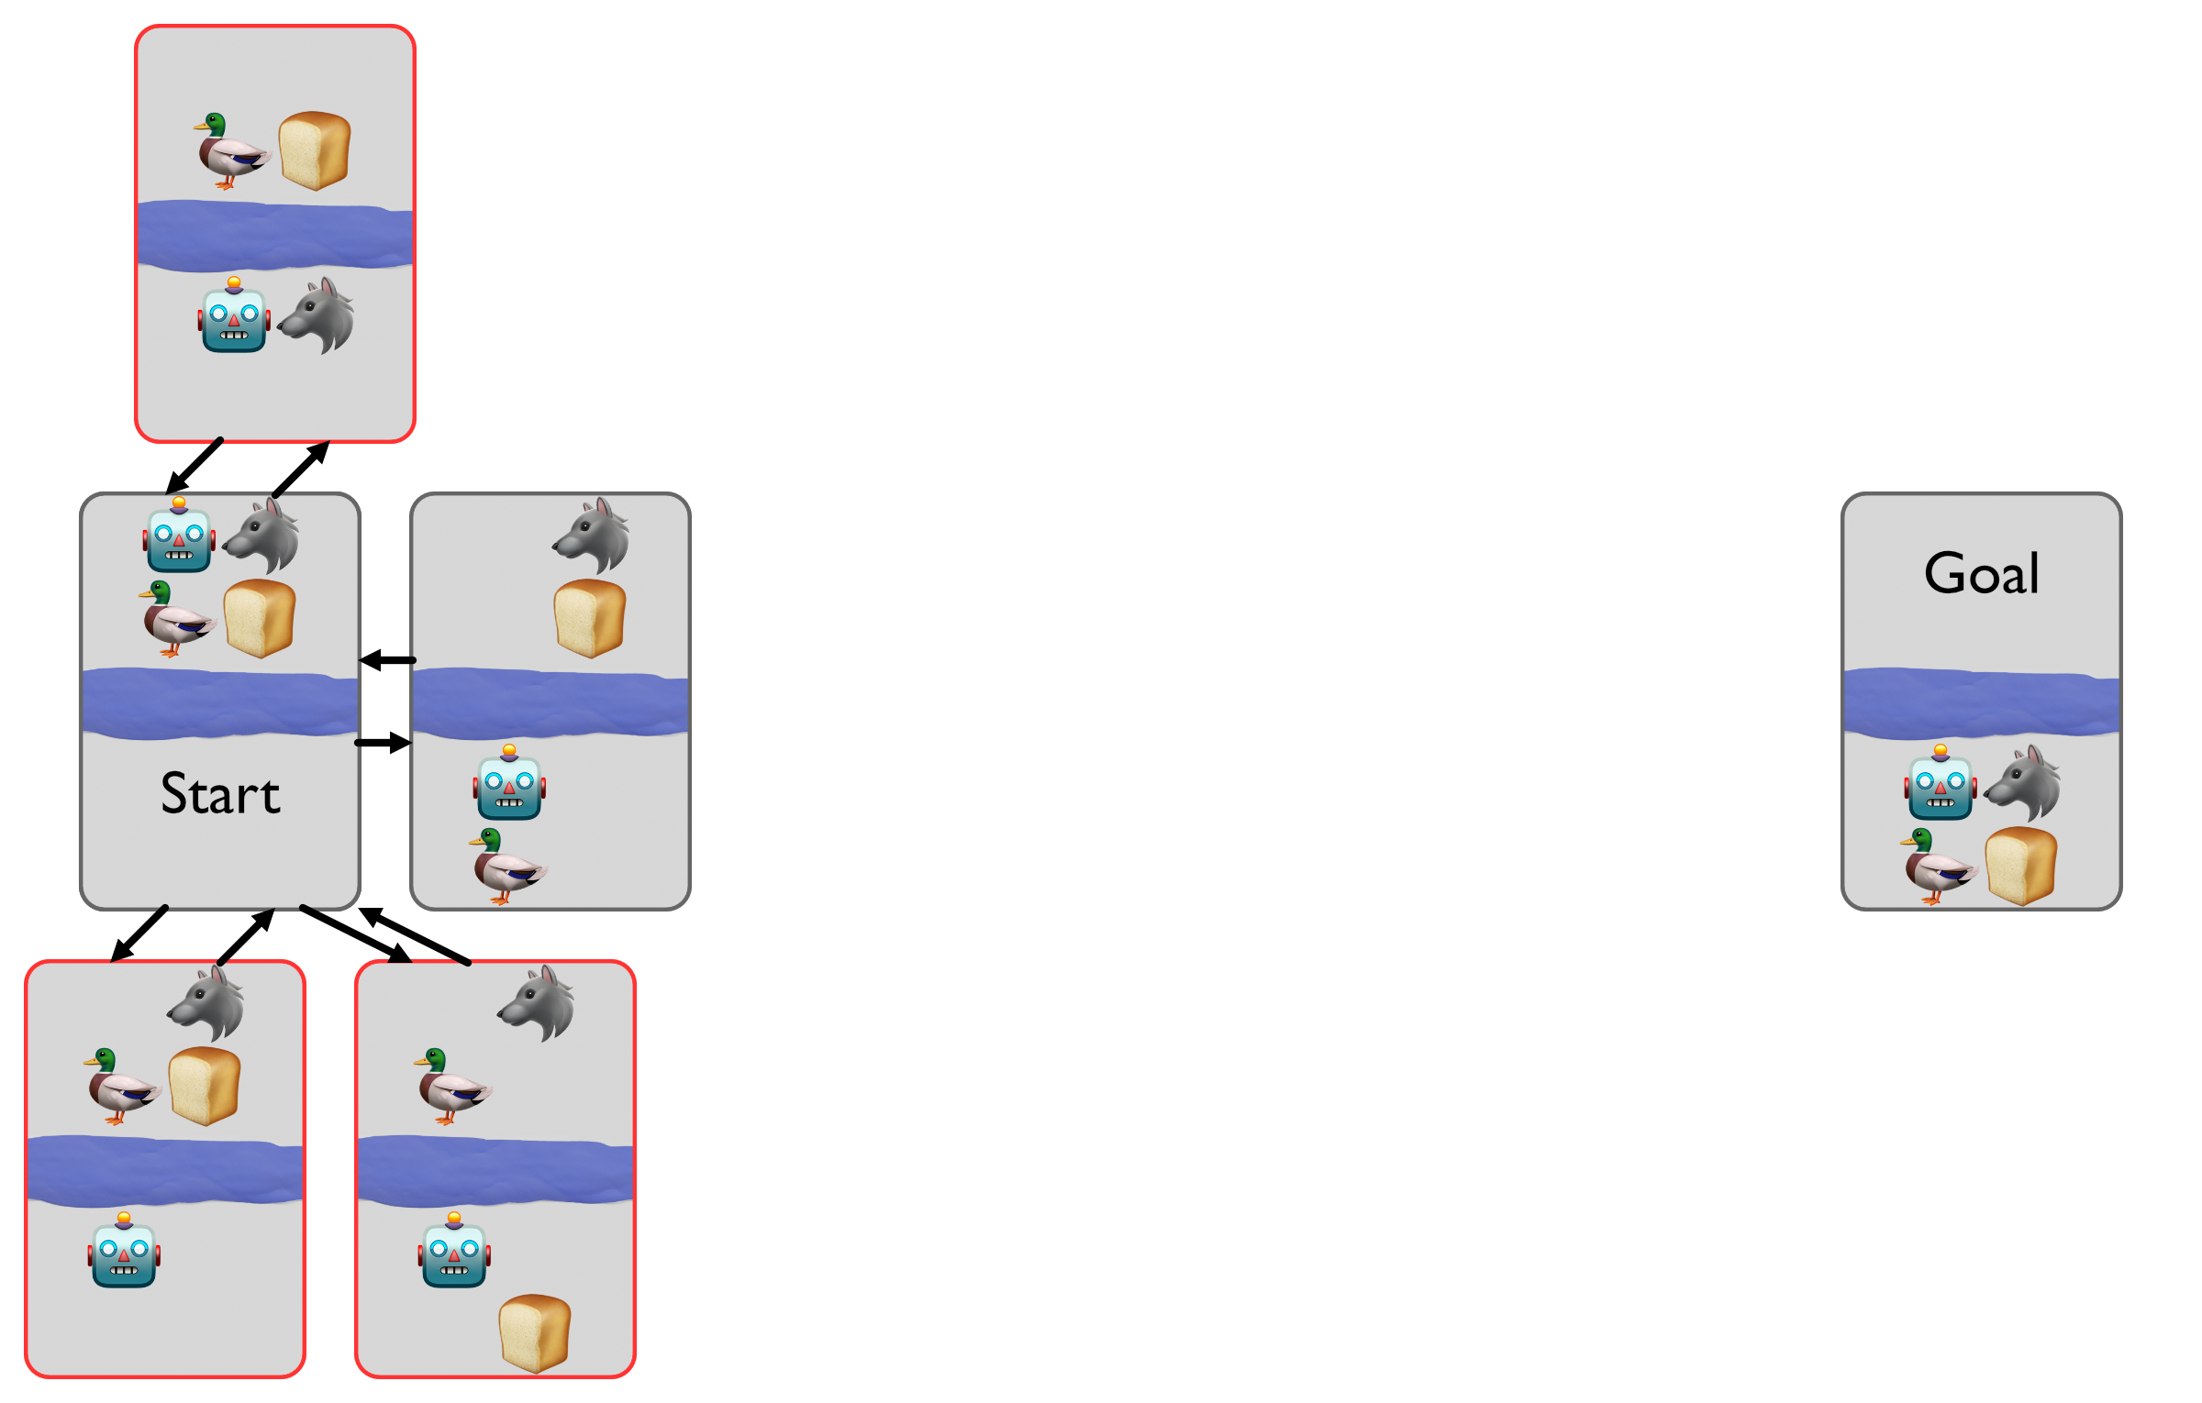
Motivation: Crossing a River …with Constraints

Slide 7
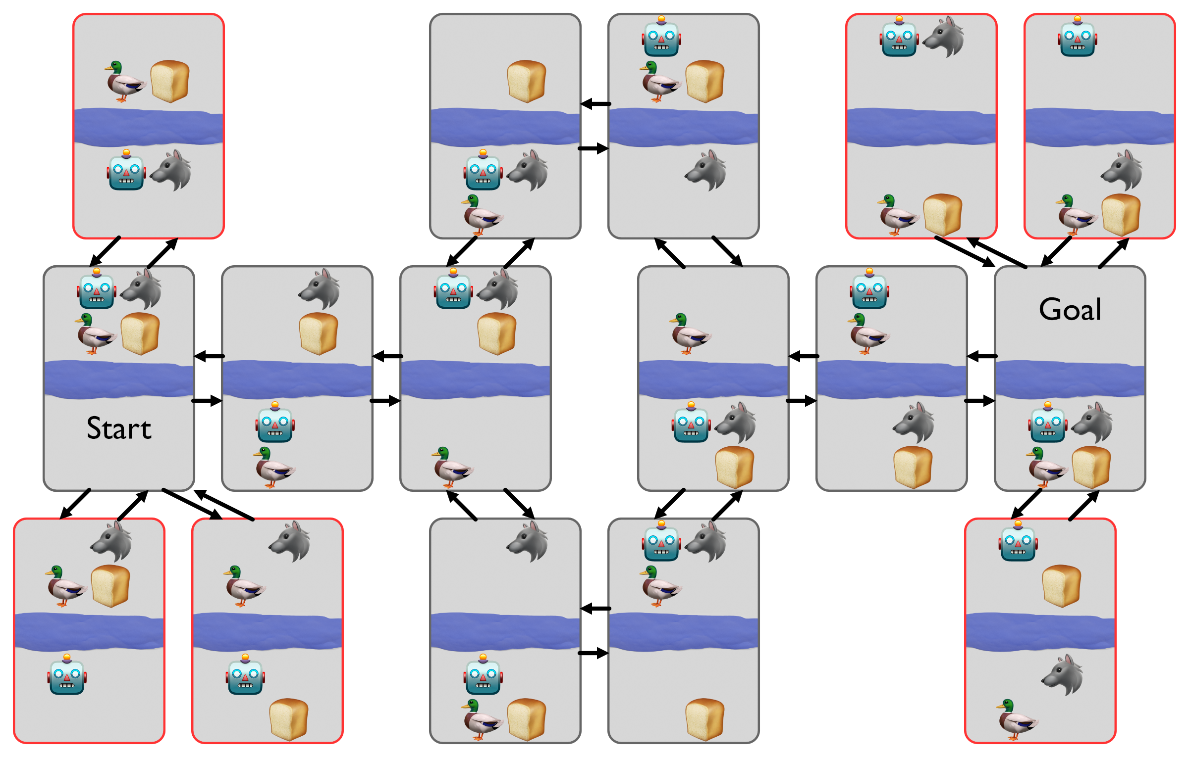
Motivation: Crossing a River …with Constraints

Slide 8
Motivation: Crossing a River …with Constraints Solved!

Slide 9
Motivation: How do we solve more problems (and with increasing complexity)?
Next we’ll talk about (and mostly review) state space search, and ask questions about how to represent the world and how we can leverage that representation to achieve our goals.

Slide 10
Reading & Slide Credits
Slide Credits (from which many of the reference images have been taken or adapted):
MIT’s 16.410: Principles of Autonomy
S. M. LaValle: Planning Algorithms [An excellent free textbook] Mostly Ch. 6
CMU’s 15.381
CMU Motion Planning Course

Slide 11
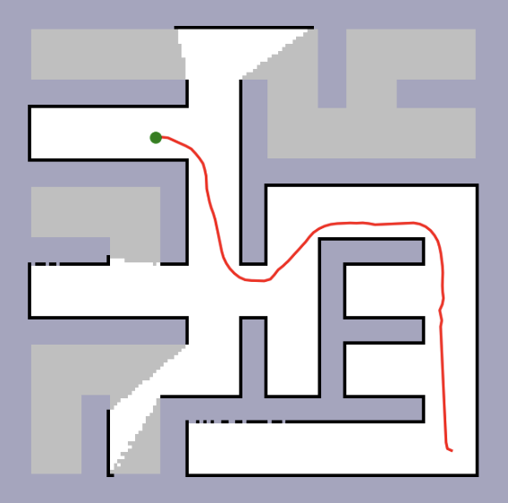
Many of the building blocks of autonomy rely on some type of search
Search is a critical component of many of the tools my robot needs:
Navigation
Motion Planning & Manipulation
Task Planning & Scheduling
Localization and Map Building

Slide 12
Search implies that you’re looking for something: so what are we looking for?
We “search” over states of the world.

Slide 13
Search implies that you’re looking for something: so what are we looking for?
We “search” over states of the world.
For today, we will assume:
We know the “state” of the world that we want to end up in. We’ll call this the “goal”
We know the current state of the world
Is that it? What else might we need?

Slide 14
Let’s revisit our river-crossing example: what did we need to find a solution?

Slide 15
Let’s revisit our river-crossing example: what did we need to find a solution?
We needed a model! Something that let us understand what actions were available to us and how taking an action will change the state of the world.

Slide 16
Search implies that you’re looking for something: so what are we looking for?
We “search” over states of the world.
To cross the river, we expanded outwards from our starting state using the actions we had available.
Note: this isn’t even the full graph! There are a number of places where the robot can cross on its own that are not shown.

Slide 17
Aside: Models
  All models are wrong, but some models are useful
– George Box
In practice, models are abstractions that aim to help us understand the world.
For our river example, the boat can capsize, something not captured by our model, but we decide that our robot doesn’t need to worry about that when it’s trying to figure out it’s high-level plan of what to do.
You don’t even always need a model to plan… but that’s for later.

Slide 18
For today, search will require 3 things:
The starting state: how the world looks at the beginning
The “goal” state: how we’d like the world to look
The actions (a.k.a. operators): which define what the agent can do and how we get from state to state

Slide 19
Let’s revisit that river again…
How do we formalize this problem?
States: What are our state variables?

Slide 20
Let’s revisit that river again…
How do we formalize this problem?
States: What are our state variables?
A: The location of the 4 entities: {robot, goose, grain, fox}
Their location can be expressed as a binary (0 or 1) or an “enum” (top vs. bottom)

Slide 21
Let’s revisit that river again…
How do we formalize this problem?
States: What are our state variables?
A: The location of the 4 entities: {robot, goose, grain, fox}
Their location can be expressed as a binary (0 or 1) or an “enum” (top vs. bottom)
Operations: How should we represent our operations?

Slide 22
Let’s revisit that river again…
How do we formalize this problem?
States: What are our state variables?
A: The location of the 4 entities: {robot, goose, grain, fox}
Their location can be expressed as a binary (0 or 1) or an “enum” (top vs. bottom)
Operations: How should we represent our operations?
Simple answer: A “move” operation that involves moving the boat (and optionally something else) across the river.
Complicated answer: operations are defined by both their postconditions (the things it changes), but also their preconditions (what must be true before the operation can happen)

Slide 23
Let’s revisit that river again…
How do we formalize this problem?
The Goal State: all entities on the bottom (South)
The Initial State: all entities on the top (North)
Operations:
Move(robot)
Move(robot, goose)
…
The move operations have preconditions that must be met: I cannot move the robot and the goose if the goose is somewhere else.
Also: some states are disallowed or invalid.

Slide 24
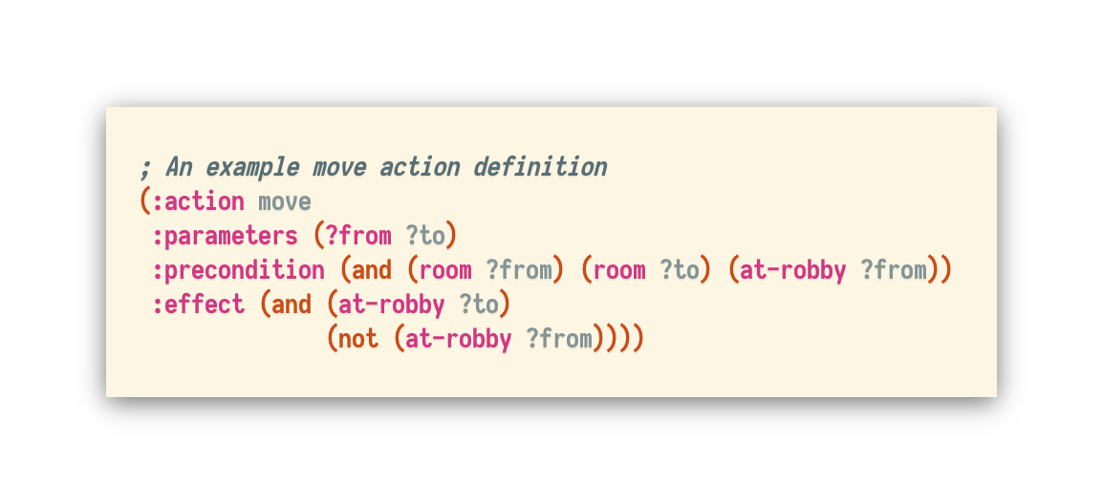
STRIPS is a language for describing planning problems like this one
Stanford Research Institute Problem Solver (STRIPS)
STRIPS-style planning is a popular way to formalize problems like this.
Go from somewhere to somewhere
”from” and “to” must be rooms.
The robot is no longer in the “from” room and is now in the “to” room
“Robby” the robot must start in the “from” room.
Code Source: CMU 15-887

Slide 25
Ok, what do we do with this model?
Let’s build a graph!

Slide 26
Ok, what do we do with this model?
Let’s build a graph!
…but wait, we did that already:

Slide 27
It’s very common to represent the world as some type of graph
Nodes corresponds to states
Edges corresponds to allowable transitions between them
What about the red “disallowed” nodes?
Are they in the graph?

Slide 28
It’s very common to represent the world as some type of graph
Nodes corresponds to states
Edges corresponds to allowable transitions between them
What about the red “disallowed” nodes?
Are they in the graph?
A: It depends! You can ban transitions to those states or just remove them altogether.

Slide 29
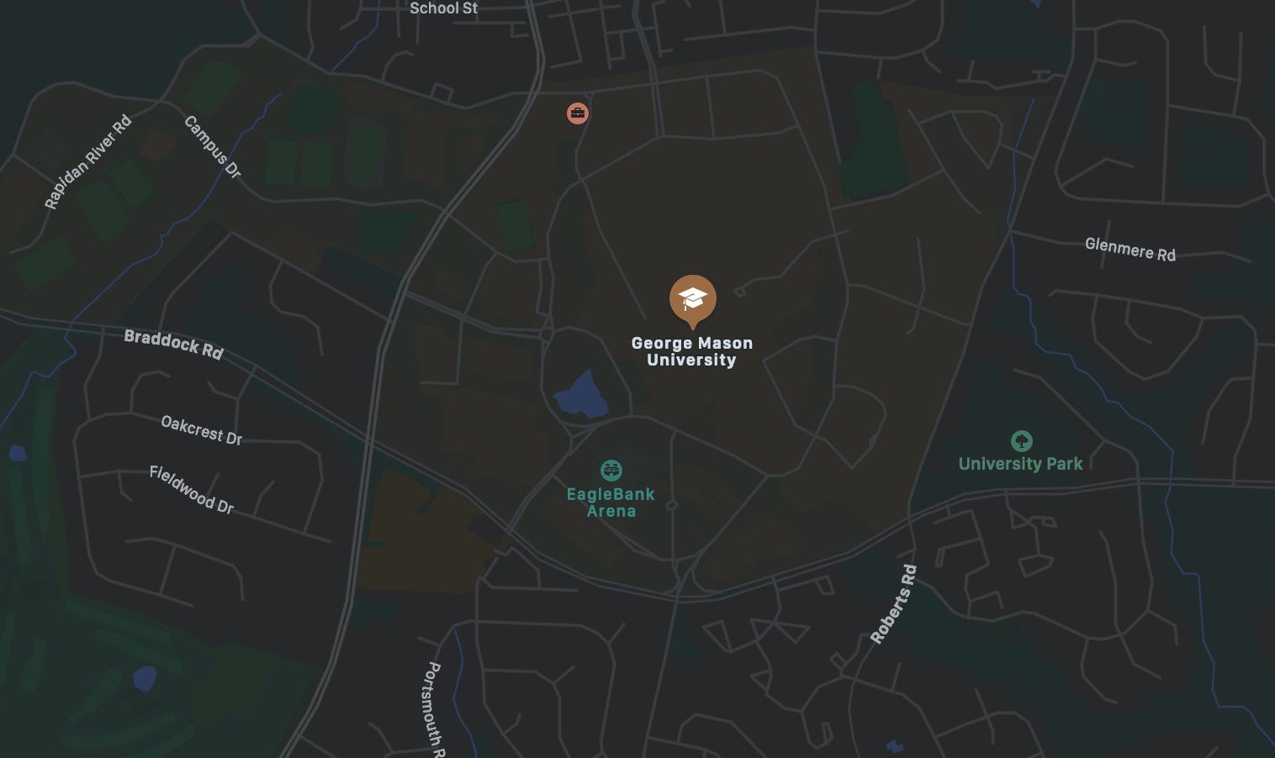
It’s very common to represent the world as some type of graph
Nodes corresponds to states
Edges corresponds to allowable transitions between them
Later, we will discuss how to get the graph for more complex examples (e.g., for navigation)
Image: Apple Maps

Slide 30
Graph Search
How to get from A to B in a world represented by a graph.

Slide 31
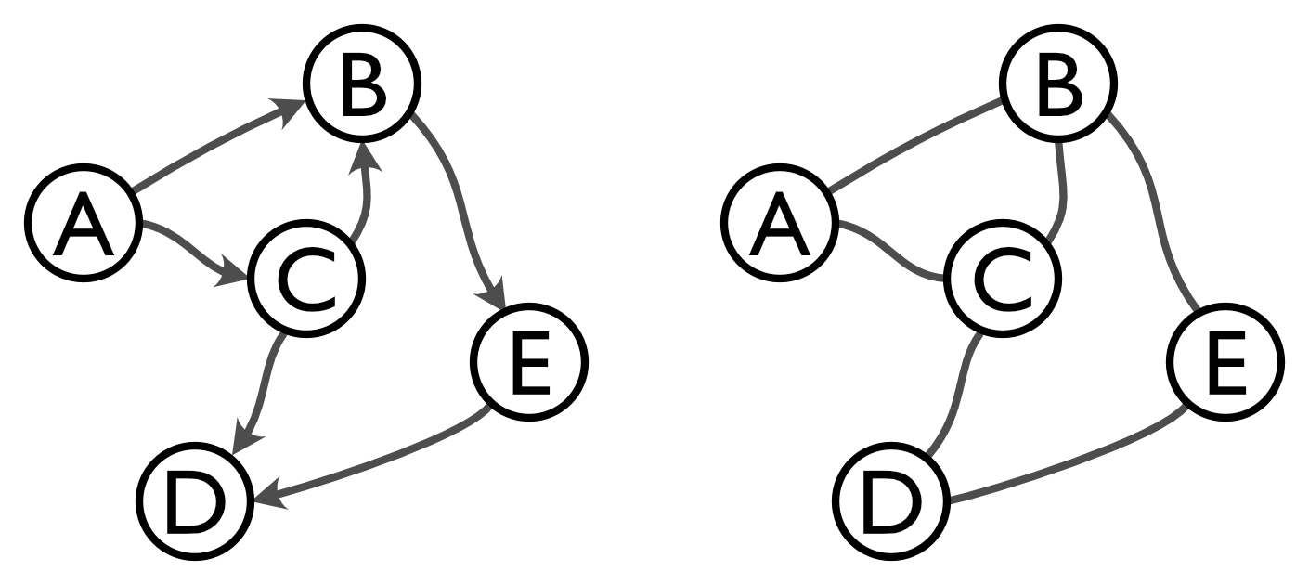
The anatomy of a graph
Nodes
States
Edges
Operators
A Directed Graph
Edges have direction
An Undirected Graph
Edges lack direction

Slide 32
The anatomy of a graph
Nodes
States
Node B
Degree 3
Node B
In Degree 2
Out Degree 1
Edges
Operators
A Directed Graph
Edges have direction
An Undirected Graph
Edges lack direction

Slide 33
The anatomy of a graph
Nodes
States
Edges
Operators
States are neighbors if they share an edge
The “tail” of an edge
The “head” of an edge
A Directed Graph
Edges have direction

Slide 34
Let’s formalize the definition of a graph
A graph is defined by its nodes (vertices) and edges:
Notation
A list (ordered):
A set (unordered):
The Nodes:
The Edges:
Notes:
V = \{ a,b,c,d,e \}
E = \{
\left< a, b \right>,
\left< a, c\right>,
\left< b, e\right>,
\left< c, b\right>,
\left< c, d\right>,
\left< e, d\right>\}

Slide 35
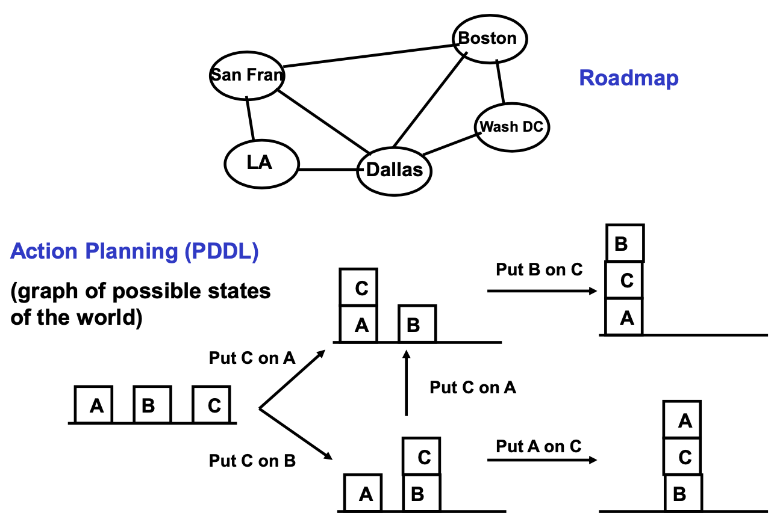
Some examples of graph-based representations for planning
Roadmap
Action Planning (PDDL)
Image from: MIT 16.410

Slide 36
Let’s formalize our problem:
State Space Search
Input: A search problem where
Graph:
The start and goal are both vertices:
Output: A simple path
The path must start at the start S and end at the goal G and it must be possible to travel between connected nodes by “following” an edge.

Slide 37
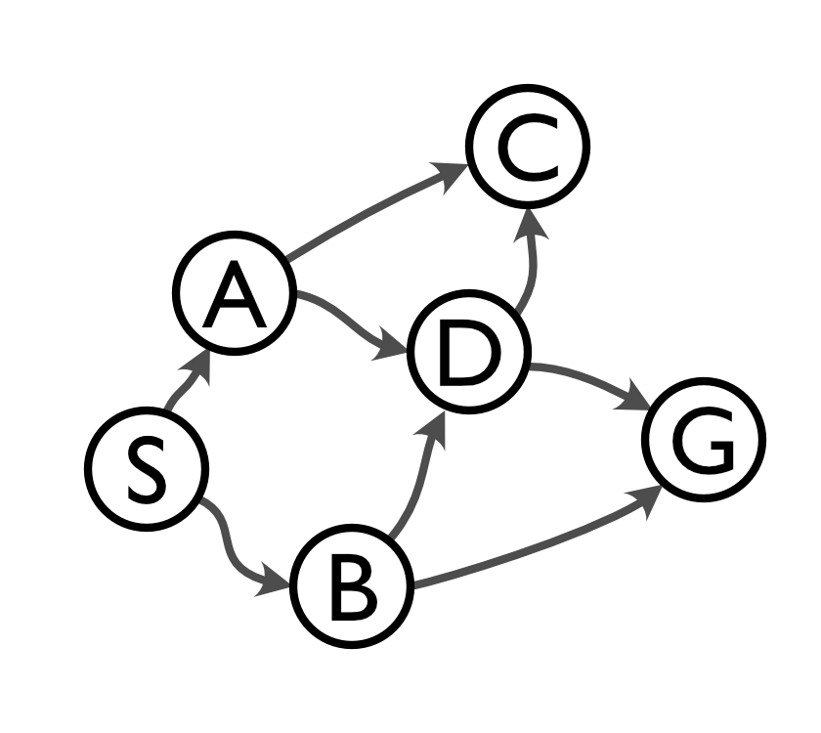
Some simple paths of an example graph
Here’s a simple graph:

Slide 38
Some simple paths of an example graph
Here’s a simple graph:
We can create simple paths by traversing the nodes.

Slide 39
Some simple paths of an example graph
Here’s a simple graph:
A (directed) path P of graph g is a sequence of vertices:
such that each successive pair is a (directed) edge in E.
We can create simple paths by traversing the nodes.
A “simple path” has no cycles; a “cycle” is a subpath where the start == the end. No cycles means no repeated vertices.

Slide 40
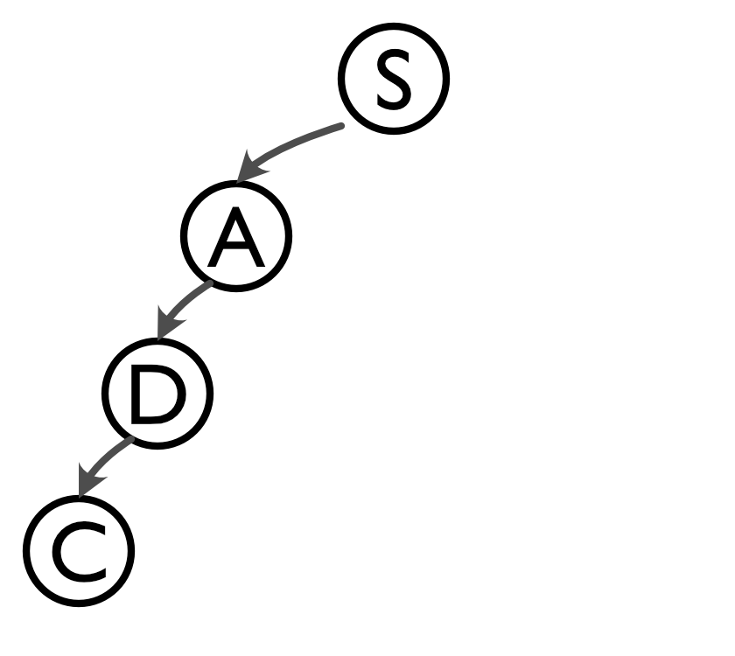
We can build a “tree” out of all the simple paths from the graph.

Slide 41
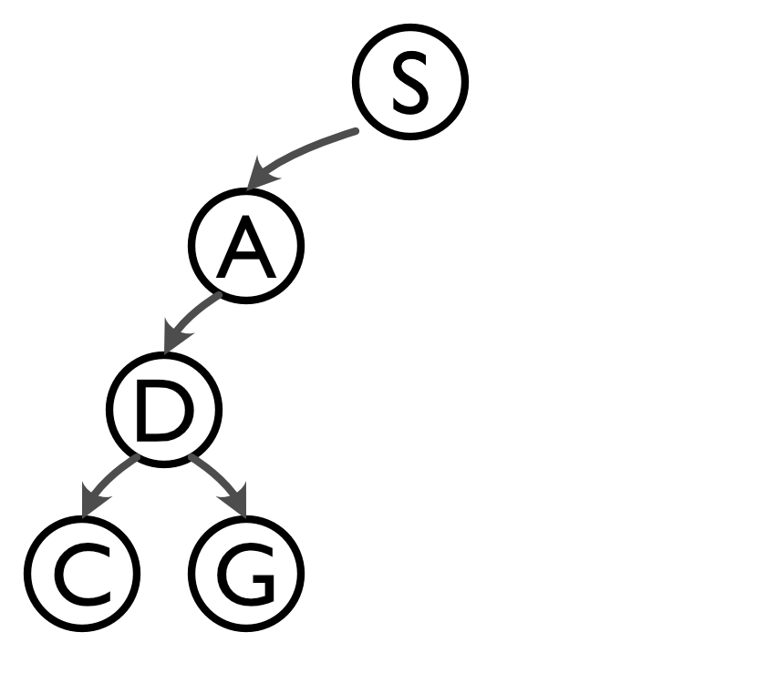
We can build a “tree” out of all the simple paths from the graph.

Slide 42
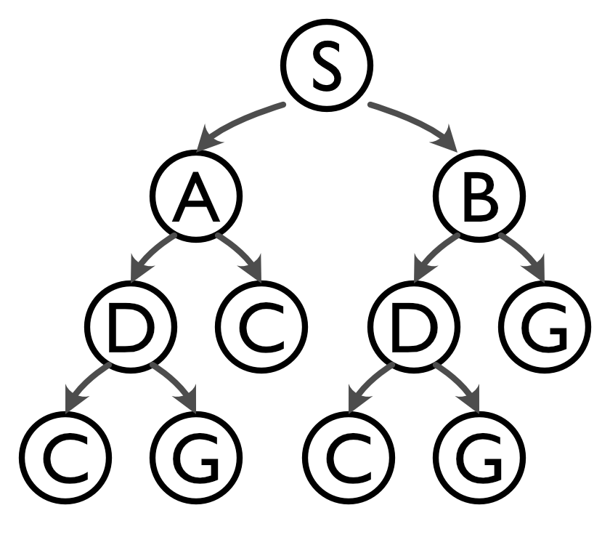
We can build a “tree” out of all the simple paths from the graph.
This is known as a “search tree”

Slide 43
The Search Tree contains all possible simple paths starting from the start node
A “tree” is a directed graph such that there is only one edge between any pair of vertices and where the “in degree” for any vertex is at most one.

Slide 44
The Search Tree contains all possible simple paths starting from the start node
A “tree” is a directed graph such that there is only one edge between any pair of vertices and where the “in degree” for any vertex is at most one.
The language we use to describe “trees” is similar to familial relationships.
Root
(no parents)
Branch
(edge)
Parent
Child
Siblings
(same parent)
Leaf
(no children)
Ancestors are upstream nodes
Descendants are downstream

Slide 45
So how do we search a graph?
There are a number of different types of search:
Uninformed | Depth-First Breadth-first Iterative Deepening | Search the entire tree until goal found
Optimal (informed) | A* Branch & Bound | Use length as a measure and find “shortest” path
Heuristic (informed) | Hill-climbing Best-first Beam | Use heuristics to guide search
Notes:
Heuristic search can be useful for searching for some kind of optimum
e.g. Annealing for solving Traveling Salesman Problem

Slide 46
You may already be pretty familiar with some different types of search
How should we traverse these nodes to find a path to the goal?

Slide 47
You may already be pretty familiar with some different types of search
How should we traverse these nodes to find a path to the goal?
1
2
7
3
6
4
5
What is this called?

Slide 48
You may already be pretty familiar with some different types of search
How should we traverse these nodes to find a path to the goal?
1
Local Search Rule
After visiting a node:
Visit its children before its siblings
Visit its children left to right
2
7
3
6
4
5
What is this called?
Depth First Search

Slide 49
You may already be pretty familiar with some different types of search
How should we traverse these nodes to find a path to the goal?
Local Search Rule
After visiting a node:
Visit its siblings before its children
Visit its children left to right
1
2
3
4
5
6
7
Breadth First Search

Slide 50
How well does each perform?
Number of steps? Length of path?
What are the path lengths for each approach for this example?
Depth First Search
Breadth First Search
1
1
2
7
2
3
3
6
4
5
6
7
4
5

Slide 51
How well does each perform?
Number of steps? Length of path?
What are the path lengths for each approach for this example?
Depth First Search
Breadth First Search
1
1
2
7
2
3
3
6
4
5
6
7
4
5
Interesting… we’ll study this more later.

Slide 52
Now we understand search!
Let’s turn it into an algorithm
We keep track of all the partial paths as an ordered list: called a queue “Q”
Basic idea:
Iteratively
  Select the next partial path from Q
  Expand it by adding the children of the head node
  Add the expansions to Q
This ends when the goal G is found
We also require that the procedure is Complete

Slide 53
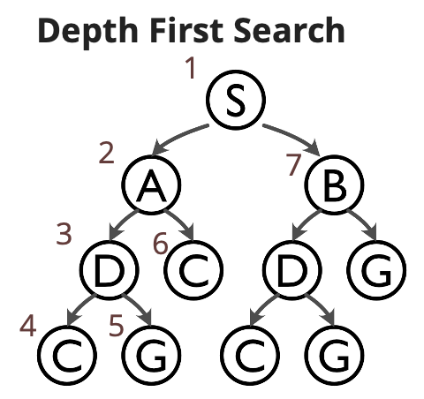
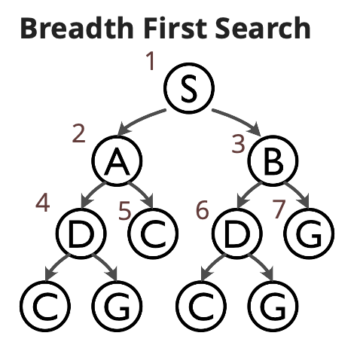
Breadth-First Search and Depth-First Search are similar
Pseudocode is effectively the same except for how Q is modified when new additions are added:
Depth-first:
add path extensions to the front of Q
pick the first element of Q
Breadth-first:
add path extensions to the back of Q
pick the first element of Q

Slide 54
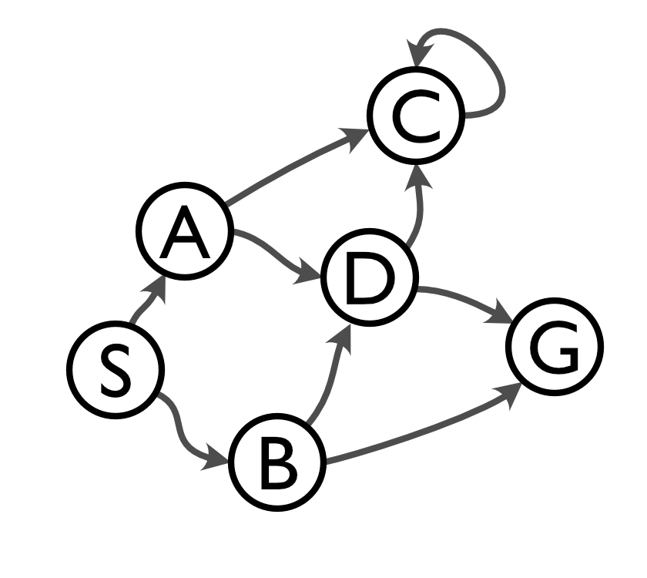
What happens if there’s a cycle in our graph?
If there is a cycle, what happens when we run Depth-First Search?

Slide 55
What happens if there’s a cycle in our graph?
If there is a cycle, what happens when we run Depth-First Search?
DFS will never terminate!
How can we avoid this?

Slide 56
What happens if there’s a cycle in our graph?
If there is a cycle, what happens when we run Depth-First Search?
DFS will never terminate!
How can we avoid this?
What if we remember what nodes we visited already and don’t add paths to Q that start with that node.

Slide 57
Iterative Deepening (IDS)
Getting the best of both DFS and BFS
Concept: explore the tree at depth-first order, at iteratively increasingly levels of depth.
Iteratively apply “depth-limited search”
Round 1
Depth of 1

Slide 58
Iterative Deepening (IDS)
Getting the best of both DFS and BFS
Concept: explore the tree at depth-first order, at iteratively increasingly levels of depth.
Iteratively apply “depth-limited search”
Round 2
Depth of 2

Slide 59
Iterative Deepening (IDS)
Getting the best of both DFS and BFS
Concept: explore the tree at depth-first order, at iteratively increasingly levels of depth.
Iteratively apply “depth-limited search”
Round 3
Depth of 3
(not needed here…)

Slide 60
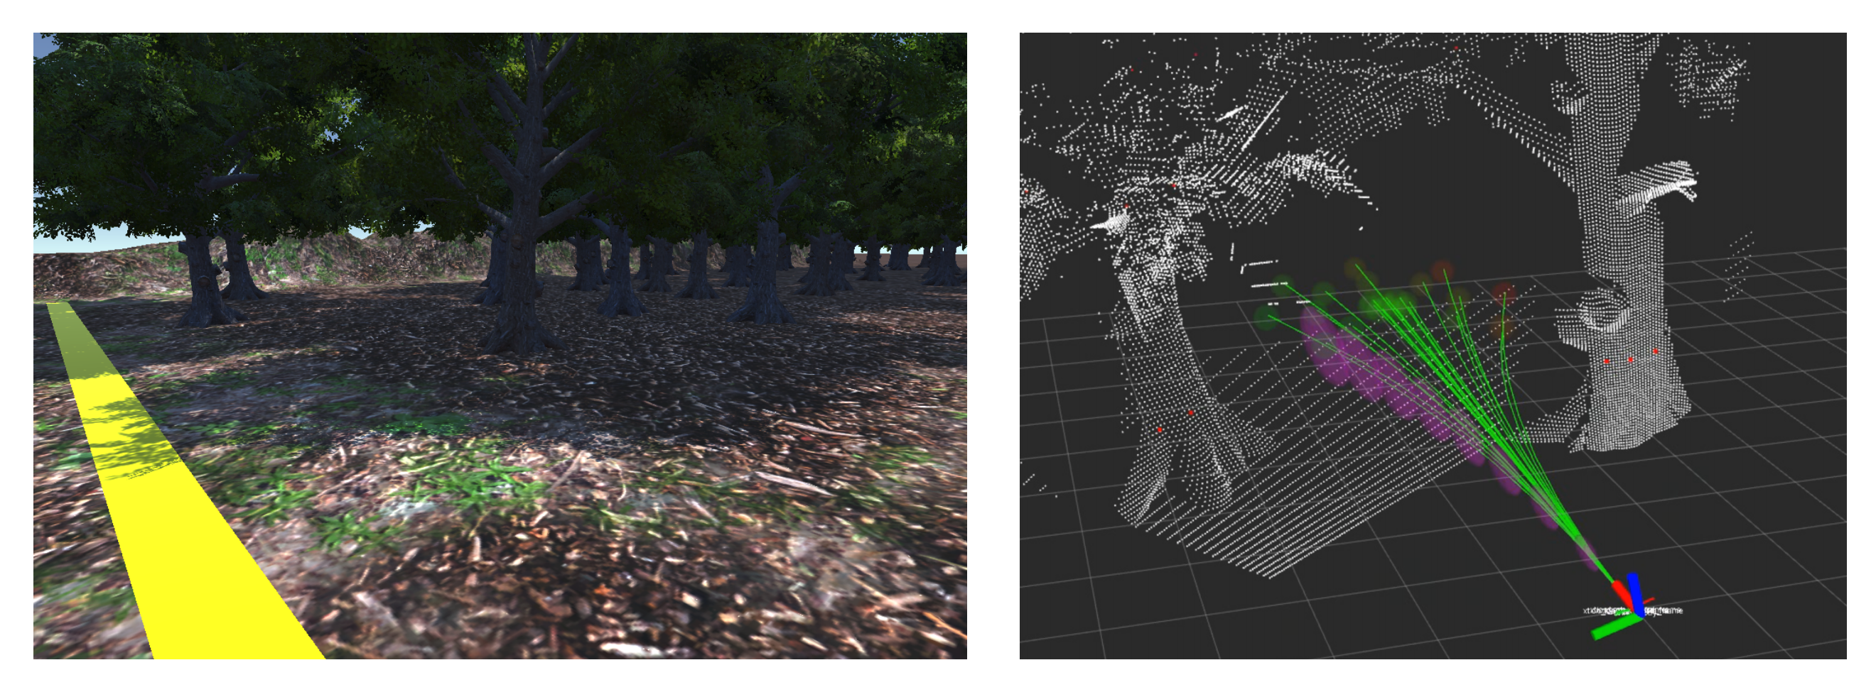
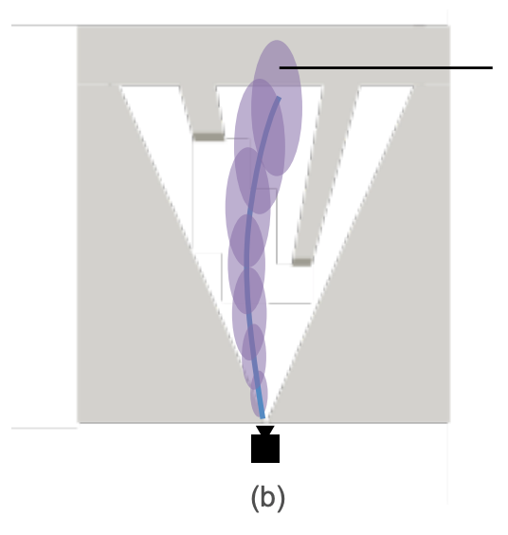
Motion Planning: getting from A to B
Motion Planning, broadly speaking, refers to how to get an autonomous vehicle from place to place.
While dodging obstacles:
Image: Pete Florence, Integrated Perception and Control at High Speed

Slide 61
Motion Planning: getting from A to B
Motion Planning, broadly speaking, refers to how to get an autonomous vehicle from place to place.
While planning a route to some faraway goal
Image: Apple Maps

Slide 62
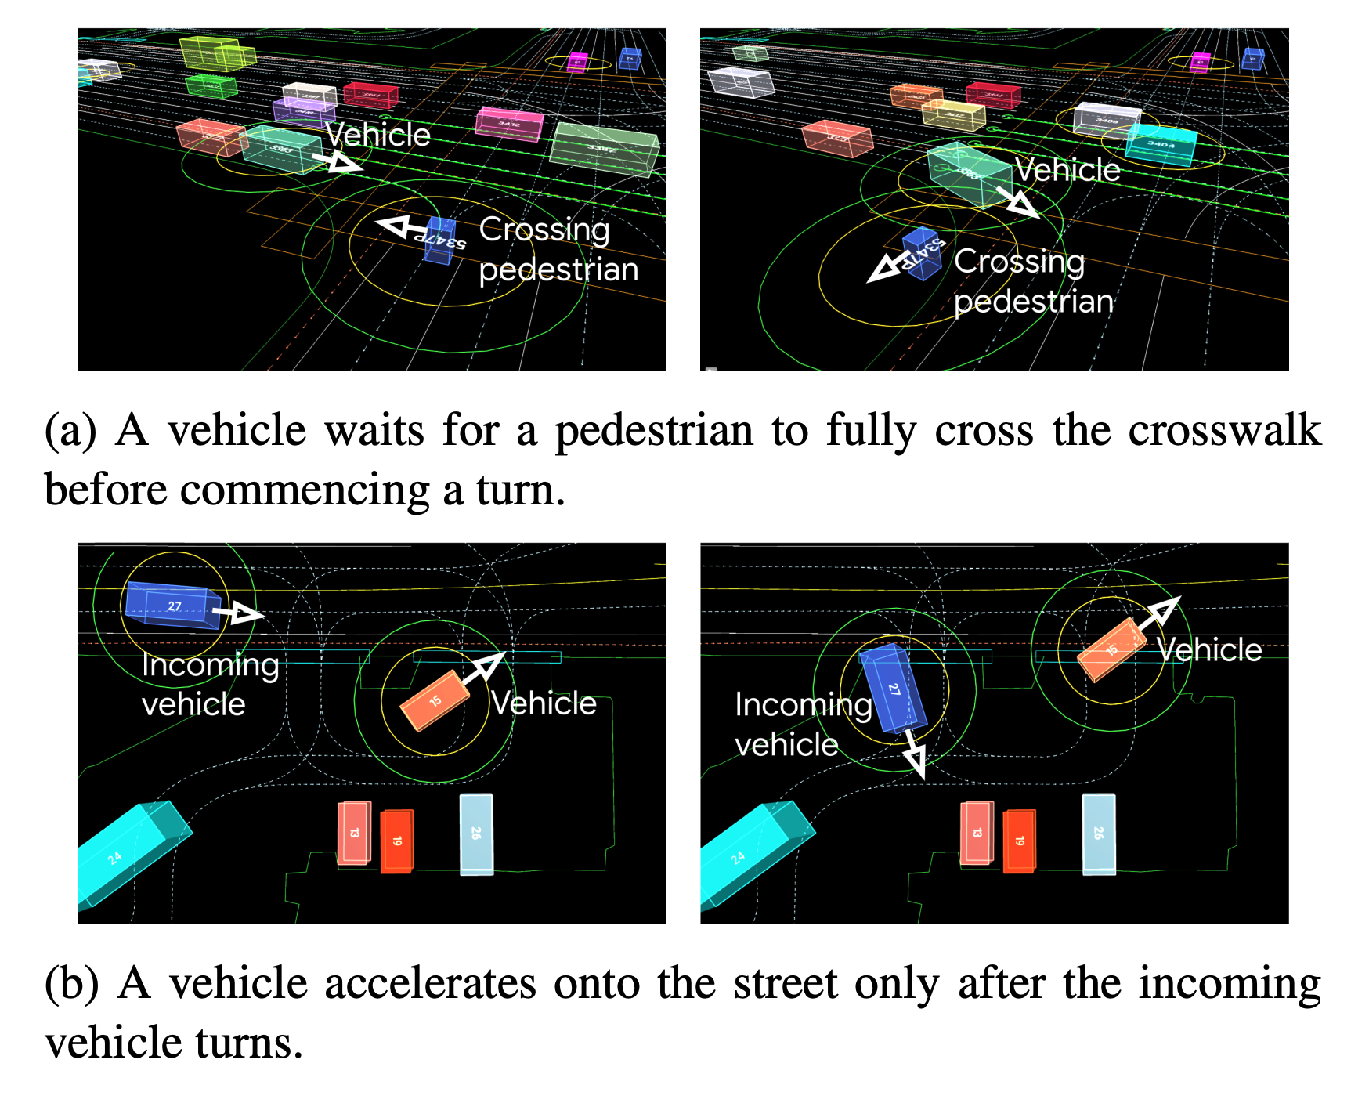
Motion Planning:
…more than just getting from A to B
Motion Planning can be even more complex than this. Waymo thinks about incredibly difficult situations:
Image: Waymo

Slide 63
The classical navigation problem: moving a robot from one point to another without collision with any obstacle
Global Goal
Global Representation
Global Path
Local Goal
Perceptual Input
Local Representation
Motion Commands
[Xiao et al., AuRo22]
Robot (Parameters, Planners, Models)

