Slide 1
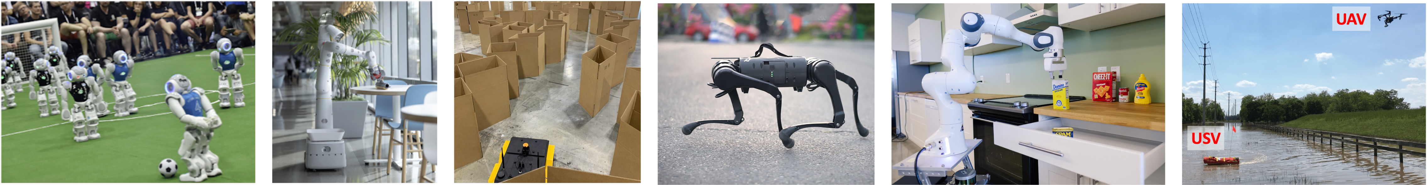
CS 485 Autonomous Robotics
Introduction to
Probabilistic Robotics I
Prof. Xuesu Xiao
George Mason University
Slides Credits: Gregory Stein

Slide 2
Logistics
Midterm Wednesday.
Spring break next week.
The standardized BARN Challenge is due after spring break (report and then presentation).
Open-ended project proposal presentation after spring break.
  5-10 min per team
  Please cover the following information:
    What problem are you trying to solve?
    Why it is worth solving?
    What are the possible approaches?
    What approach are you taking and why it is appropriate?
    What is your deliverables?
    What is your timeline?

Slide 3
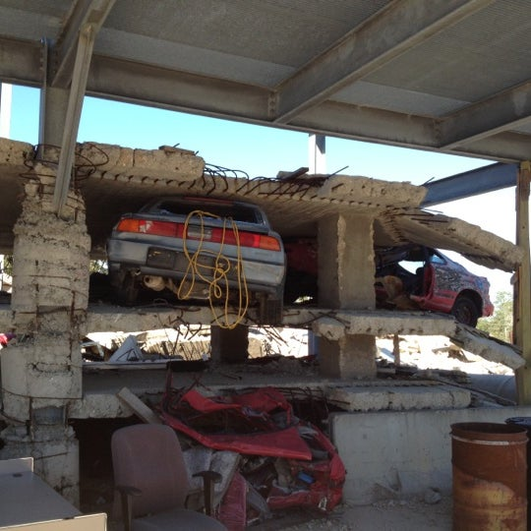
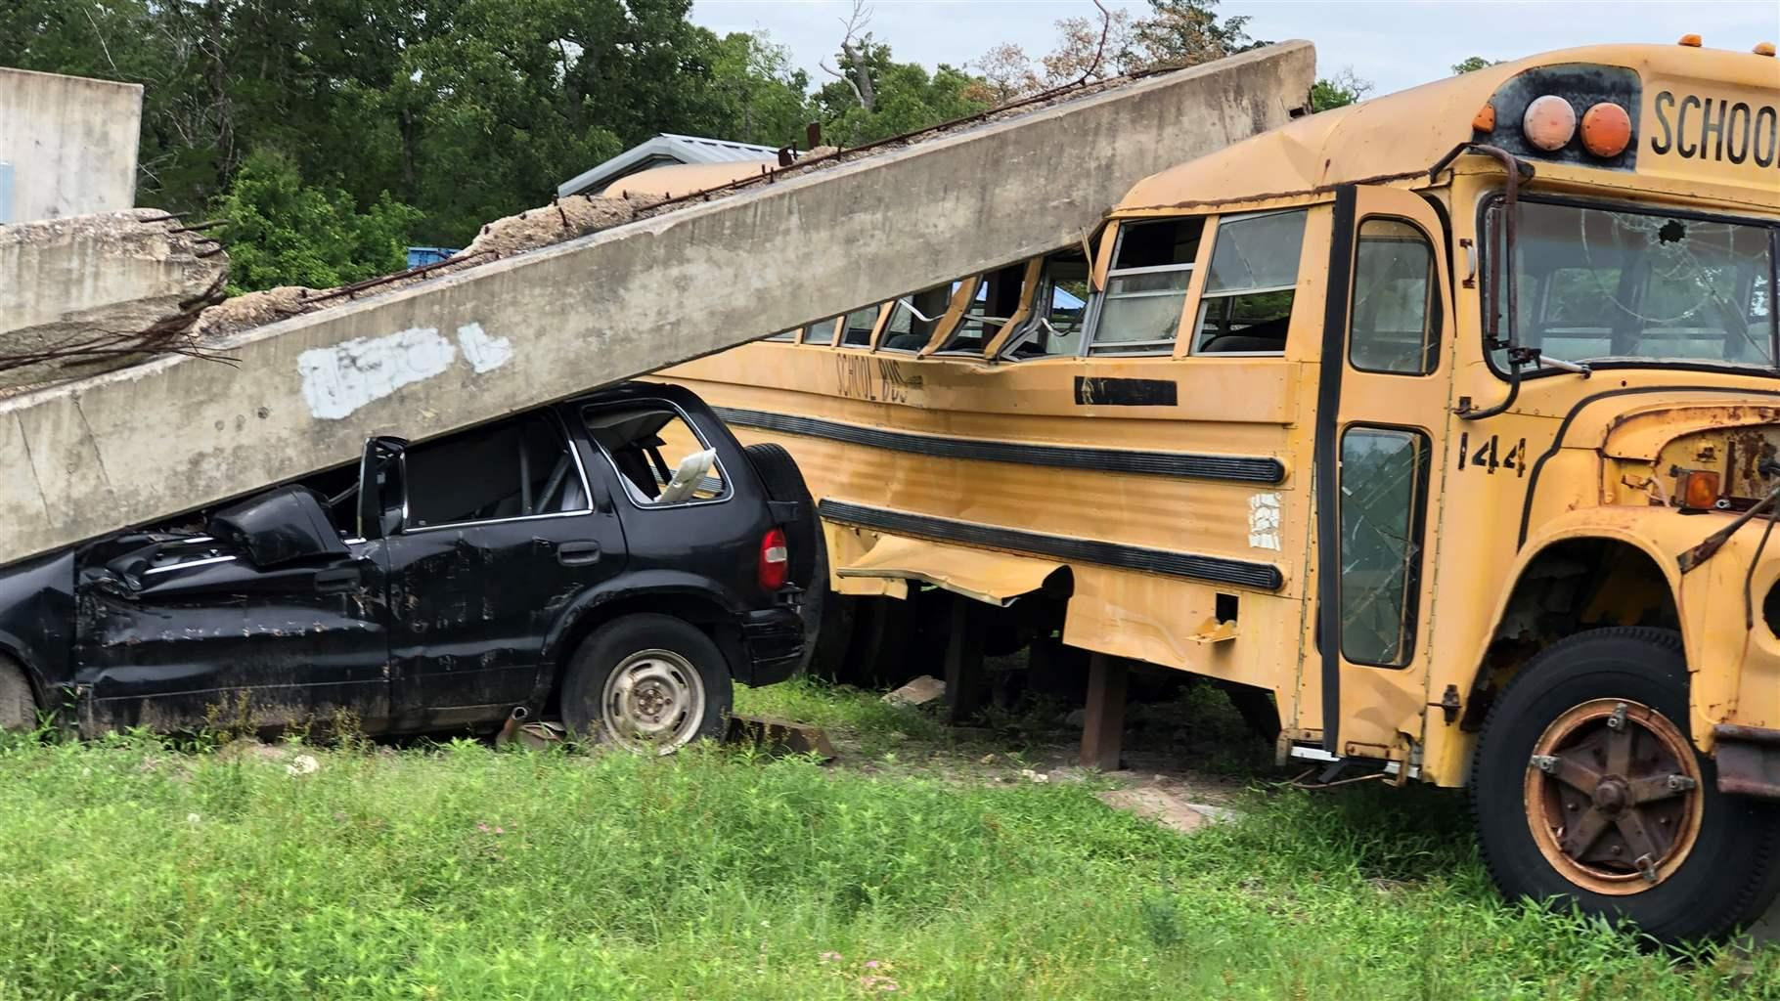
Motivation: our robot is still quite limited…
What would you like a robot to do to help?
Disaster City® Texas A&M

Slide 4
Motivation: our robot is still quite limited…
We will learn about the fundamentals:
The core mathematical tools used to represent robots and the world
How robots move and interact
How robots sense the world
How robots understand the world
How robots …
We know how to do some of those things, but not others.

Slide 5
Idea: Robots should augment or replace human capacity
…but humans are generally quite capable.
We can navigate spaces, even those we’ve never been before.
Humans can pick up objects and manipulate them.
We take in rich sensor information and use this to figure out where we are, the state of the world, and how we might interact with it.

Slide 6
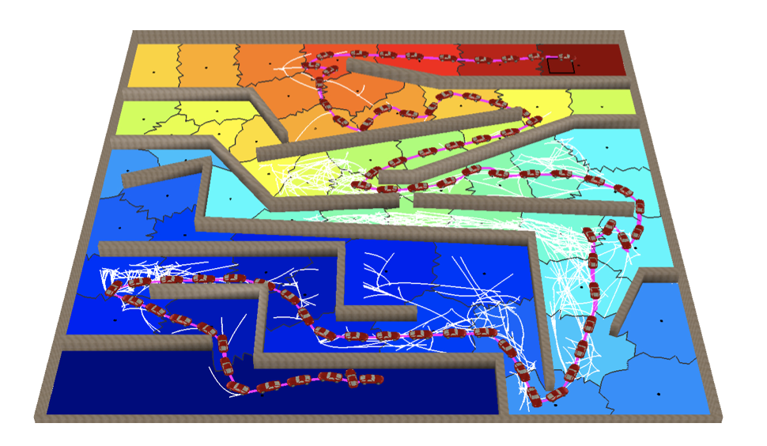
Capability: Motion Planning
Source: Direct Path Superfacets (Prof. Plaku)

Slide 7
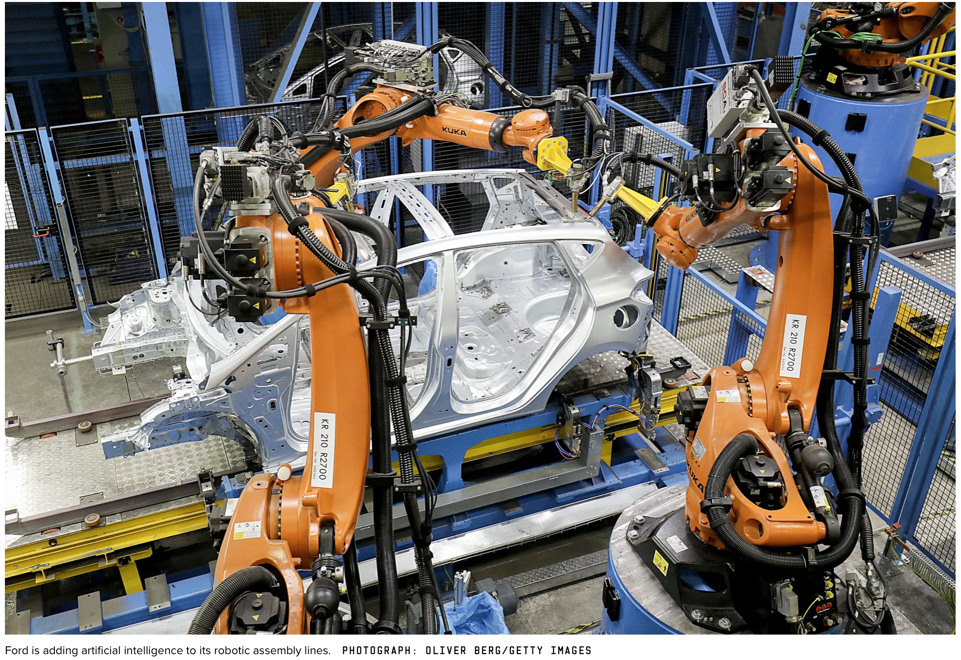
Capability: Motion Planning
Image: Wired

Slide 8
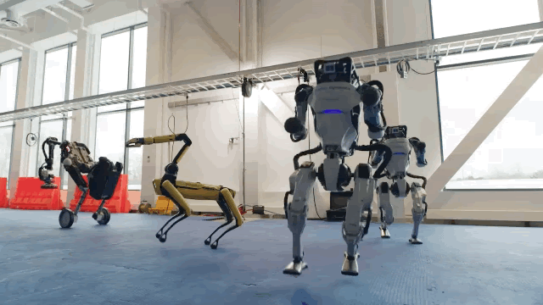
Capability: Control
Source: Boston Dynamics

Slide 9
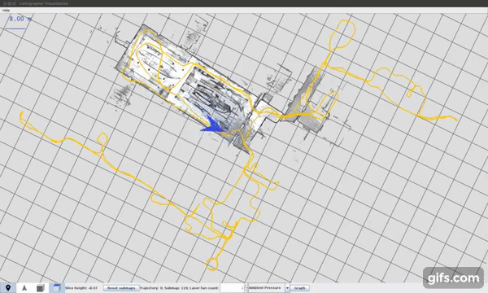
Capability: Mapping
Google Cartographer for Laser-based mapping

Slide 10
Motivation: a robot may not even know where it is in the world!
Localization will be one of the core capabilities we discuss today (and next week). The robot must use its noisy and imperfect sensors to figure out where it is in the world.
Only then can it know how to act.
We’ll start by discussing how we think about the robot’s ability to sense its surroundings and what to do when those observations are noisy and imperfect.

Slide 11

Motivation: a robot wandering the halls
Consider a robot in a hallway.
Example from the Probabilistic Robotics textbook

Slide 12
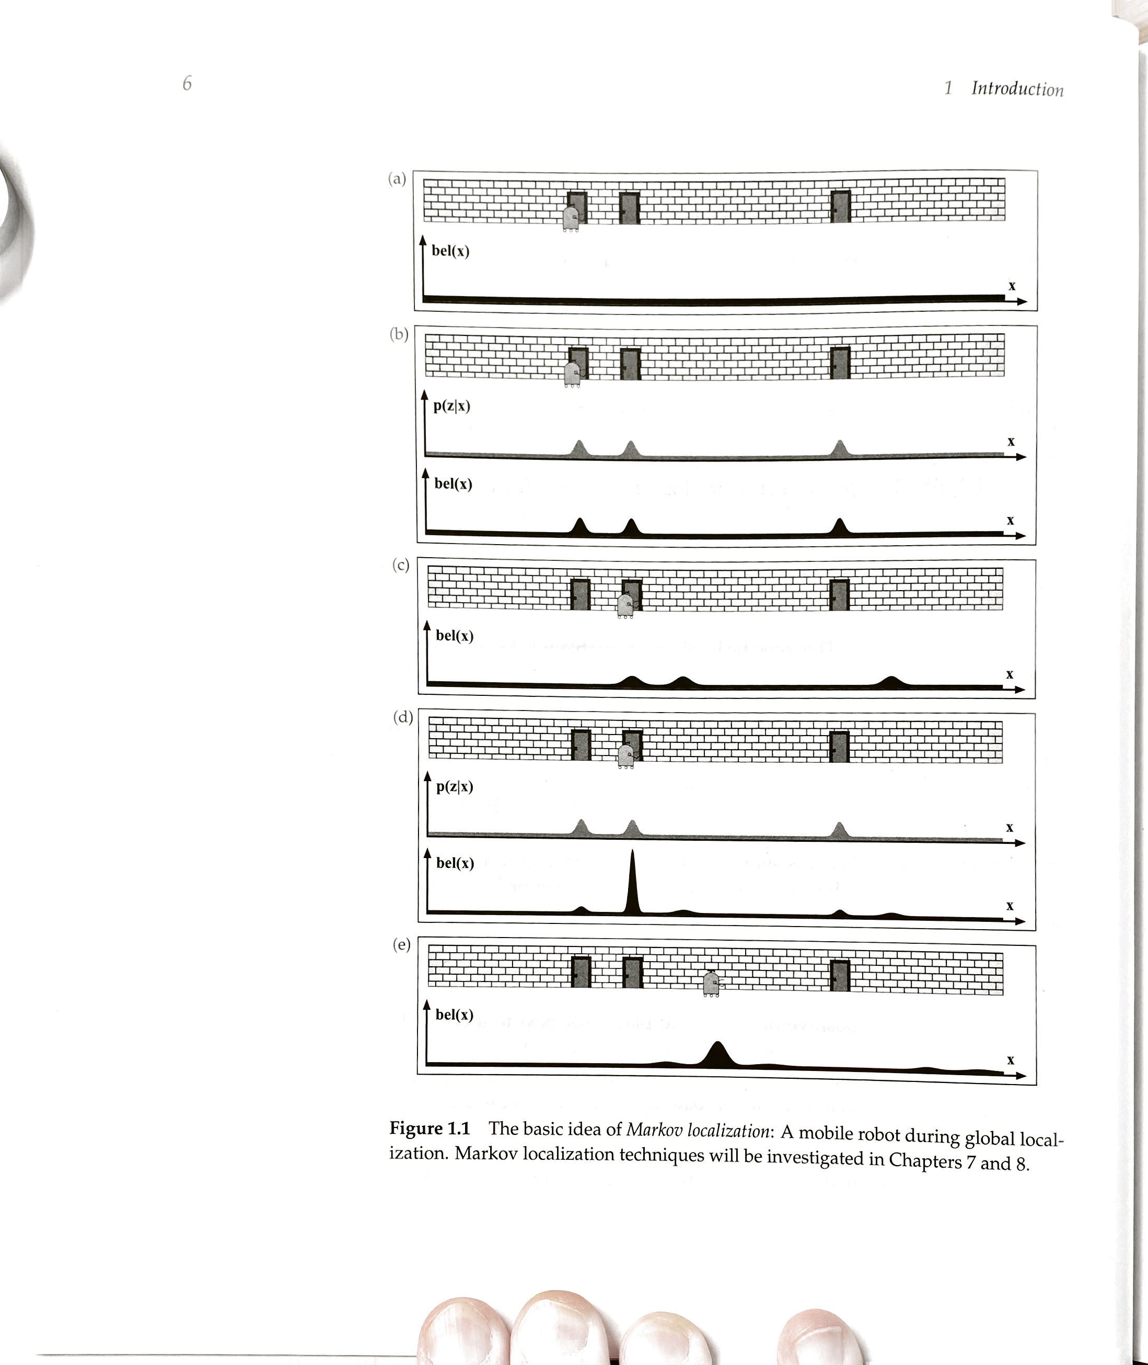
Motivation: a robot wandering the halls
Consider a robot in a hallway. It’s ”lost” and so its initial belief (the probability distribution over its position) is uniform:
Example from the Probabilistic Robotics textbook

Slide 13
Motivation: a robot wandering the halls
Consider a robot in a hallway. It’s ”lost” and so its initial belief (the probability distribution over its position) is uniform:
Then the robot looks and sees this behind it:
Where’s the robot?
Example from the Probabilistic Robotics textbook

Slide 14
Motivation: a robot wandering the halls
Consider a robot in a hallway. It’s ”lost” and so its initial belief (the probability distribution over its position) is uniform
When I receive an observation, I can update my belief
I don’t know which door, but I’m by one of them.
Example from the Probabilistic Robotics textbook

Slide 15
Motivation: a robot wandering the halls
Next the robot moves to the right a couple meters
We know the robot has moved to the right a bit, though not quite how much, since it’s motion is a bit noisy.
Example from the Probabilistic Robotics textbook

Slide 16
Motivation: a robot wandering the halls
Next the robot moves to the right a couple meters. It looks again… and finds another door!
The new observation is similar to the first: we know
we are near a door.
Example from the Probabilistic Robotics textbook

Slide 17
Motivation: a robot wandering the halls
Next the robot moves to the right a couple meters. It looks again… and finds another door!
The new observation is similar to the first: we know
we are near a door. Yet we can combine it with our
belief of where we are to refine it.
Example from the Probabilistic Robotics textbook

Slide 18
Outline for today
Filtering Overview
Discrete Filtering (Hidden Markov Model)
Our states are discrete
Kalman Filtering
States are continuous

Slide 19
Reading & Slide Credits
Slide Credits (from which many of the reference images have been taken or adapted):
CMU 16.385 (Temporal State Models Lecture)
GTSAM Tutorial
The Probabilistic Robotics Textbook
(Lots of other small things; referenced when appropriate.)

Slide 20
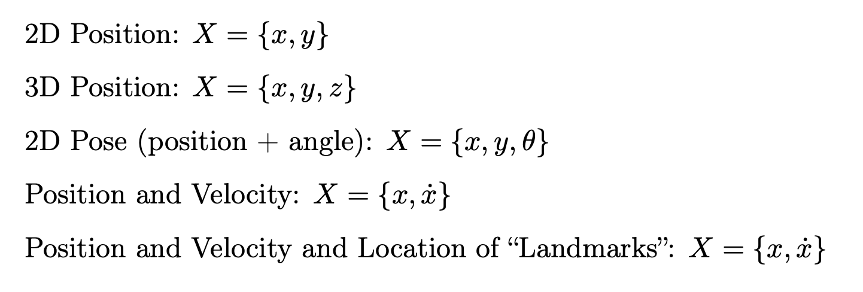
There are many different ways to represent the state of the world “X”

Slide 21
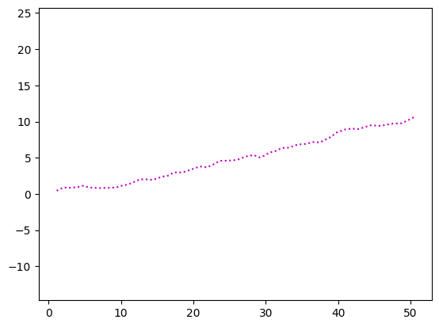
Let’s consider another simple example:
A robot with noisy wheels wandering around
That makes sense: the robot moves but is somewhat jittery.
We go in the direction we want.

Slide 22
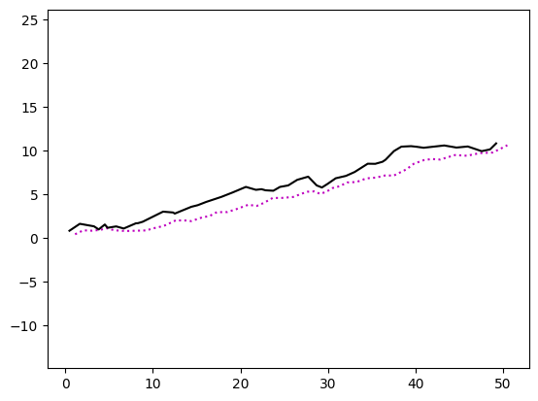
Let’s consider another simple example:
A robot with noisy wheels wandering around
That makes sense: the robot moves but is somewhat jittery.
We go in the direction we want.
Here’s the issue: our measurement of the wheel motion is also noisy.
The curves don’t match:
We don’t know where we are!

Slide 23
What do we know so far?
Ideas?

Slide 24
What do we know so far?
Ideas? What are the observations we have been given?

Slide 25
What do we know so far?
Ideas? What are the observations we have been given?
We have the motion in x and y.
We also have a model for how to use that motion to get position: we just sum them up over time.
What else? Do I roughly know where I am?
Do I have a pretty good idea where I am not?

Slide 26
What do we know so far?
Ideas? What are the observations we have been given?
We have the motion in x and y.
We also have a model for how to use that motion to get position: we just sum them up over time.
Also, we have a “noise model”: because we can directly see the relationship between the “true” measurements and the “noisy” ones; we’re not clueless about where we are:
E.g., We know we’re not *at* x=50 by
the end, but we’re not likely near the
origin at x=0.

Slide 27
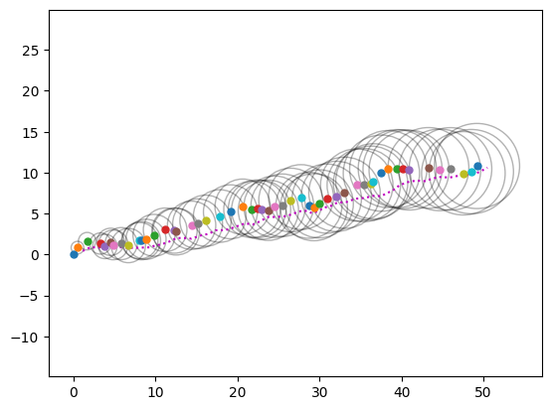
We can associate “confidence bounds” on our measurements
What do we notice about the 95% bounds shown here as gray circles?
We’ll discuss where these come from later.
Key: they get bigger as we move! Why?
Each time we move, we introduce more noise.
Can we improve?
Not really… Not unless we are given more information.
Any Ideas?

Slide 28
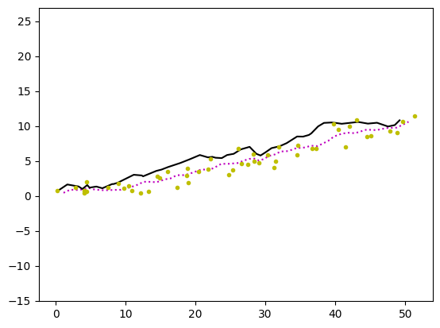
What if we were given some GPS measurements? Will this help?
Why might GPS help us?
A: Those measurements are based on the true position, not the noisy one.
This gives us an independent measurements of the true position, which we can use to improve our state estimate.

Slide 29
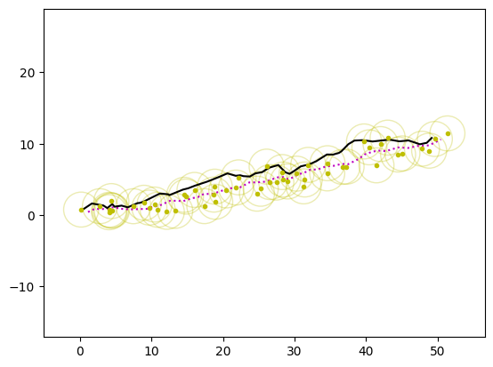
The “GPS” here is a bit noisy, but maybe it can help us get “back on track”
Why might GPS help us?
A: Those measurements are based on the true position, not the noisy one.
This gives us an independent measurements of the true position, which we can use to improve our state estimate.
Let’s see what happens!

Slide 30
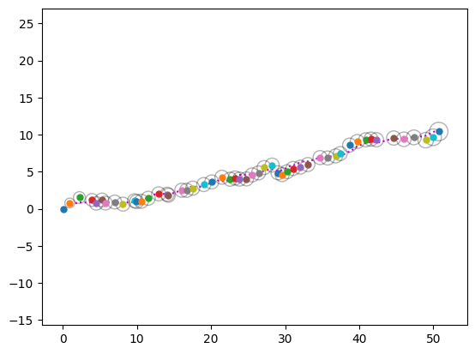
We can combine the GPS measurements with the motion model to get the states

Slide 31
We can combine the GPS measurements with the motion model to get the states
It’s not perfect but is certainly better.
Also, the “confidence” is better
Before:

Slide 32
How do we do this?
That’s what we’ll work out for the rest of today

Slide 33
First, we’ll build up our mathematical tools

Slide 34
Crash Course: A Brief Review of Probability and notation for probability
What’s this?
The probability of getting the value b from some process.
What’s this?
The probability of getting both a and b.
What’s this?
Imagine these values are “heads” or “tails” of a coin, or some other random process.

Slide 35
Crash Course: A Brief Review of Probability and notation for probability
What’s this?
The probability of getting the value b from some process.
What’s this?
The probability of getting both a and b.
What’s this?
Imagine these values are “heads” or “tails” of a coin, or some other random process.

Slide 36
Crash Course: A Brief Review of Probability and notation for probability
Conditional Probability: the likelihood of getting some value b conditioned on the fact that I already know the value of a.
So what’s this?
“probability of b given a”

Slide 37
Crash Course: A Brief Review of Probability and notation for probability
Conditional Probability: the likelihood of getting some value b conditioned on the fact that I already know the value of a.
So what’s this?
“probability of b given a”

Slide 38
Crash Course: A Brief Review of Probability and notation for probability
Rules of conditional probability:

Slide 39
Crash Course: A Brief Review of Probability and notation for probability
Rules of conditional probability:
From here, we can derive Bayes’ Theorem:

Slide 40
Crash Course: A Brief Review of Probability and notation for probability
The “expectation” is a weighted sum of a function taken over some probability distribution. Let’s say we have some function “f” that takes a single argument b. We also have a probability distribution over b: P(b). The expected value of f is written as:

Slide 41
What is the problem we are trying to solve?
We want to find the (current) state of the world based on everything we know and have observed so far.

Slide 42
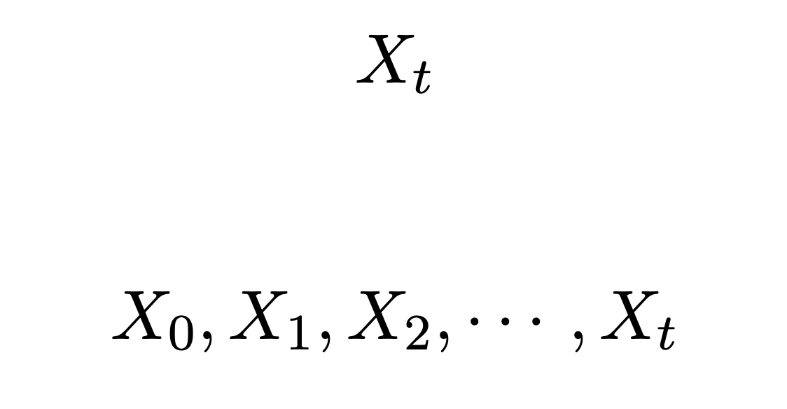
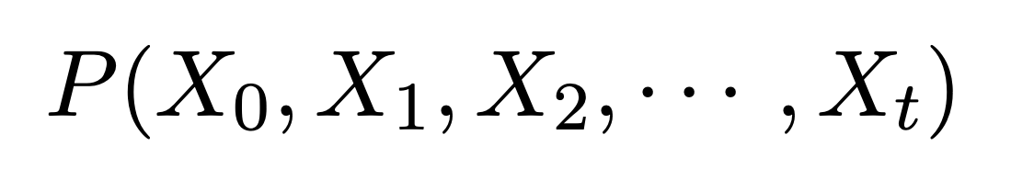
What is the problem we are trying to solve?
We want to find the (current) state of the world based on everything we know and have observed so far.
The state changes over time:
We use a sequence of random variables:
Together, a joint probability is needed to represent them all:

Slide 43
What is the problem we are trying to solve?
We want to find the (current) state of the world based on everything we know and have observed so far.
For today: we just want to know where the robot is…
How big is this distribution?

Slide 44
What is the problem we are trying to solve?
We want to find the (current) state of the world based on everything we know and have observed so far.
For today: we just want to know where the robot is…
How big is this distribution? Pretty big…

Slide 45
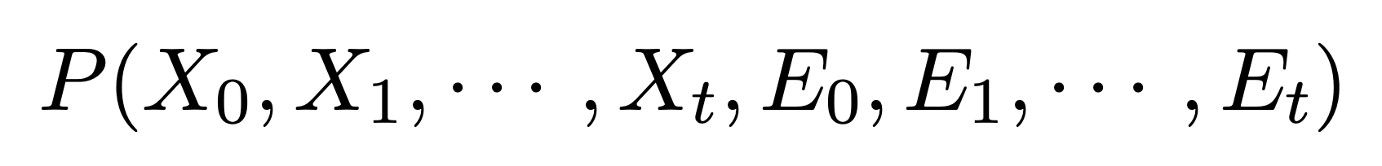
Earlier, we saw that we could also include observations in our estimate
The total joint probability looks like this:
States are the things we want.
Observations (evidence) is what we have measured that can give use information about the states.
States
Observations (“Evidence”)

Slide 46
Earlier, we saw that we could also include observations in our estimate
The total joint probability looks like this:
States are the things we want.
Observations (evidence) is what we have measured that can give use information about the states.
The distribution is massive.
We need a way to simplify it.
States
Observations (“Evidence”)

Slide 47
We will make some simplifying assumptions

Slide 48
We will make some simplifying assumptions
#1: Markov Assumption
A system satisfying the Markov Property is memoryless. (okay, well what does that mean?)

Slide 49
We will make some simplifying assumptions
#1: Markov Assumption
A system satisfying the Markov Property is memoryless. (okay, well what does that mean?)
In general, the state could depend on all my history up until now:

Slide 50
We will make some simplifying assumptions
#1: Markov Assumption
A system satisfying the Markov Property is memoryless. (okay, well what does that mean?)
In general, the state could depend on all my history up until now:
If the system is Markov, there is no additional information to be gained from those earlier states and actions:

Slide 51
What sort of system is not Markov
What about a “Fibonacci-like” system?
To figure out the next “state”, I need to add the value of the two previous states. If my “state” is only the most recent number, computing what state I’ll end up in requires using both previous states.
Can we make this system Markov?
Yes! Just have the “state” include both previous numbers.
“Every system is Markov”. All you need is a bigger/better/more complete state representation.

Slide 52
What sort of system is not Markov
What about a “Fibonacci-like” system?
To figure out the next “state”, I need to add the value of the two previous states. If my “state” is only the most recent number, computing what state I’ll end up in requires using both previous states.
Can we make this system Markov?
Yes! Just have the “state” include both previous numbers.
“Every system is Markov”. All you need is a bigger/better/more complete state representation.

Slide 53
What sort of system is not Markov
What about a “Fibonacci-like” system?
To figure out the next “state”, I need to add the value of the two previous states. If my “state” is only the most recent number, computing what state I’ll end up in requires using both previous states.
Can we make this system Markov?
Yes! Just have the “state” include both previous numbers.
“Every system is Markov”. All you need is a bigger/better/more complete state representation.

Slide 54
What sort of system is not Markov
What about a “Fibonacci-like” system?
To figure out the next “state”, I need to add the value of the two previous states. If my “state” is only the most recent number, computing what state I’ll end up in requires using both previous states.
Can we make this system Markov?
Yes! Just have the “state” include both previous numbers.
“Every system is Markov”. All you need is a bigger/better/more complete state representation.

Slide 55
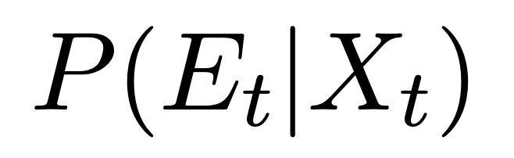
We will make some simplifying assumptions
#1: Markov Assumption
A system satisfying the Markov Property is memoryless.
This will also help us reduce the observation model.
The likelihood of an observation could depend on all states up until now. We’ll instead assume that an observation at a particular time, depends only on the current state:
Example: think of GPS. It doesn’t matter where I used to be. Only where I am now.

Slide 56
We will make some simplifying assumptions
#1: Markov Assumption
A system satisfying the Markov Property is memoryless.
Combined these assumptions imply that we only need the following to relate states to other states and to observations:
State Transition Model
A.k.a. a Motion Model
Observation Model

Slide 57
We will make some simplifying assumptions
#2: Stationary Process Assumption
A process is “stationary” if it does not change over time.
This means that the relationship between the state and each observation does not change over time.
In principle, the state transition and observation models could change over time, but we assume they don’t.

Slide 58
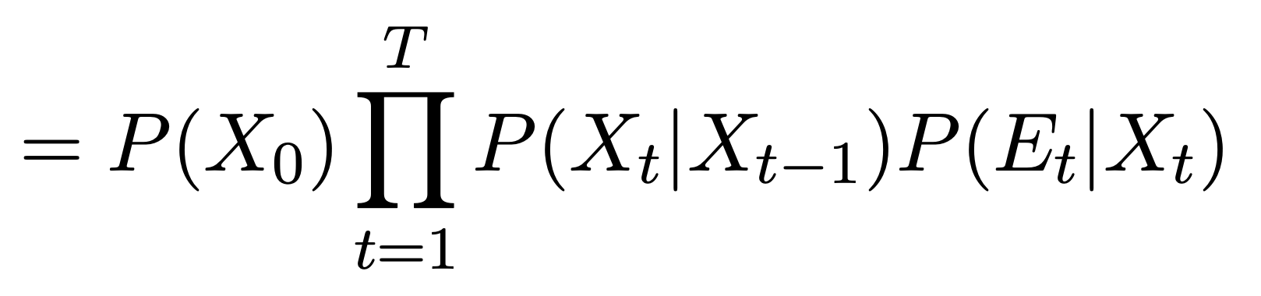
We will make some simplifying assumptions
#3: Prior State Assumption
We’ll assume that we have at least some idea of where we started.
This means that we’ll have a prior state distribution in advance:

Slide 59
Combined, our assumptions let us rewrite the joint probability distribution
Each term is something we understand, and each is much lower-dimensional than the original.
So how do we solve it?

Slide 60
Combined, our assumptions let us rewrite the joint probability distribution
Prior
Motion/State Transition Model
Observation Model
Each term is something we understand, and each is much lower-dimensional than the original.
So how do we solve it?

Slide 61
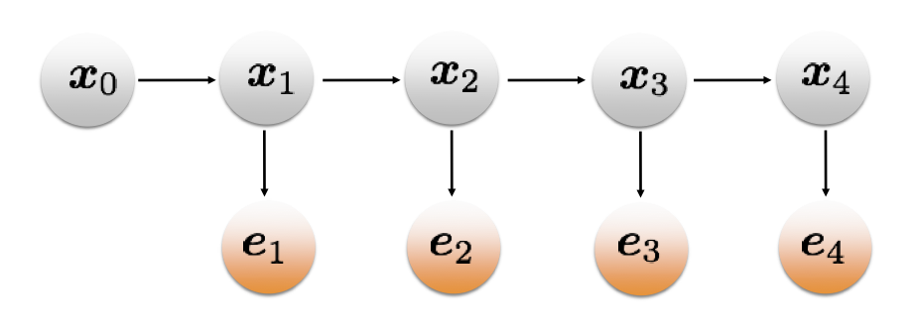
It is common to represent probability distributions like these as a graph
Nodes are random variables or input information
Edges are terms in the probability distribution
We will revisit this later!
Prior
Motion/State Transition Model
Observation Model
The prior

Slide 62
It is common to represent probability distributions like these as a graph
Nodes are random variables or input information
Edges are terms in the probability distribution
We will revisit this later!
Prior
Motion/State Transition Model
Observation Model
The prior
Including robot motion

Slide 63
It is common to represent probability distributions like these as a graph
Nodes are random variables or input information
Edges are terms in the probability distribution
We will revisit this later!
Prior
Motion/State Transition Model
Observation Model
The prior
Including robot motion
Including observations

Slide 64
It is common to represent probability distributions like these as a graph
Nodes are random variables or input information
Edges are terms in the probability distribution
We will revisit this later!
Prior
Motion/State Transition Model
Observation Model
The prior
Including robot motion
Including observations

Slide 65
Discrete Filtering and the Hidden Markov Model
With a number of visuals and equations drawn from CMU 16.385 (Temporal State Models Lecture)

Slide 66
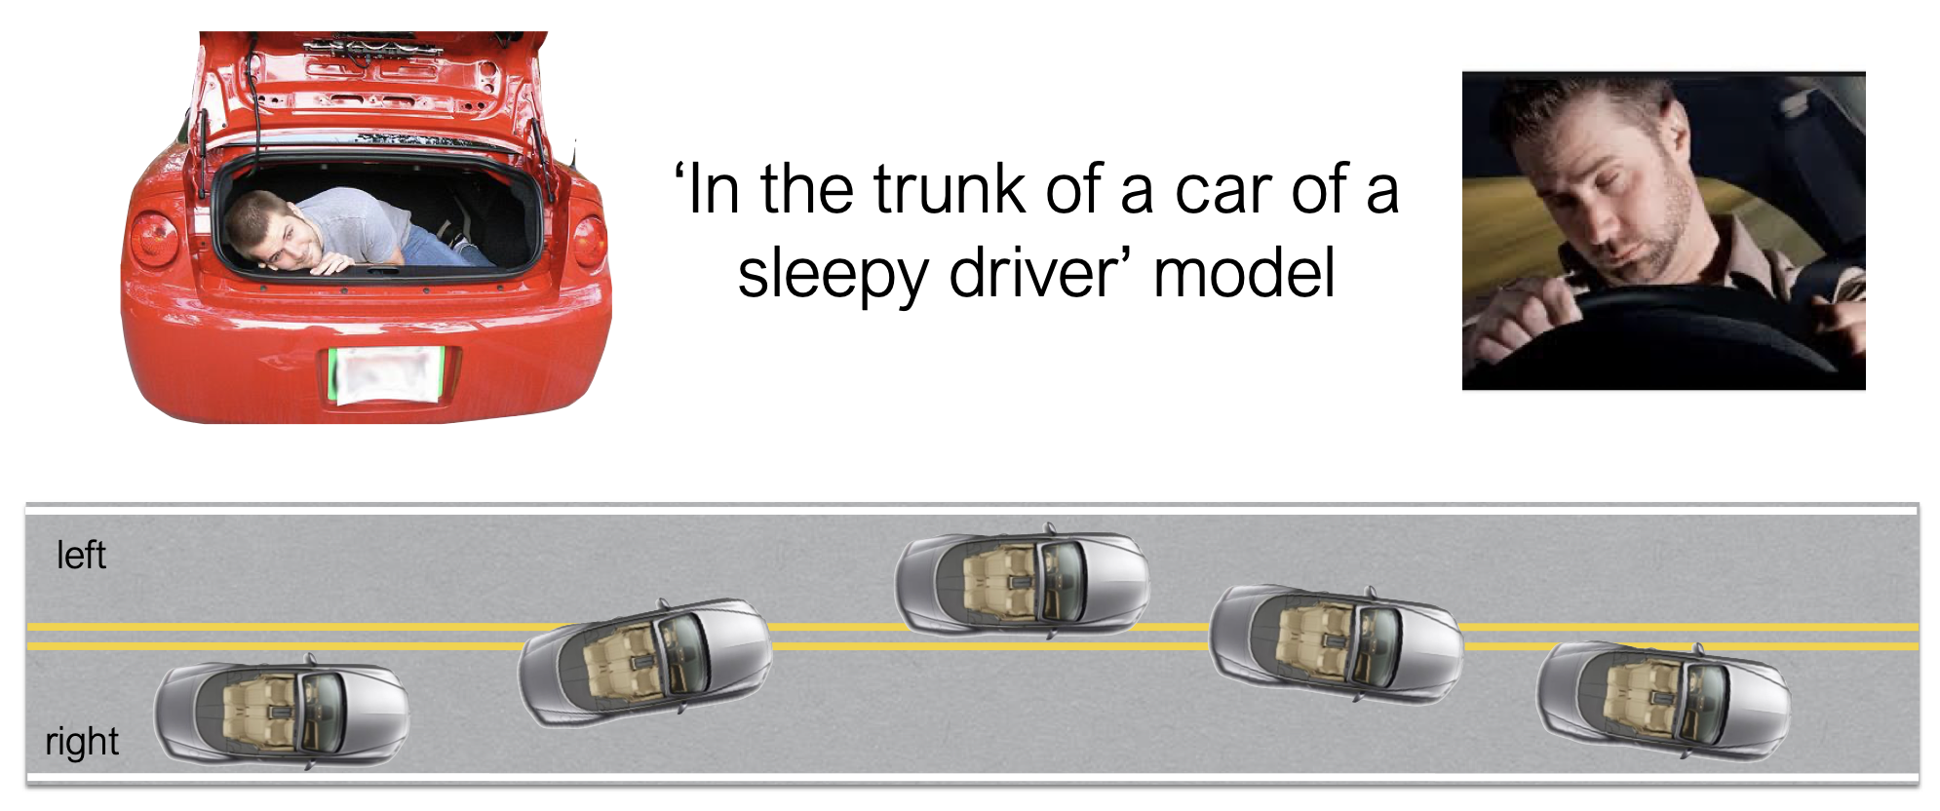
This is an insane example… but is too good to pass up

Slide 67
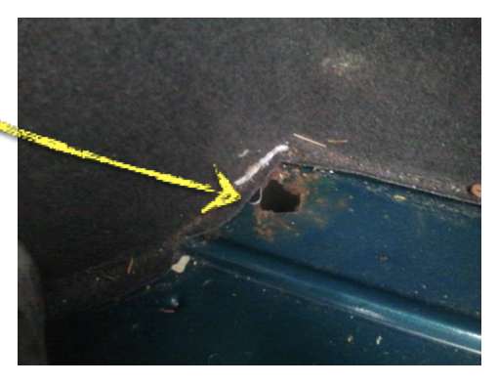
This is an insane example… but is too good to pass up
Through a hole, you can sort of make out what lane you are in

Slide 68
This is an insane example… but is too good to pass up
We want to figure out where the car is likely to be, so we need to revisit our equation from earlier and the terms to define it:

Slide 69
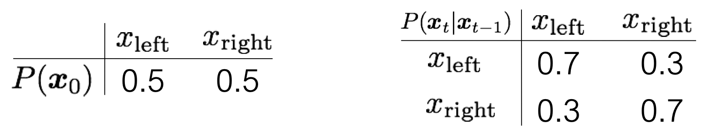
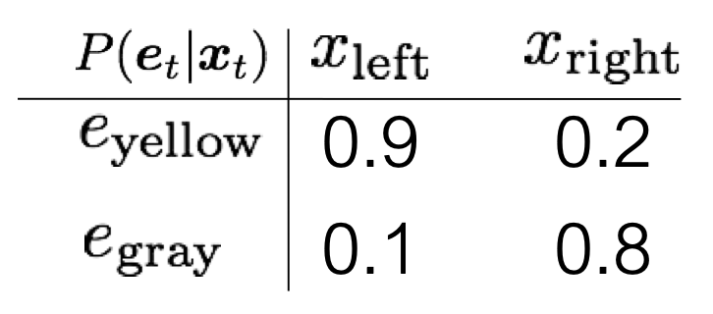
Sleepy Driver HMM
Defining the terms we need
Prior
Motion/State Transition Model
Observation Model
What do these tell us?

Slide 70
Sleepy Driver HMM
Defining the terms we need
Prior
Motion/State Transition Model
Observation Model
What do these tell us? The prior?

Slide 71
Sleepy Driver HMM
Defining the terms we need
Prior
Motion/State Transition Model
Observation Model
What do these tell us? The prior?
We don’t have any info about what lane we start in.

Slide 72
Sleepy Driver HMM
Defining the terms we need
Prior
Motion/State Transition Model
Observation Model
What do these tell us? The motion model?

Slide 73
Sleepy Driver HMM
Defining the terms we need
Prior
Motion/State Transition Model
Observation Model
What do these tell us? The motion model?
We usually stay in the same lane, but switch 30% of the time.

Slide 74
Sleepy Driver HMM
Defining the terms we need
Prior
Motion/State Transition Model
Observation Model
What do these tell us? The observation model?

Slide 75
Sleepy Driver HMM
Defining the terms we need
Prior
Motion/State Transition Model
Observation Model
What do these tell us? The observation model?
We are pretty good at telling what lane we are in.
Slightly more accurate in the left lane.

Slide 76
Sleepy Driver HMM
Defining the terms we need
Prior
Motion/State Transition Model
Observation Model
Also, these are probability distributions, so something must sum to 1.
What is it?

Slide 77
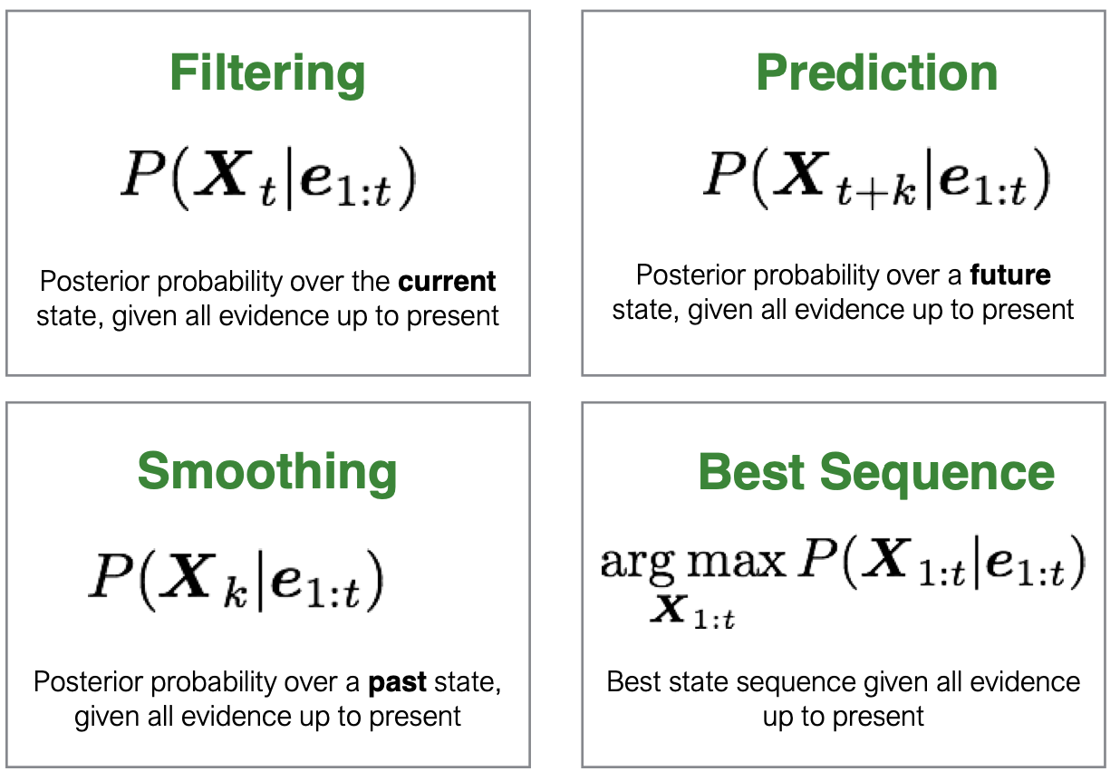
Temporal Inference has multiple tasks we could want to solve

Slide 78
Temporal Inference has multiple tasks we could want to solve

Slide 79
Let’s start with filtering
Where is the robot now?
We can compute this term recursively: we know the relationship between the current state and the last one and can use that to figure out the relationship between the current one and the prior.

Slide 80
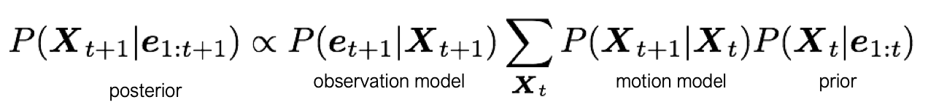
Let’s start with filtering
Where is the robot now?
We can compute this term recursively: we know the relationship between the current state and the last one and can use that to figure out the relationship between the current one and the prior.

Slide 81
Let’s start with filtering
Where is the robot now?
We can compute this term recursively: we know the relationship between the current state and the last one and can use that to figure out the relationship between the current one and the prior.
Also, a probability distribution over the states is known as the “belief” or “belief distribution”. Often notated as b_{t} or Bel(t) or just P(x).

Slide 82
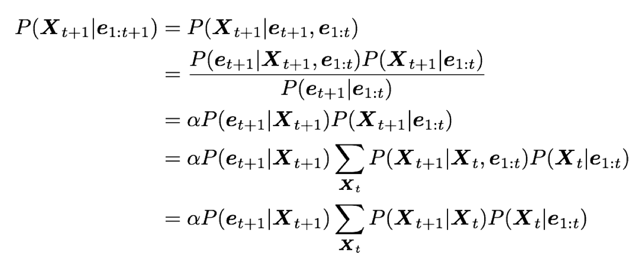
Let’s start with filtering
Where is the robot now?
We can use what we know about probability to write this in terms of distributions and terms we know:

Slide 83
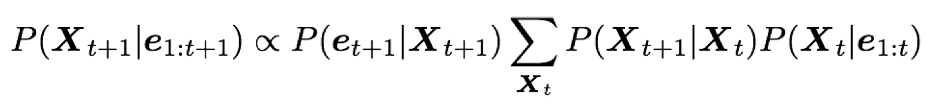
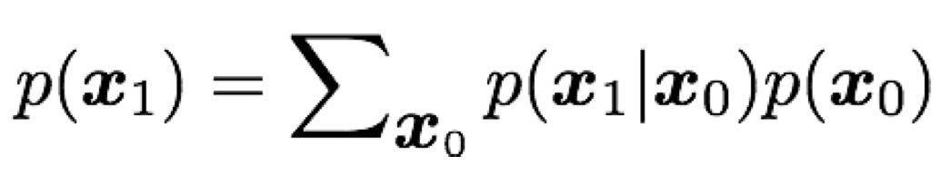
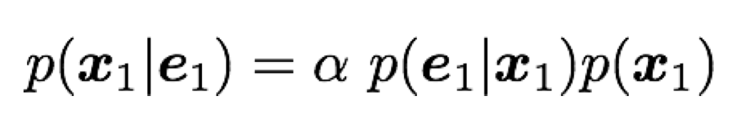
Let’s start with filtering
Where is the robot now?
Our filtering equation looks as follows:
It’s often easiest to represent this as a two-stage problem.
Prediction Step:
From robot motion
Update Step:
From observation

Slide 84
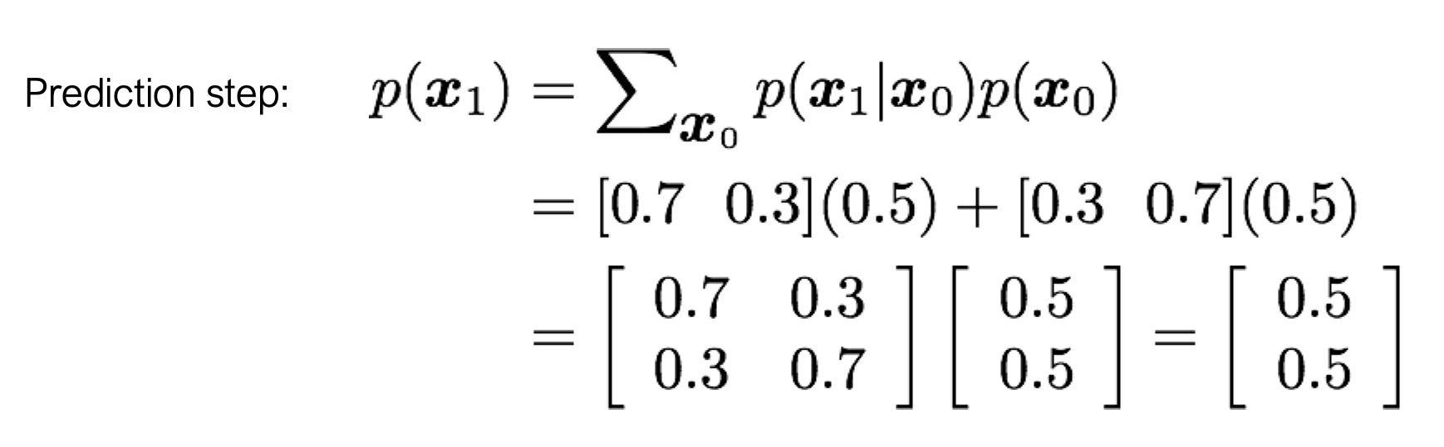
What if I see Yellow at time t=1?
First, we go for the prediction step:

Slide 85
What if I see Yellow at time t=1?
First, we go for the prediction step:

Slide 86
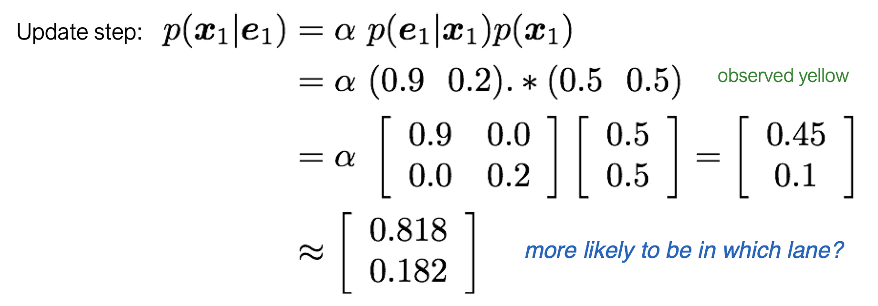
What if I see Yellow at time t=1?
Next we need to run the “update” step, which corresponds to receiving an observation:
What elements do we take from the matrix?

Slide 87
What if I see Yellow at time t=1?
Next we need to run the “update” step, which corresponds to receiving an observation:

Slide 88
Putting both steps together

Slide 89
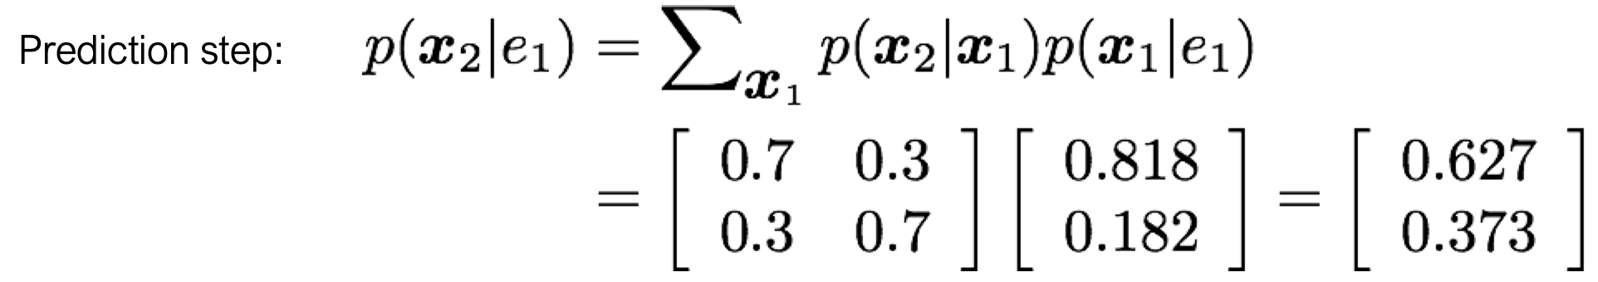
What if we predict again?
We see something that looks like the following:
Why does our “confidence” decrease?
What is the physical origin of this?

Slide 90
Temporal Inference has multiple tasks we could want to solve

Slide 91
Temporal Inference has multiple tasks we could want to solve

Slide 92
How do we “predict”?

Slide 93
How do we “predict”?
We’ve already done it!
We run the “predict” operation but don’t “update” (since we haven’t received another observation)

Slide 94
Temporal Inference has multiple tasks we could want to solve

Slide 95
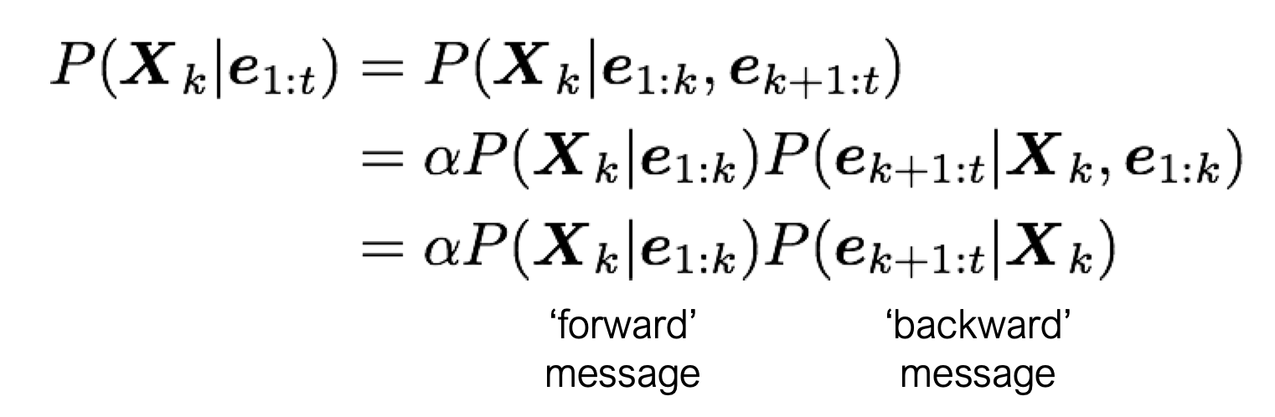
Next is smoothing
Using more recent measurements, we can get a better understanding of where we used to be.
Think of GPS: if I was just wandering around for a while and we get a GPS measurement, I can better estimate both where I am now and also where I was for the last few time steps.

Slide 96
Next is smoothing
Using more recent measurements, we can get a better understanding of where we used to be.
Think of GPS: if I was just wandering around for a while and we get a GPS measurement, I can better estimate both where I am now and also where I was for the last few time steps.

Slide 97
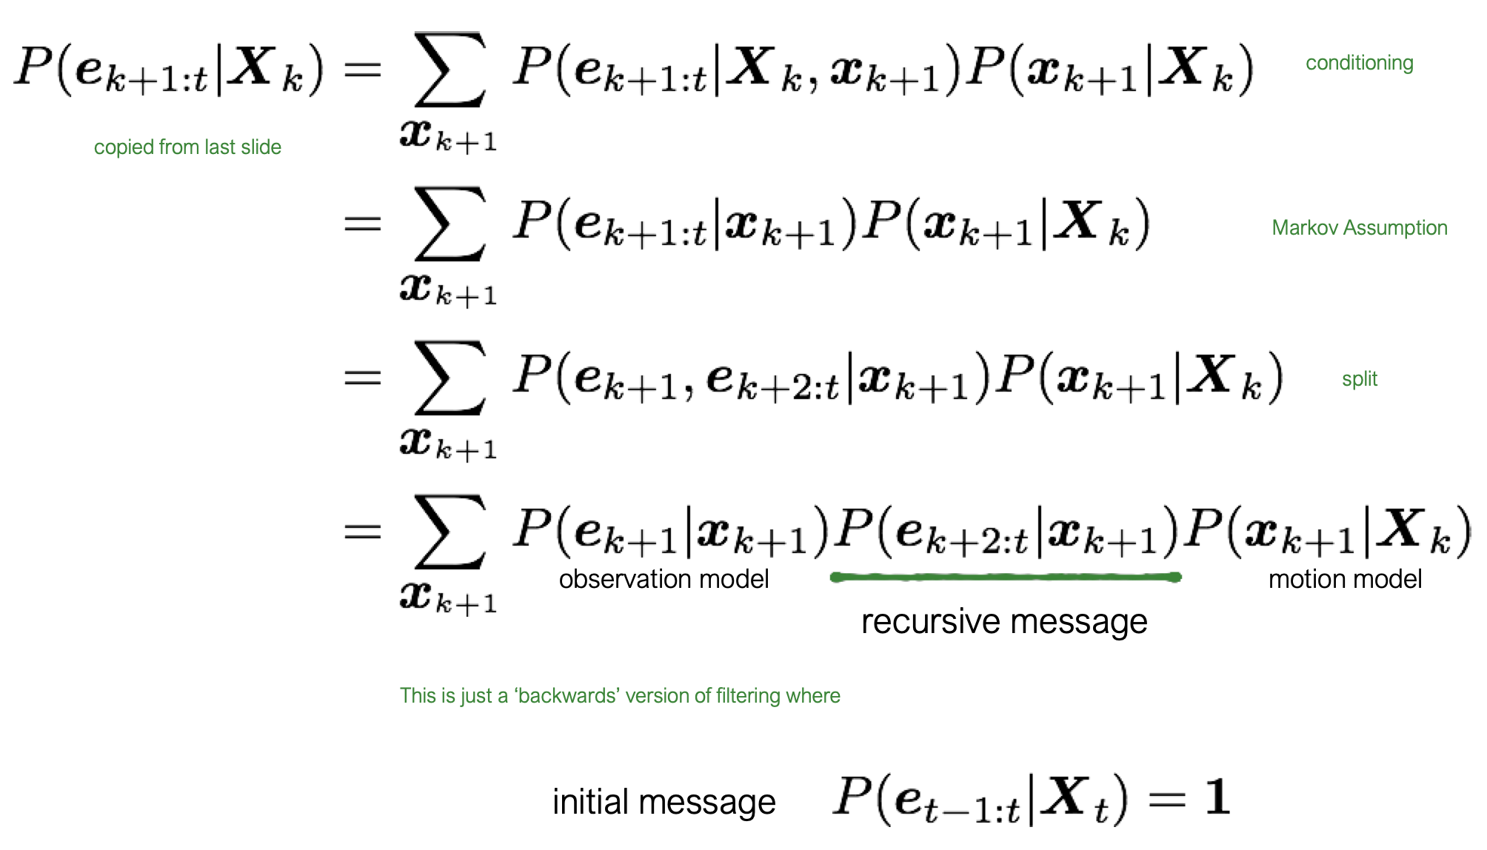
The forward message is just filtering, but we also need a “backwards message”
Filtering involves passing information forwards in time.
“Backwards filtering” passes information from later time steps

Slide 98
Temporal Inference has multiple tasks we could want to solve

Slide 99
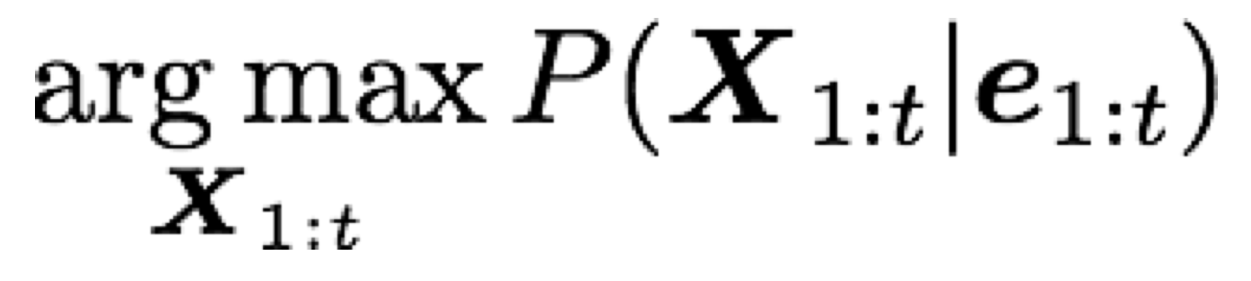
The “best sequence” problem
Imagine that I want to know how far I’ve traveled from my noisy measurements: to compute an accurate total distance, we need to know where we’ve been at each time.
Application: using GPS while running.
We’ve basically already solved this problem:

