Slide 1
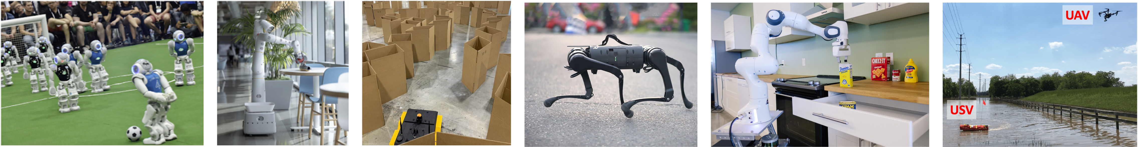
CS 485 Autonomous Robotics
A Gentle Introduction to ROS
Prof. Xuesu Xiao
George Mason University
Slides Credits: Gregory Stein

Slide 2
Agenda for today
Introduction to ROS
Classmates' introduction for team formation
  Team formation due Feb 5
  Send an email of your team info to the instructor and TA

Slide 3
Let’s look at some robots
Robots are good for lots of things!
Their application determines their function.

Slide 4
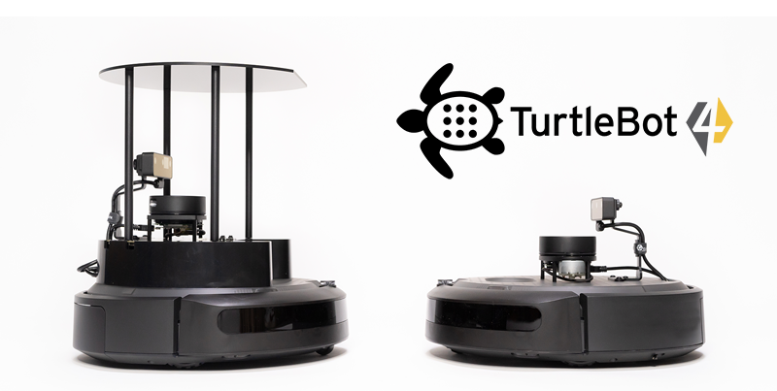
Clearpath’s Turtlebot

Slide 5
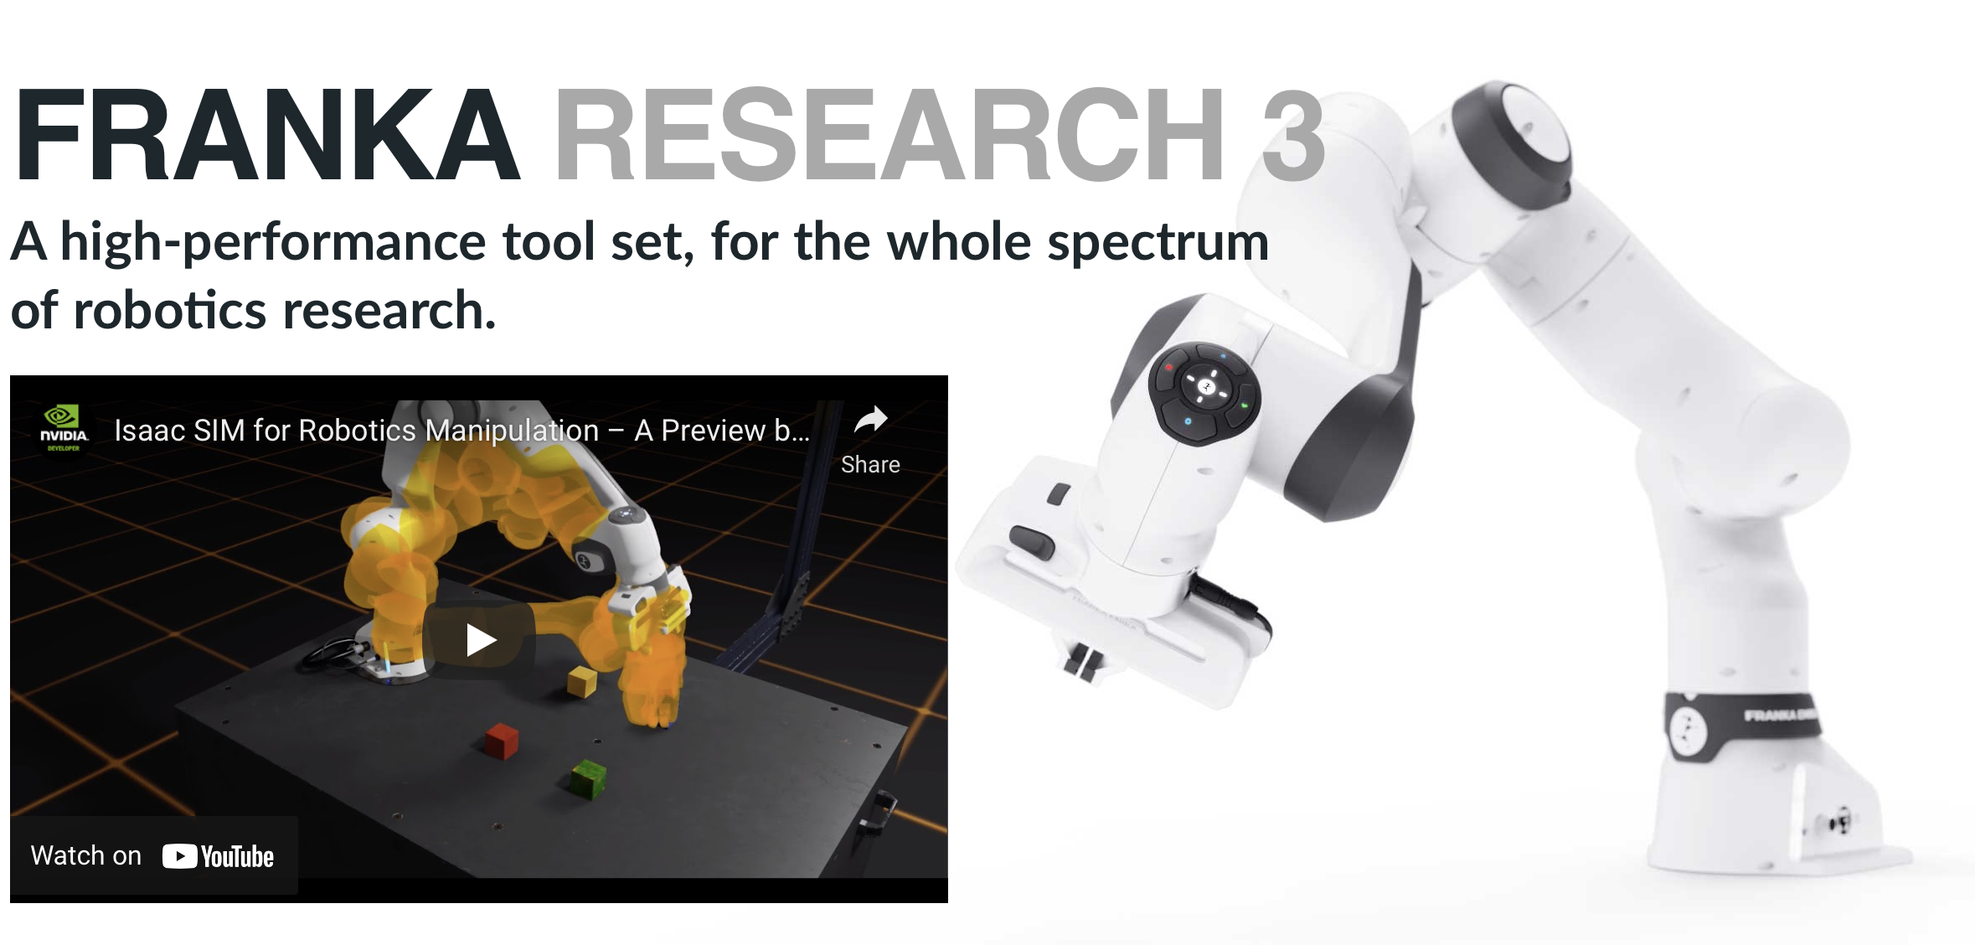
FRANKA makes some nice robot arms

Slide 6
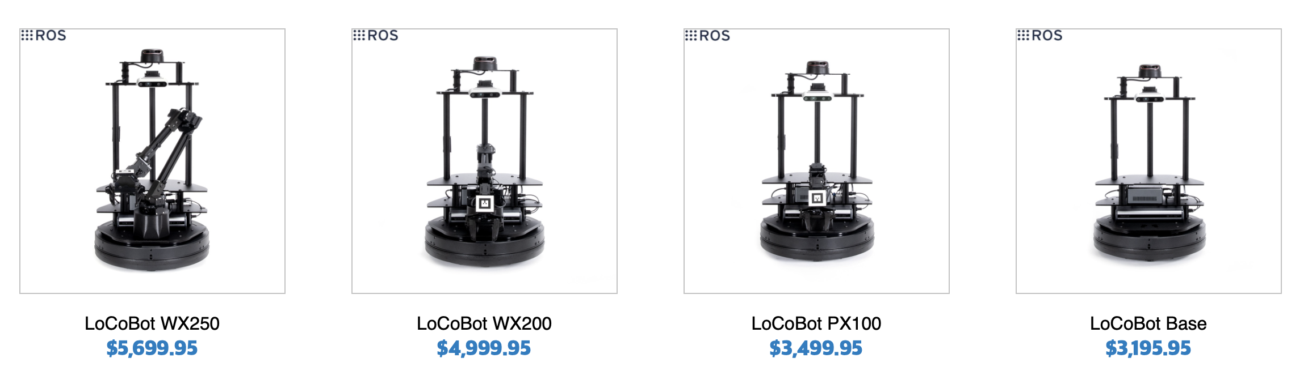
A mobile manipulator can both move around and interact with objects
The GMU Autonomous Robotics Lab has a few LoCoBots

Slide 7

The Baxter and PR2 are both defunct, but the Fetch is solid (and costs ~$100k)

Slide 8
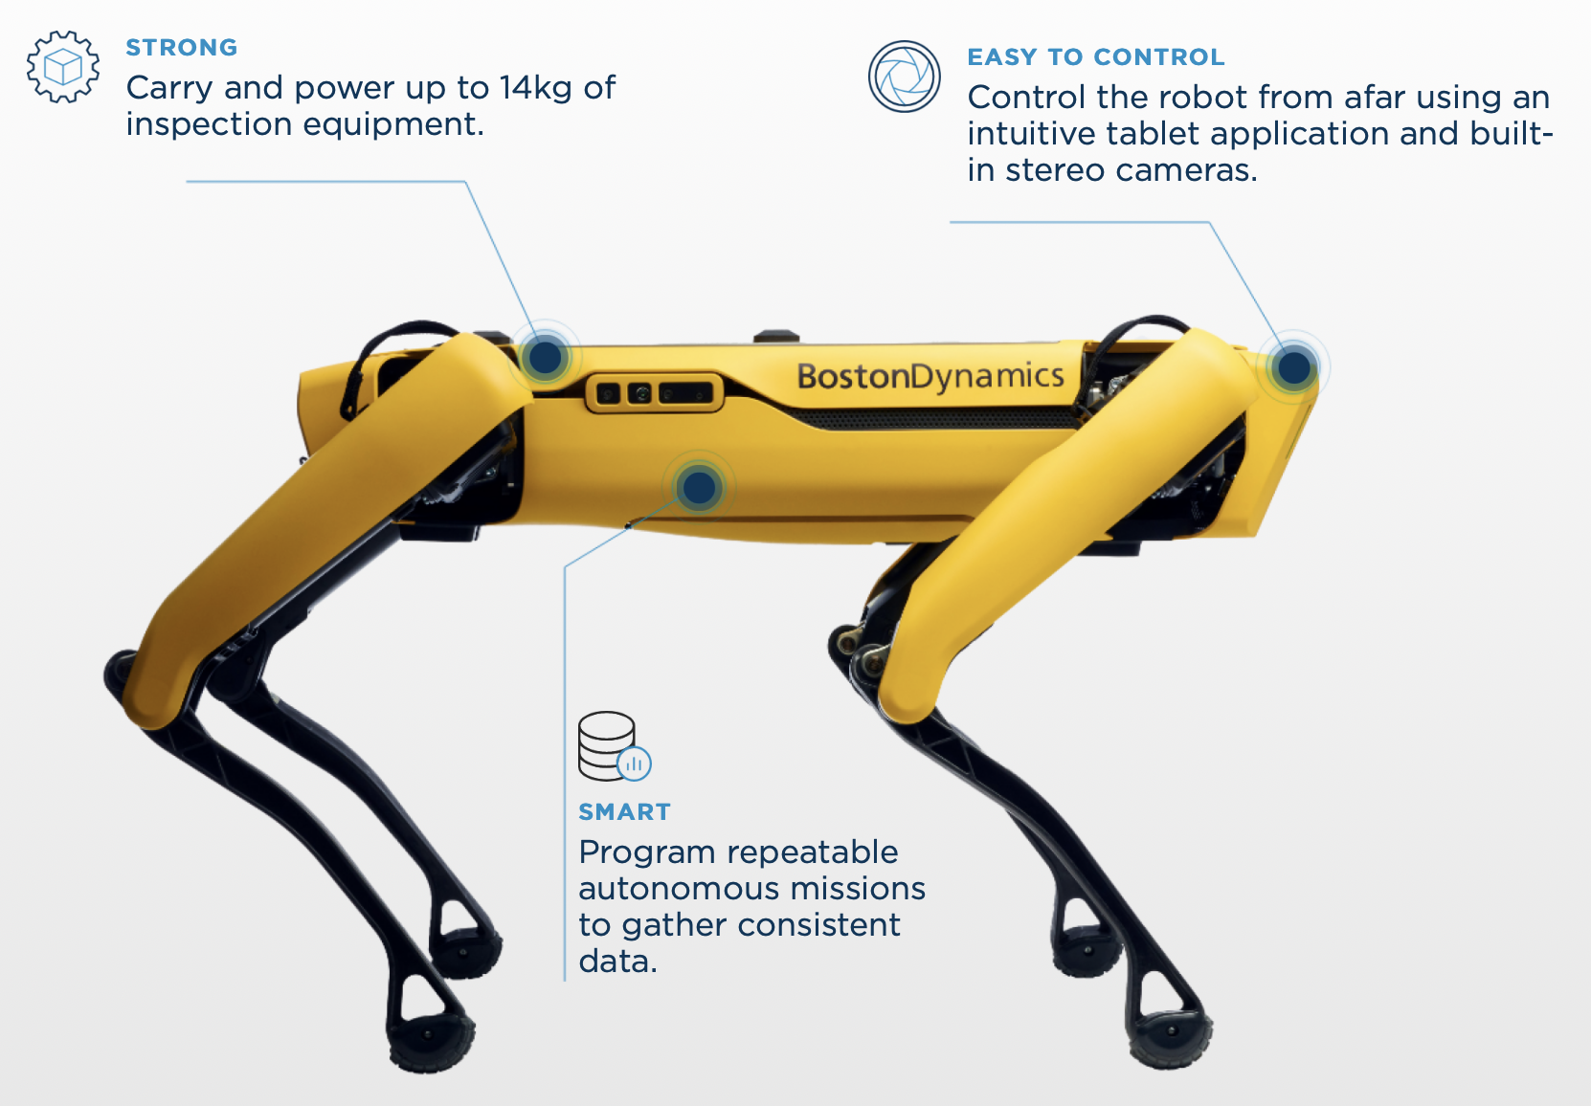
Boston Dynamic’s Spot is also fantastic

Slide 9
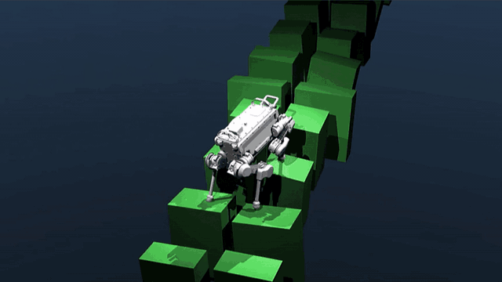
There are also many available simulation tools: MuJoCo

Slide 10
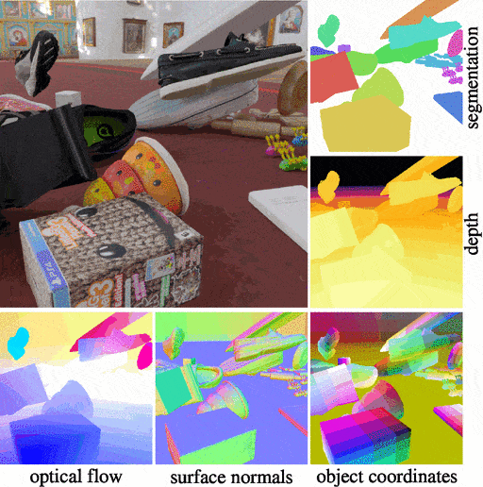
There are also many available simulation tools: Bullet Physics

Slide 11
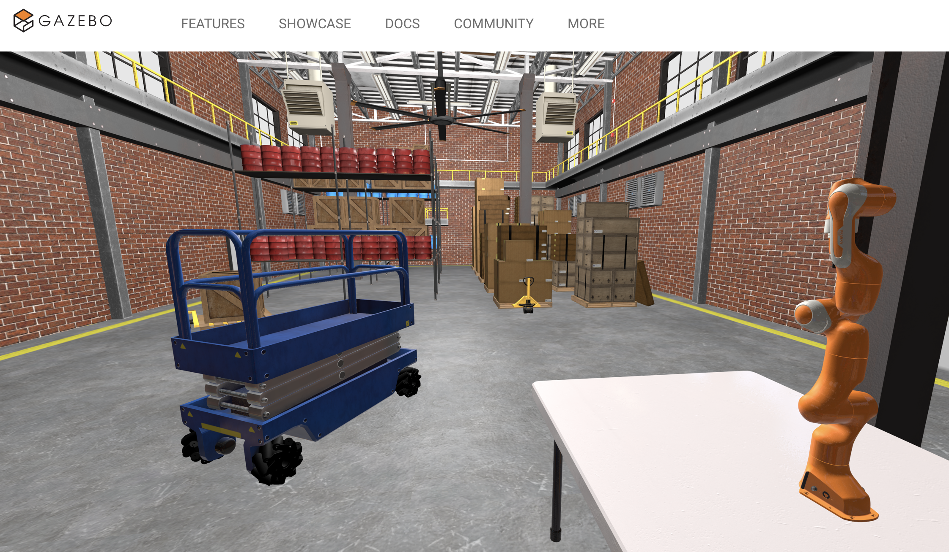
There are also many available simulation tools: Gazebo

Slide 12
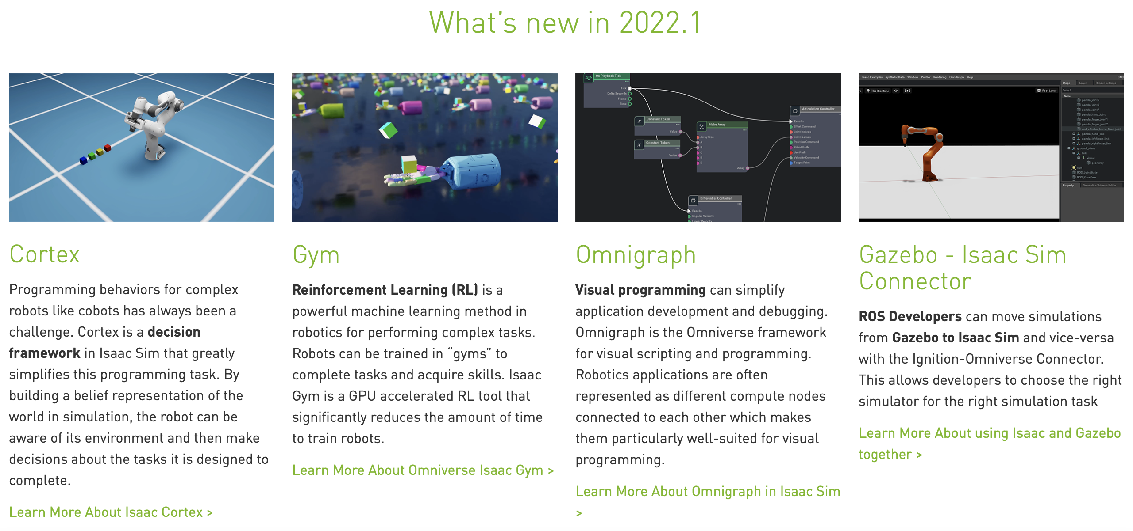
There are also many available simulation tools: Isaac Sim (from Nvidia)

Slide 13
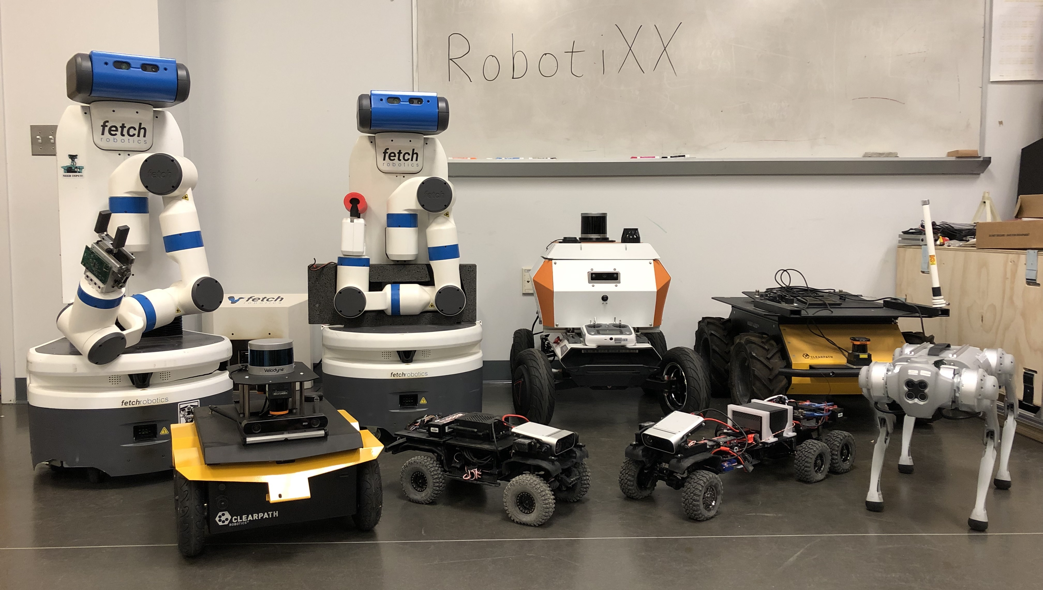
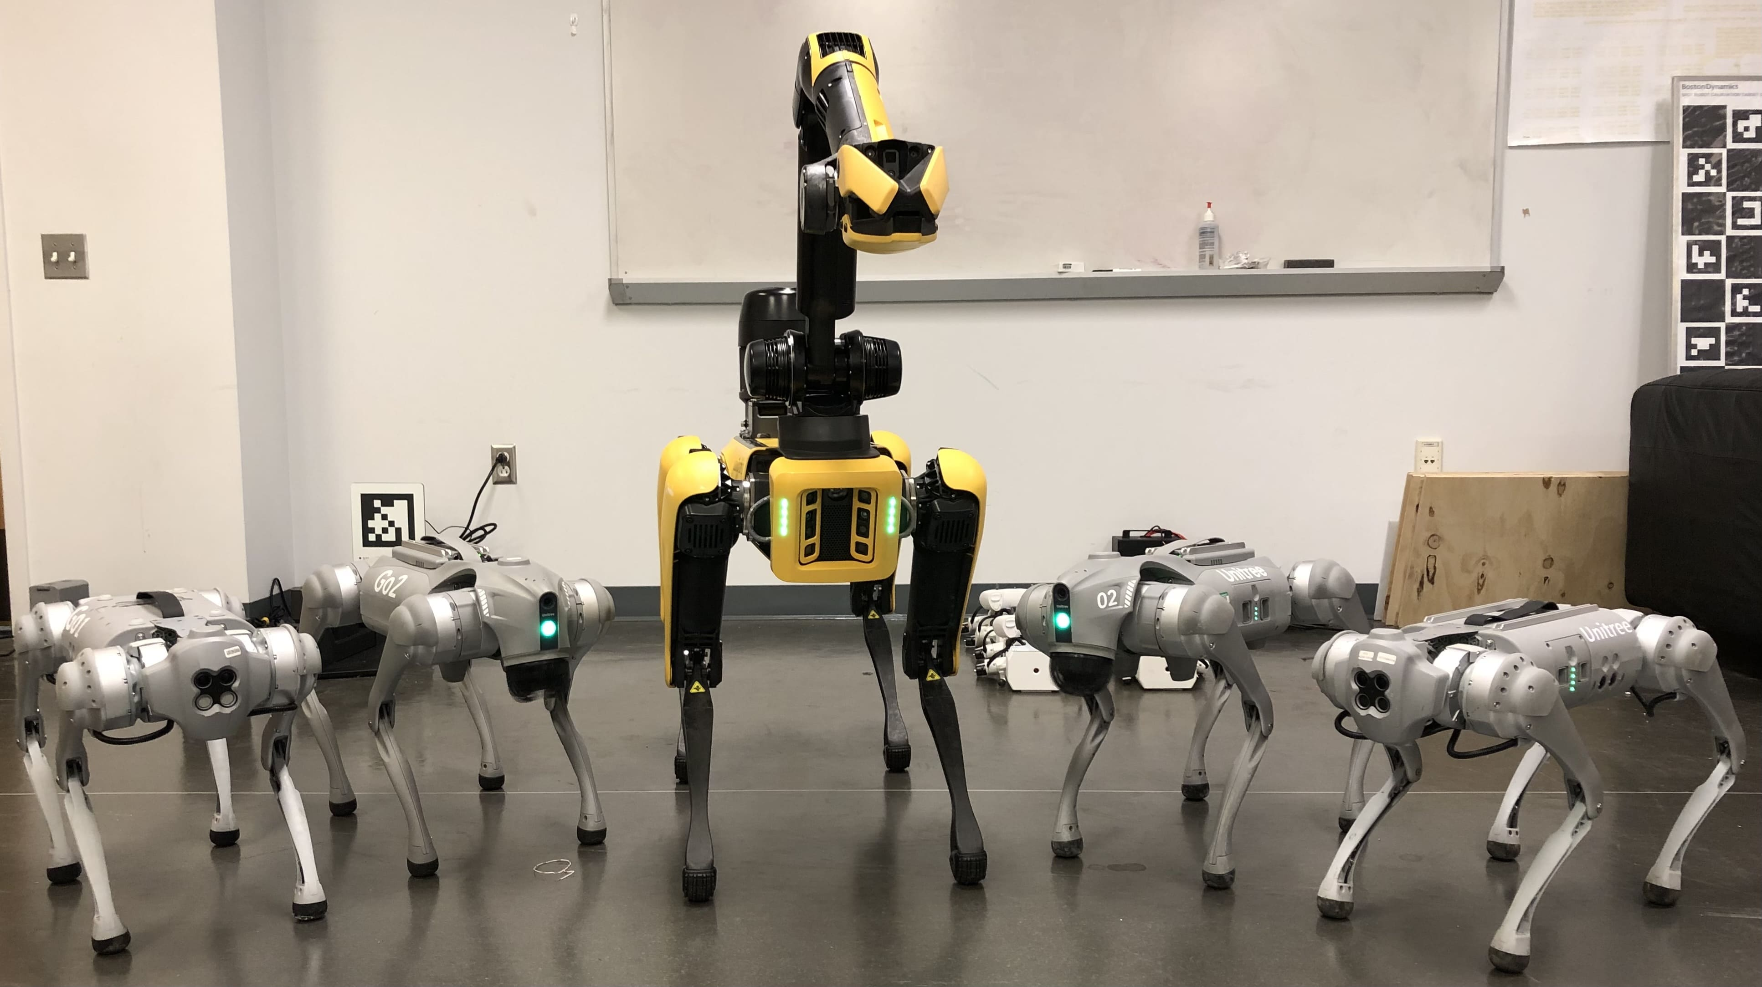
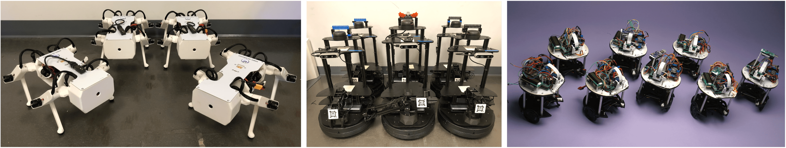
Robots in the RobotiXX Lab

Slide 14
Then, let’s look at some humans
Humans that have been, or will be, building autonomous robots.
Robots will only be as good as the humans that build them (or at least for now when we don’t have Skynet yet…).

Slide 15
Motivation: We need a system that humans can use to empower the usage of all these robots and tools

Slide 16
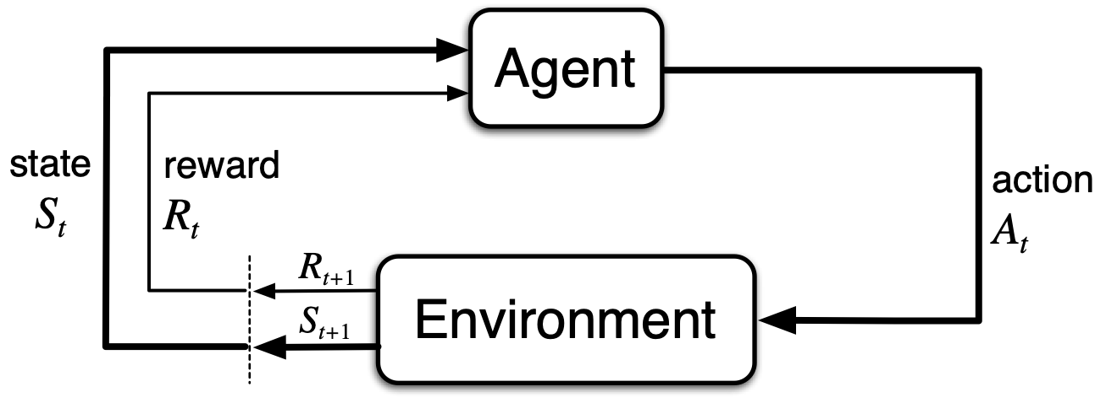
Motivation: We need a system that empowers us to use all these robots
From: Sutton & Barto, Reinforcement Learning

Slide 17
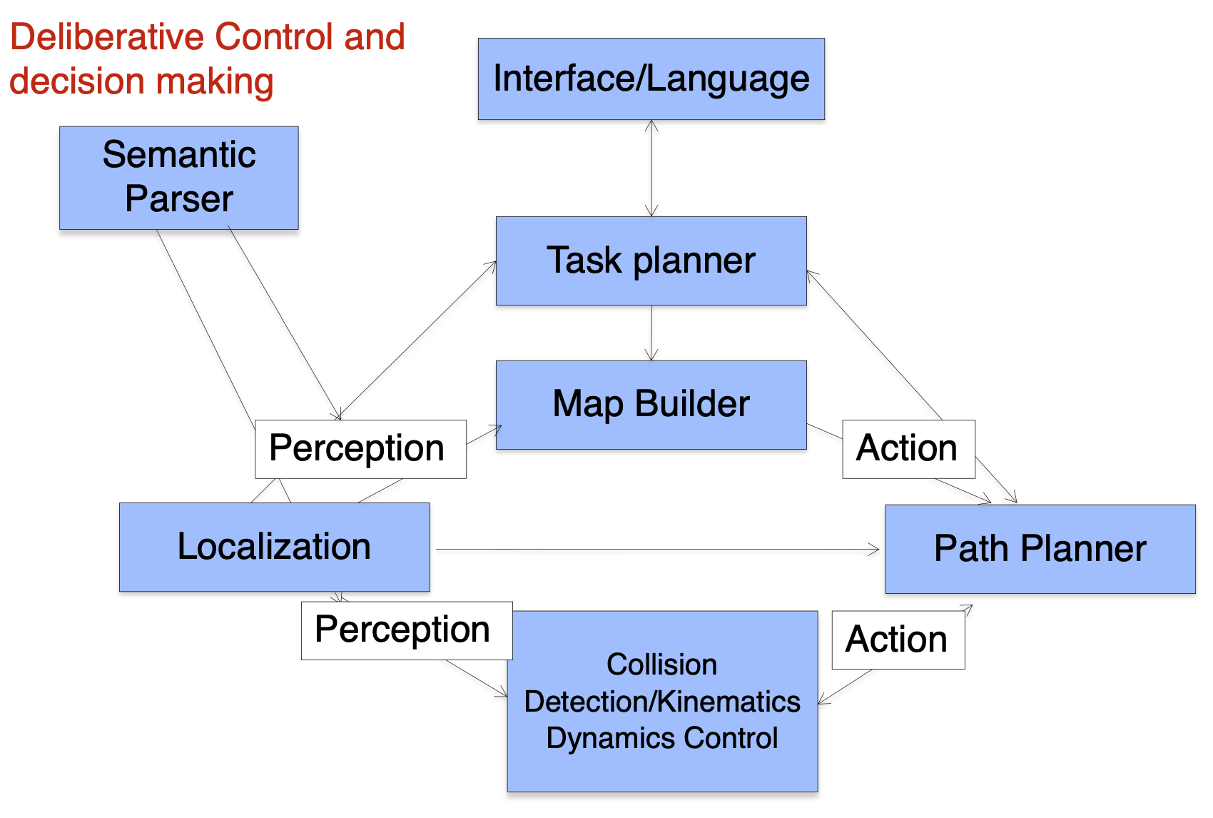
Motivation: We want to break up robot capabilities into composable blocks

Slide 18
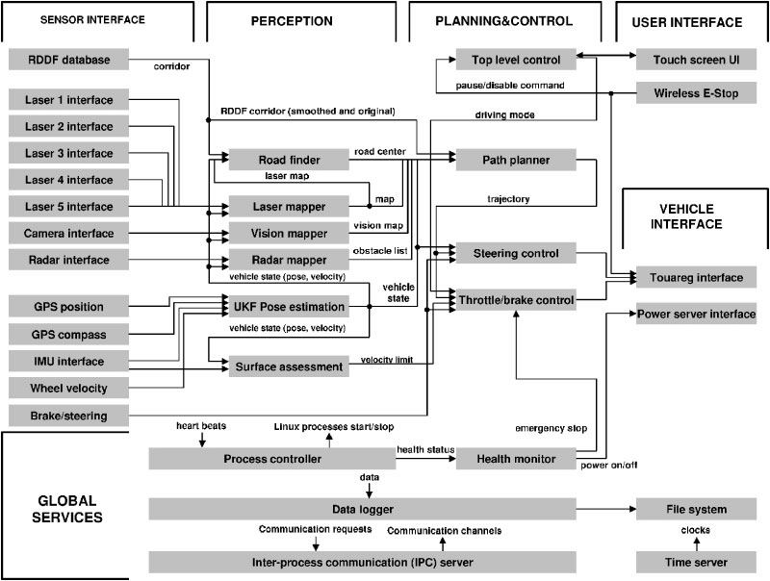
Motivation: We want to break up robot capabilities into composable blocks
From: https://www.researchgate.net/figure/Flowchart-of-Stanley-software-system-The-software-is-roughly-divided-into-six-main_fig17_224773193

Slide 19
Introduction to ROS
The Robot Operating System is used on many robots.

Slide 20
ROS: The Robot Operating System
So what’s ROS?
Is it really an “operating system”? Well it’s not a file system, but it does (true to its name) operate robots.
ROS is more of an orchestration system: it’s what spawns different processes and handles communication between them and sensors and motors, etc.

Slide 21
Robots often need many of the same capabilities
Earlier, we discussed many different types of robots. There are overlapping capabilities between them. They may use the same sensors, the same algorithms, etc…
We could make a monolithic system, but it would be somewhat difficult to design such systems.

Slide 22
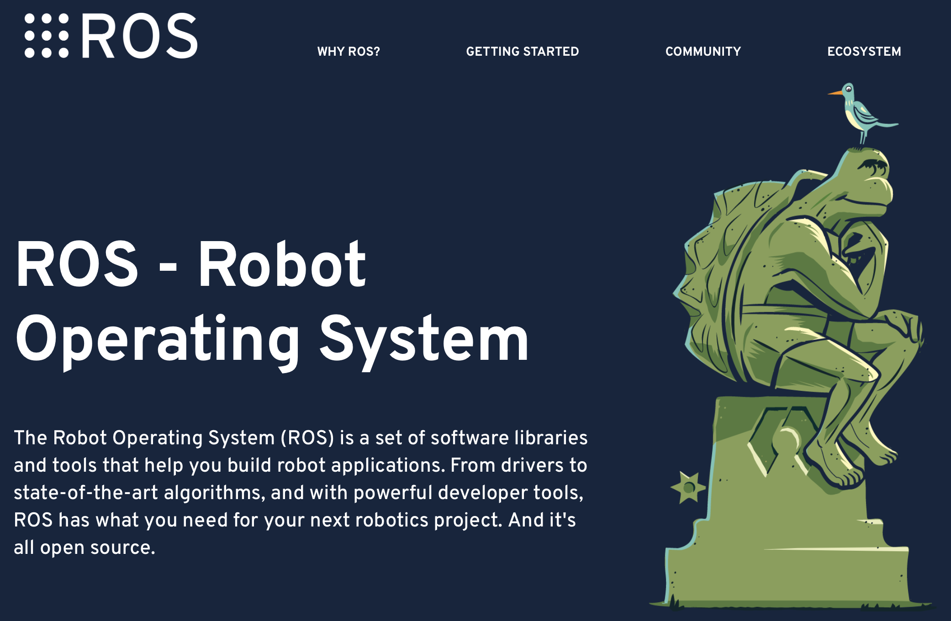
Robot systems tend to be modular
ROS is going to be our way of managing, building, running these processes.

Slide 23
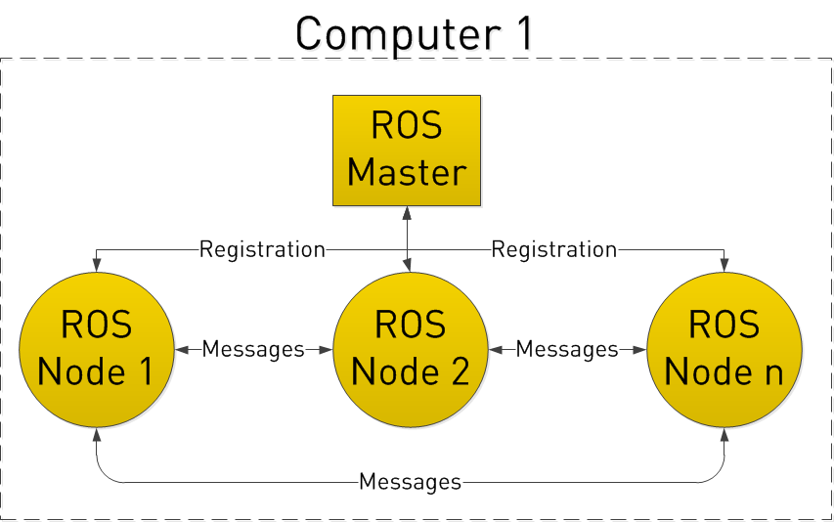
ROS Master (roscore): The process you run to connect the pieces (“nodes”)
Command: roscore

Slide 24
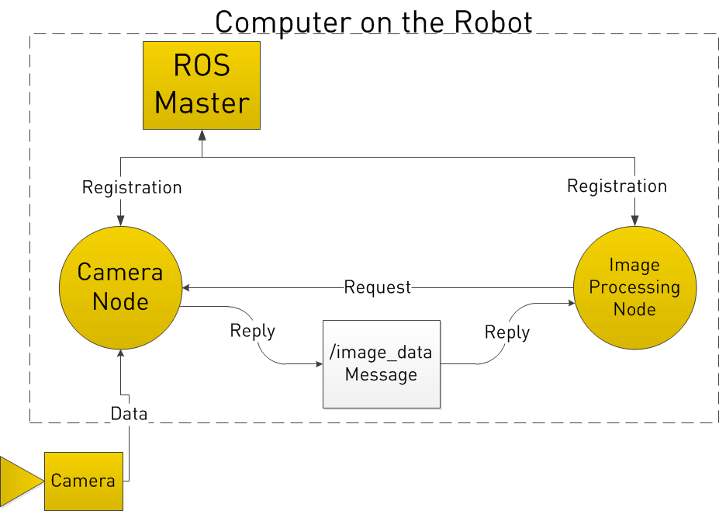
Here’s a simple example of a robot with a camera and an image processing node

Slide 25
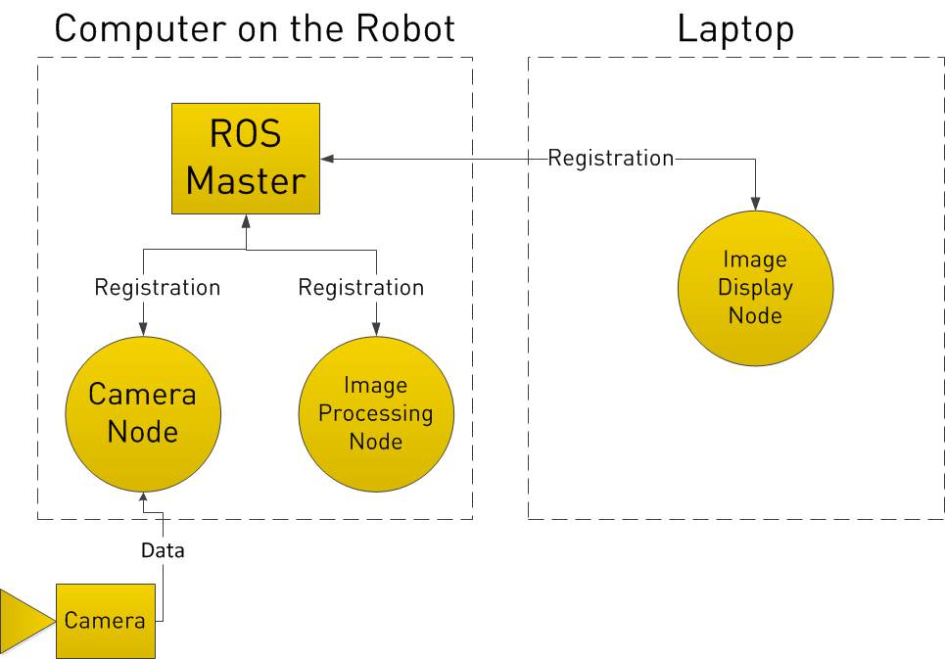
ROS also supports remote access

Slide 26
Some ROS terminology
Core Concepts:
A “node” is a single ROS process
A “topic” is a named channel on which data can be shared
A “message” is a piece of data shared by a “topic”
Functionality:
A “publisher” is a function that sends data to a topic (often run within Python or C++).
A “subscriber” is a function that listens for messages on a topic; when a new message appears on a topic, the subscriber’s associated function is run with that message as input.

Slide 27
Commands to publish and listen to a topic
roscore # Start ros
rostopic list # Look at the topics
rostopic pub /hello std_msgs/String "Hello Robot"
rostopic list # Look at the topics again (/hello is there)
rostopic echo /hello # Listen to that topic
rosnode list
rosnode info
rostopic info /hello

Slide 28
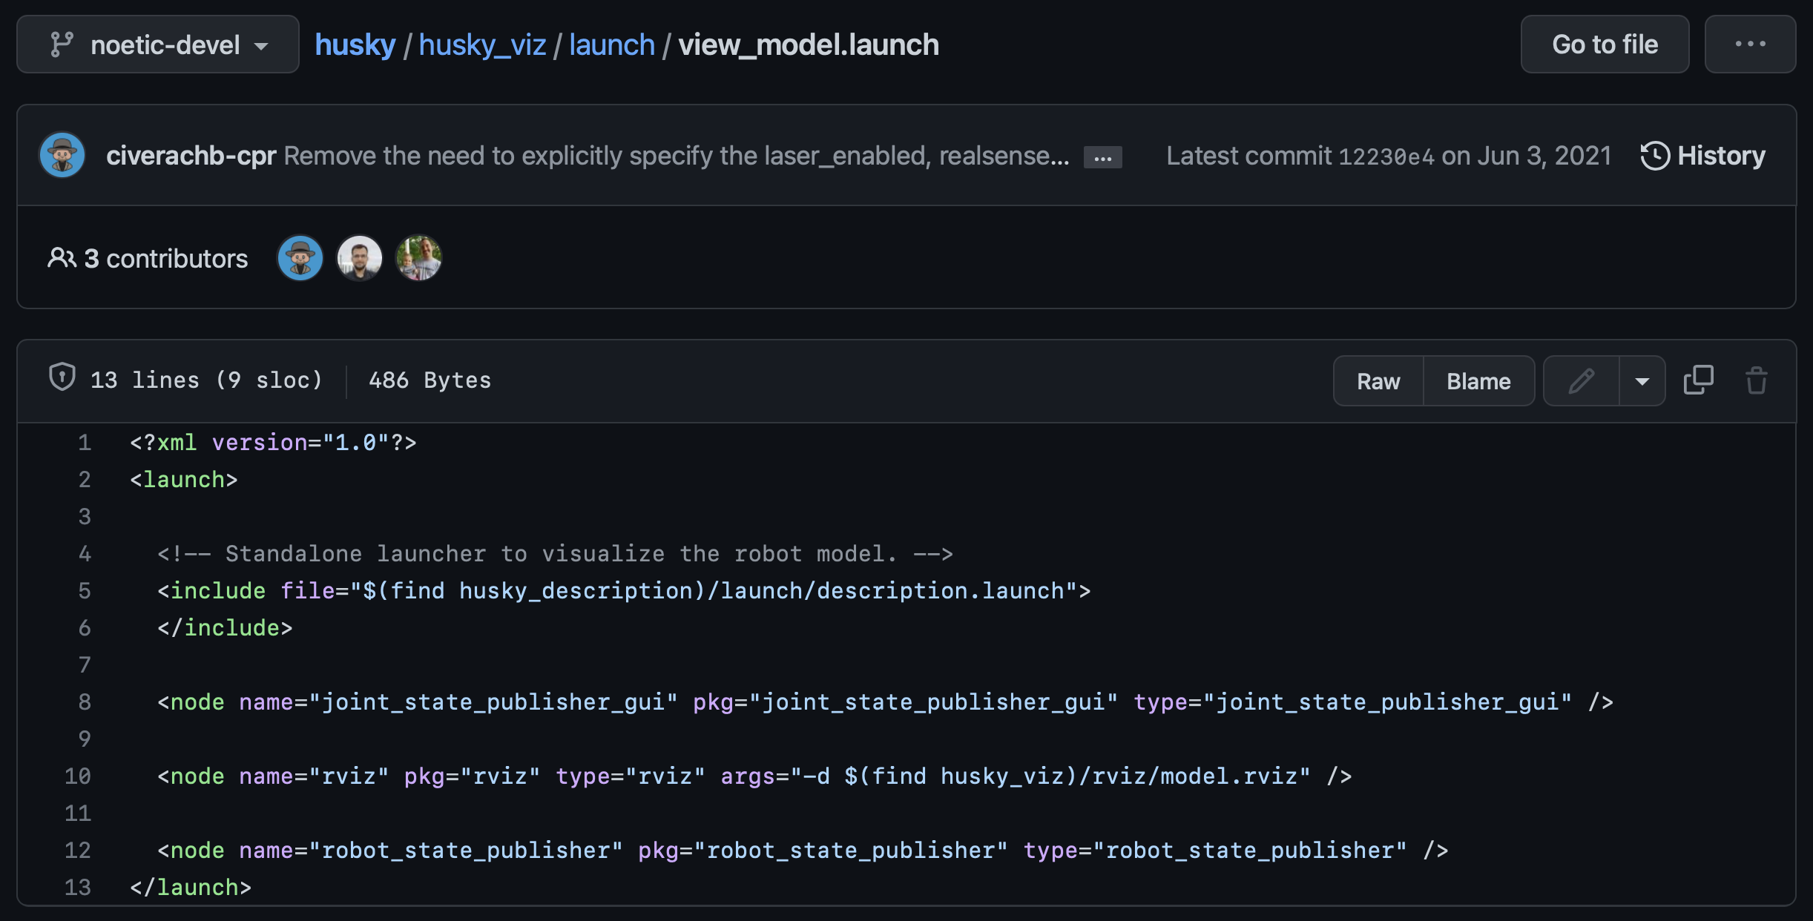
roslaunch Launch files use XML syntax to spin up multiple processes at once

Slide 29
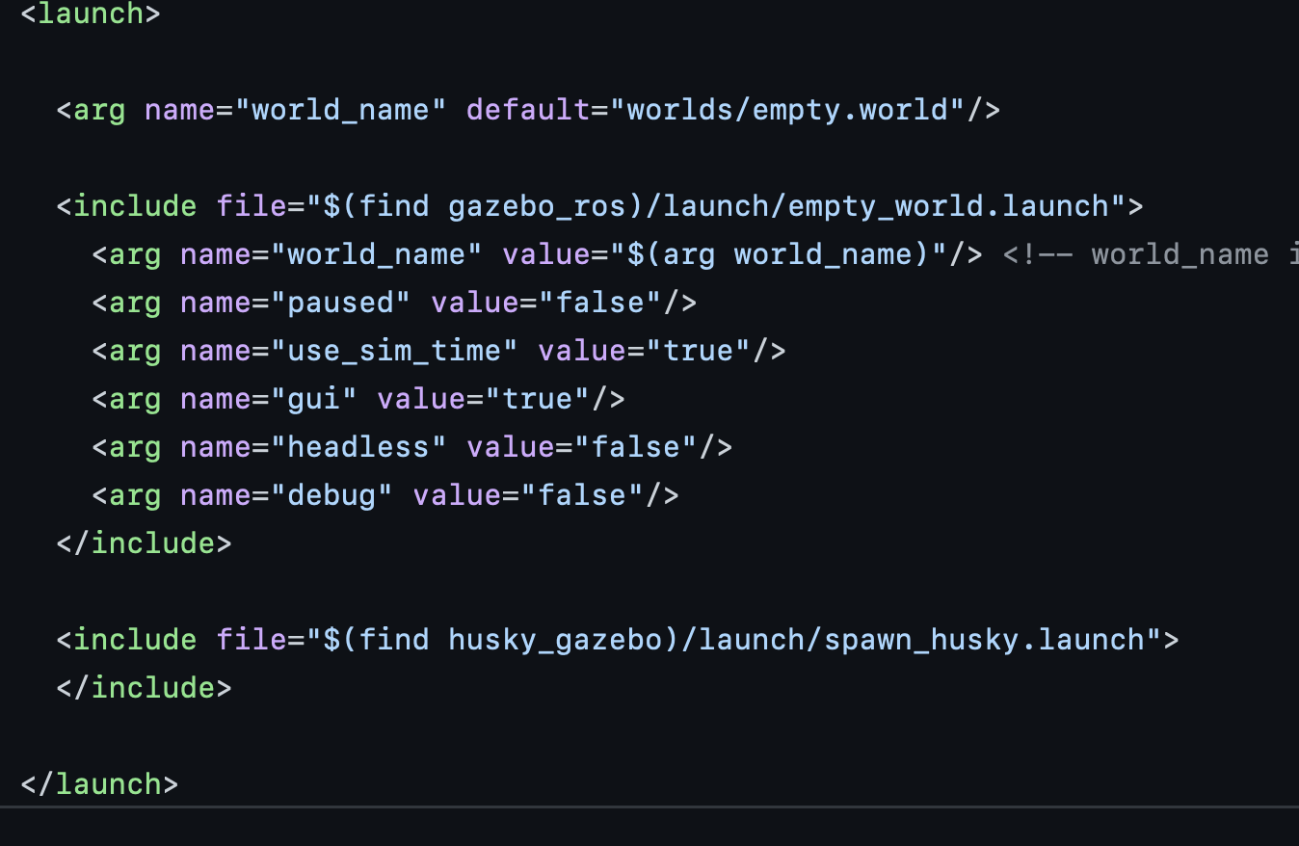
roslaunch Launch files use XML syntax to spin up multiple processes at once

Slide 30
Launch files are incredibly useful
With a single file, we can spin up a suite of sensors and processes, algorithms, etc.

Slide 31
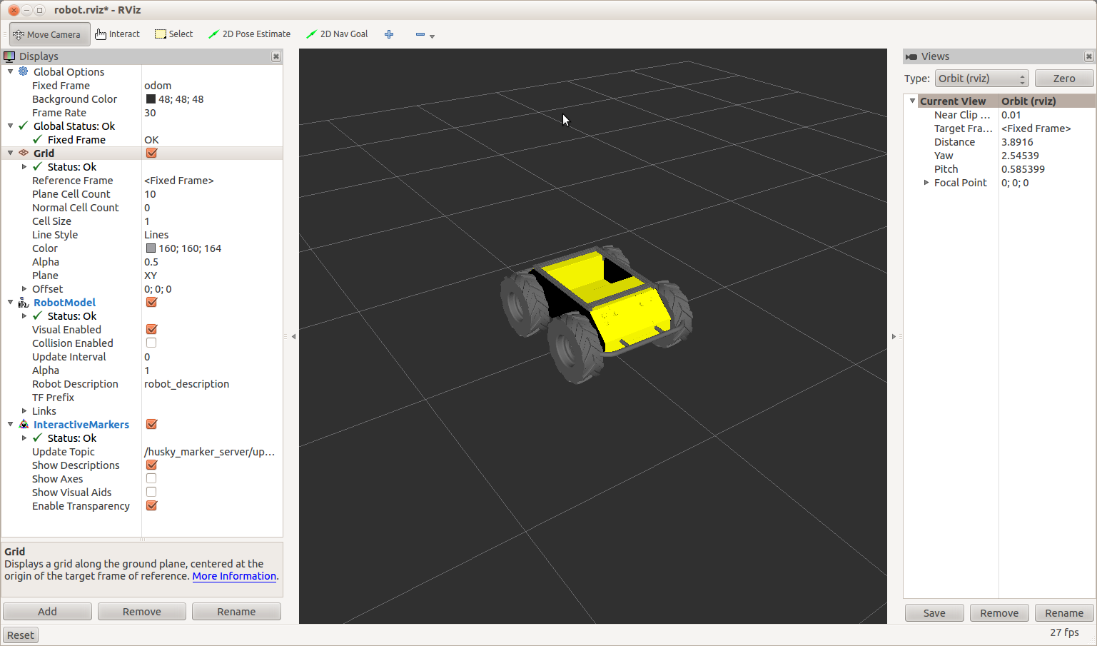
RVIZ: the ROS visualizer

Slide 32
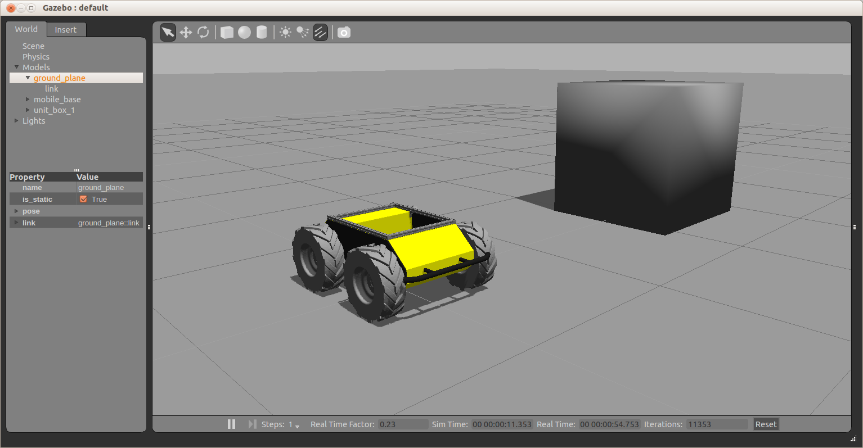
Gazebo is a simulator that is meant to integrate with ROS

Slide 33
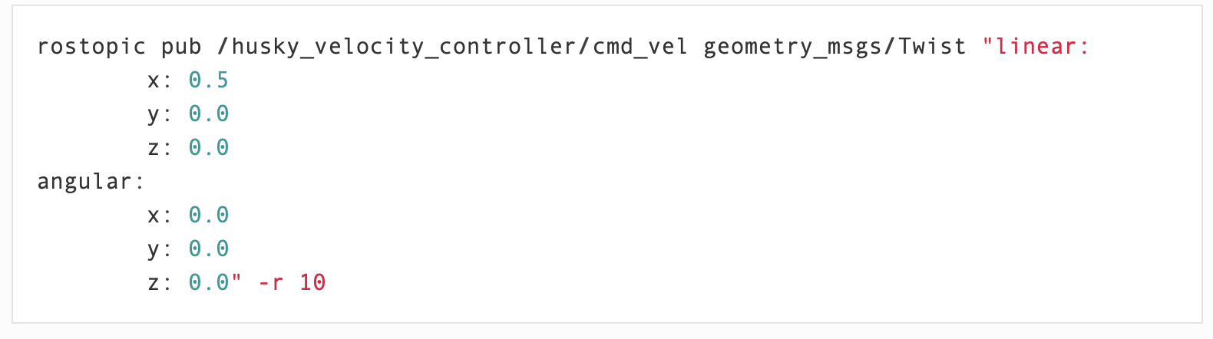
Publishing to a topic that drives a robot

Slide 34
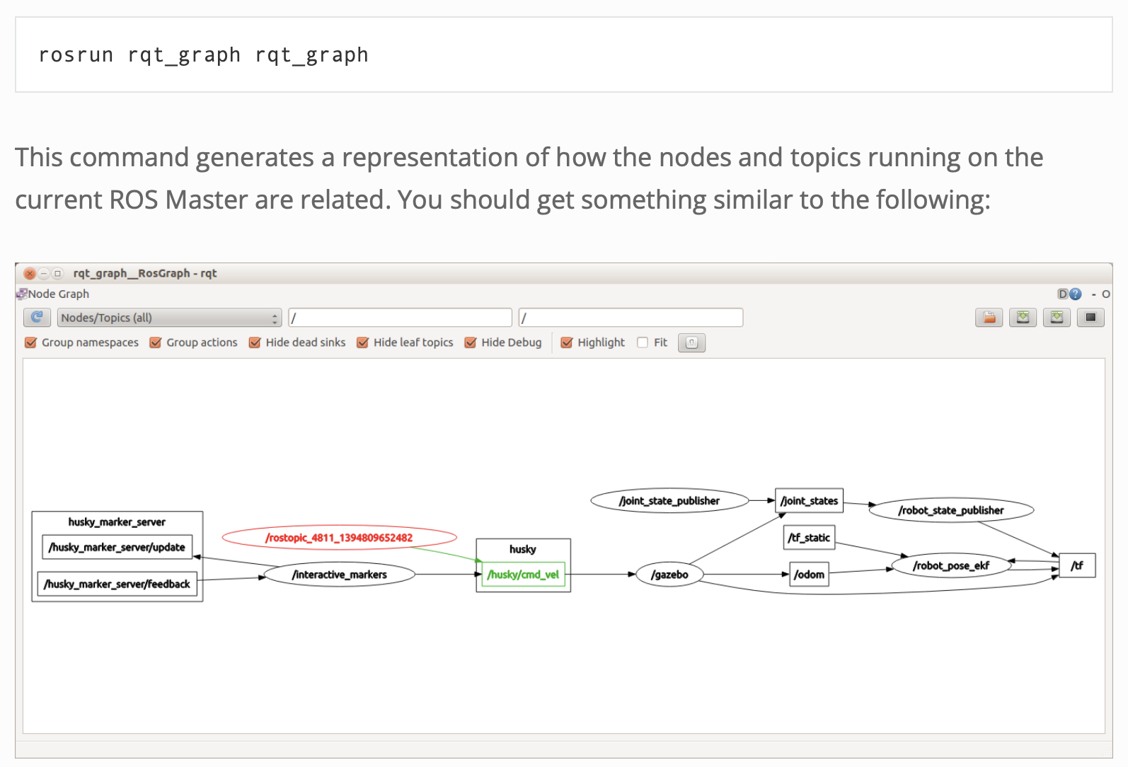
ROS has many tools for visualization, logging, and inspection

Slide 35
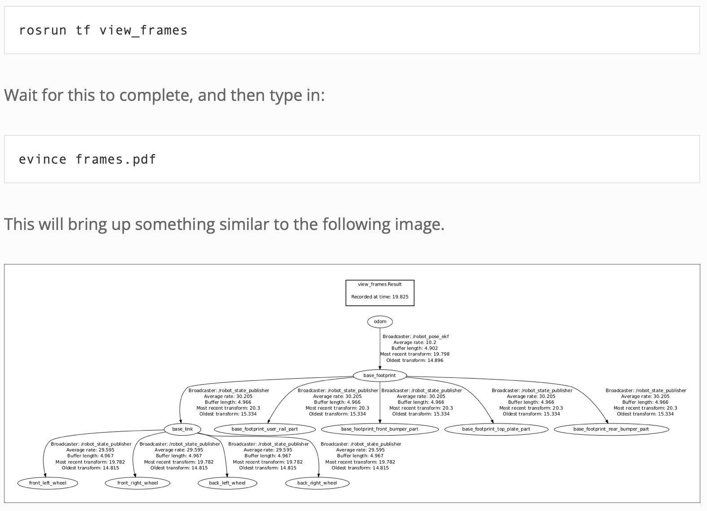
ROS has many tools for visualization, logging, and inspection
A similar command is
rosrun rqt_tf_tree rqt_tf_tree

Slide 36
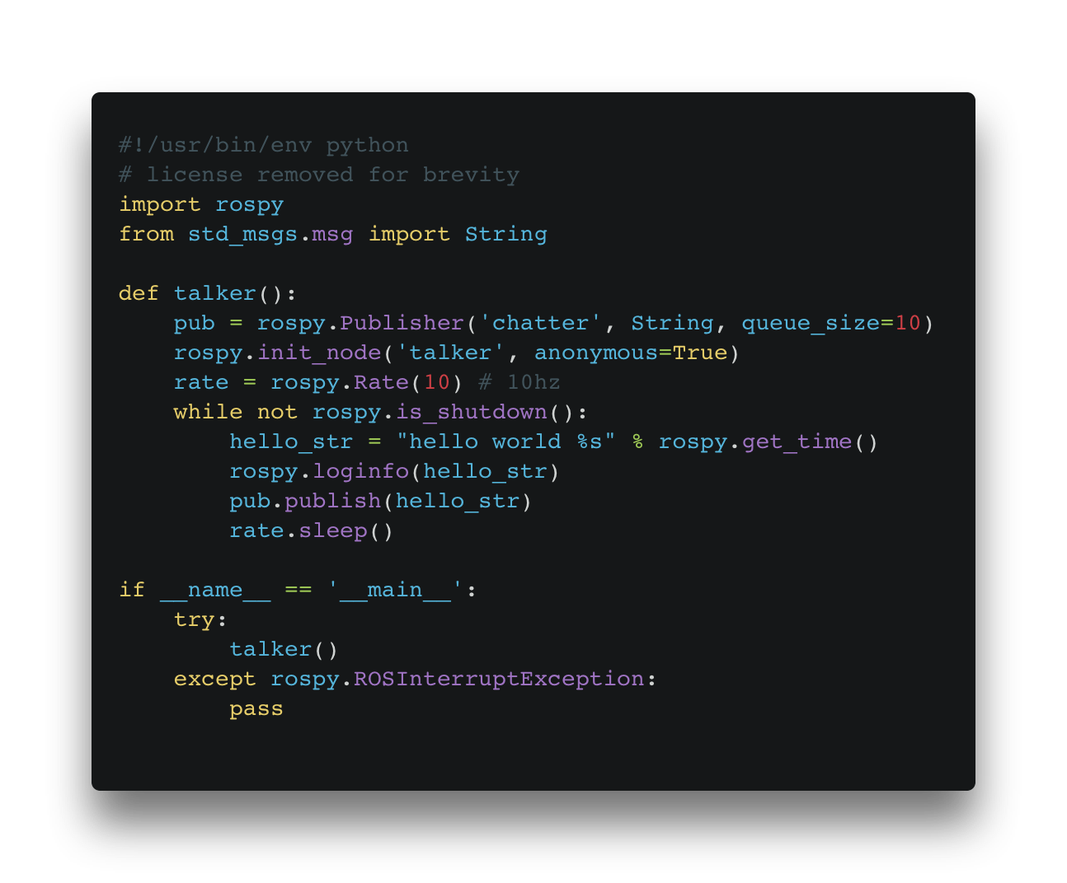
A ROS Publisher
From the ROS Tutorials

Slide 37
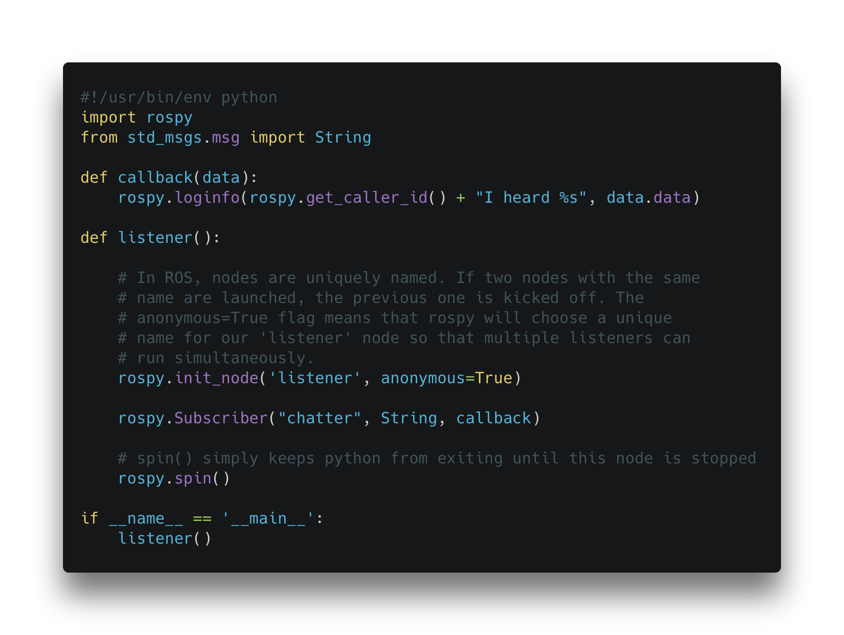
A ROS Listener
From the ROS Tutorials

Slide 38
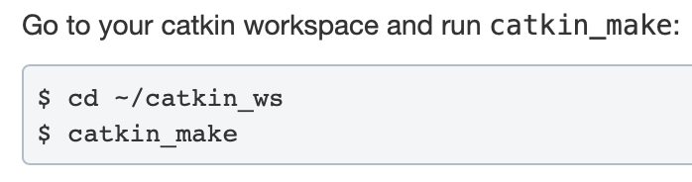
ROS also comes with a build system: Catkin
We need to run catkin to let ROS know that these new processes exist.
A “workspace” is a folder that contains code for multiple packages. catkin_make “builds” the code (or in the Python case, let’s ROS know that these nodes exist).

Slide 39
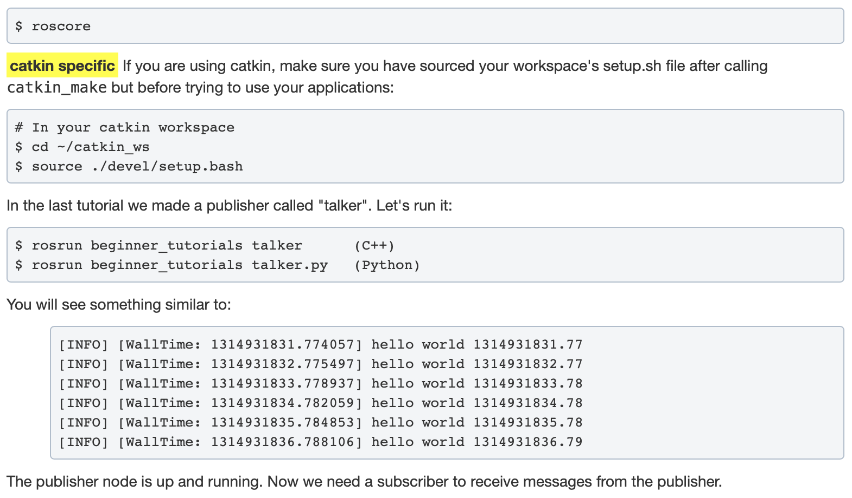
rosrun spawns a single node from a single package (like a single line from a launch file)

Slide 40
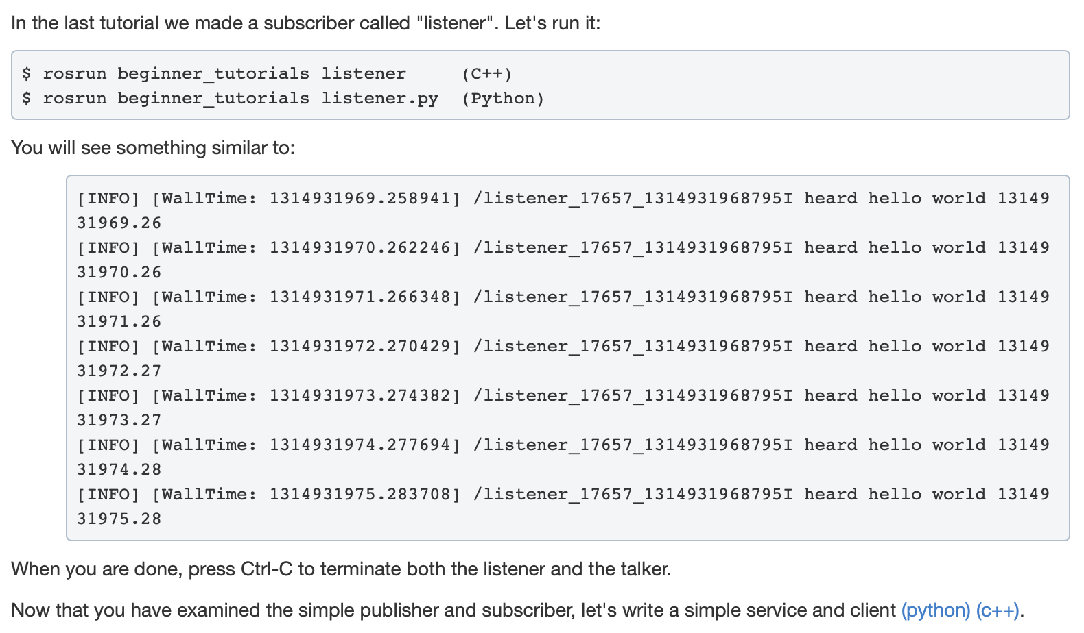
rosrun spawns a single node from a single package (like a single line from a launch file)

Slide 41
Let’s do some inspecting
rostopic list # Look at the topics again (/hello is there)
rostopic echo /hello # Listen to that topic
rosnode list
rosnode info
rostopic info […]

Slide 42
ROS also supports recording and playing back data
The “rosbag” tool is quite useful. It records messages on a set of specified topics and can play it back in a number of ways.
We can play back the data in real time
We can play back the data faster or more slowly
We can step through the datum one at a time (to avoid any issues of timing or dropping messages) in Python or C++

Slide 43
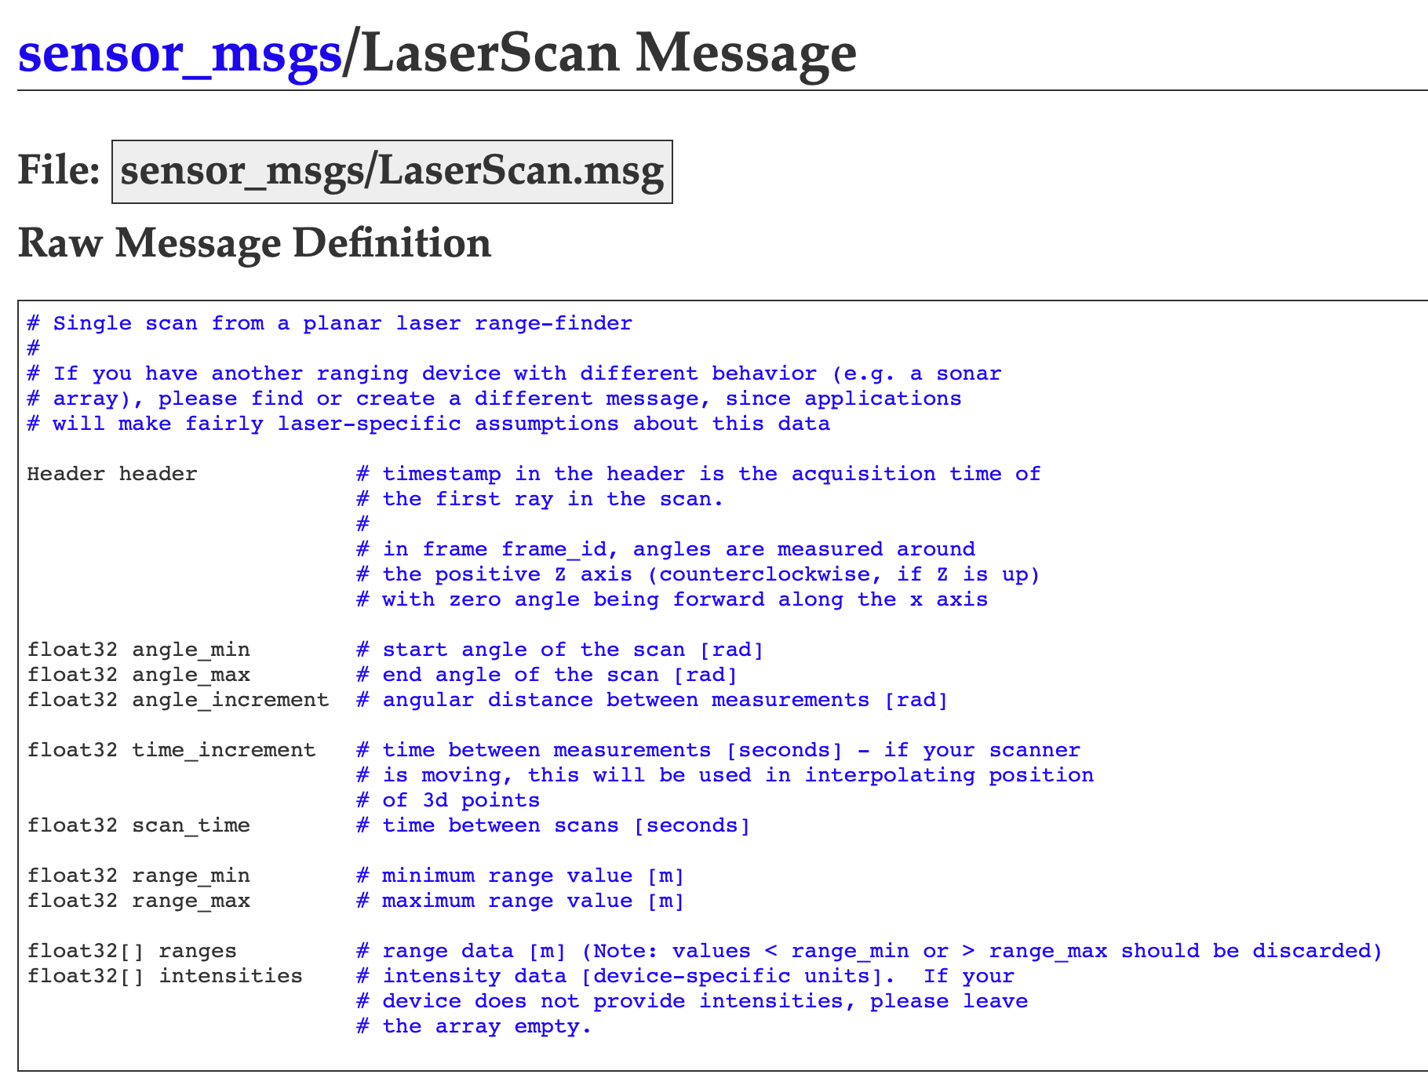
ROS has many different “message types” and “composite messages”

Slide 44
Classmates introduction for team formation
Introduce yourself to the whole class in 1 min
  Who are you? Which year are you in? Which major are you in?
  Why are you interested in robotics?
  What is your skillset? Math? Hardware? System? Programming? C++? Python?
  What kinds of robotics project would you like to work on?

