Slide 1
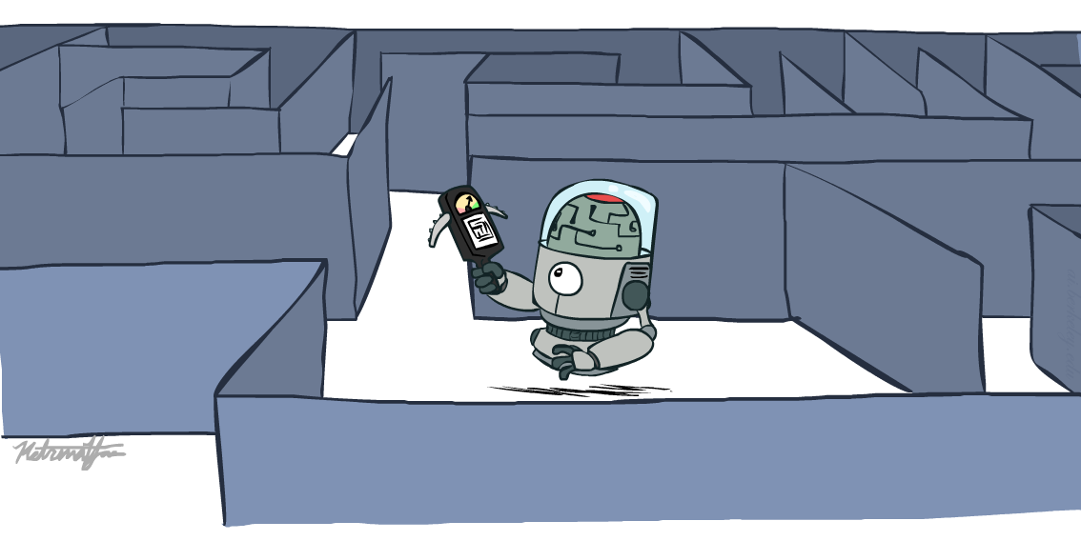
CS 580: Artificial Intelligence
Informed Search
Prof. Xuesu Xiao
George Mason University
[Based on slides created by Dan Klein and Pieter Abbeel for CS188 Intro to AI at UC Berkeley.
All original materials available at http://ai.berkeley.edu.]
Notes:
Please retain proper attribution, including the reference to ai.berkeley.edu. Thanks!

Slide 2

Today
Informed Search
  Heuristics
  Greedy Search
  A* Search
Graph Search

Slide 3
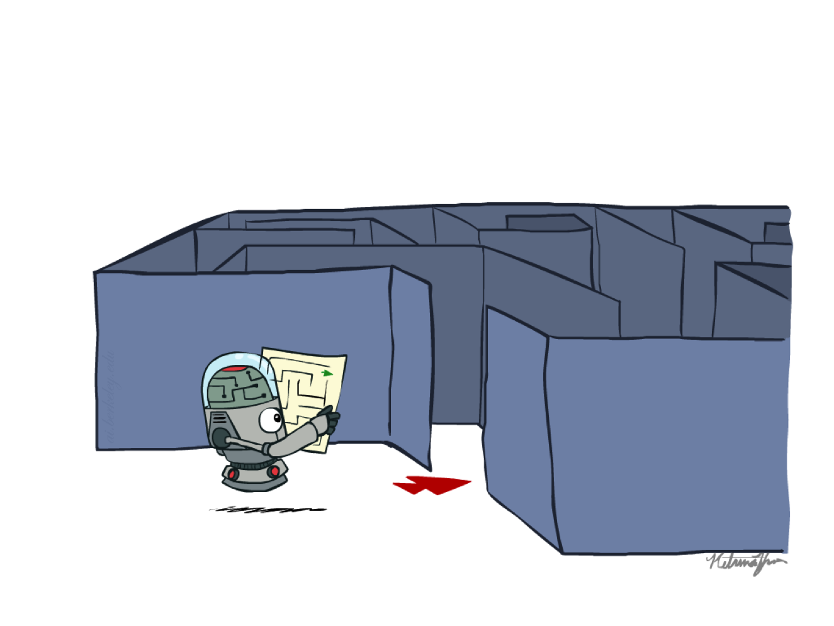
Recap: Search

Slide 4
Recap: Search
Search problem:
  States (configurations of the world)
  Actions and costs
  Successor function (world dynamics)
  Start state and goal test
Search tree:
  Nodes: represent plans for reaching states
  Plans have costs (sum of action costs)
Search algorithm:
  Systematically builds a search tree
  Chooses an ordering of the fringe (unexplored nodes)
  Optimal: finds least-cost plans

Slide 5
Example: Pancake Problem
Cost: Number of pancakes flipped
Notes:
Gates, W. and Papadimitriou, C., "Bounds for Sorting by Prefix Reversal.", Discrete Mathematics. 27, 47-57, 1979.

Slide 6
Example: Pancake Problem
State space graph with costs as weights
4
2
3
2
3
4
3
4
2
3
2
2
4
3
Notes:
A* expanded 8100 ; Path cost = 33
UCS expanded 25263 . Path cost = 33
Greedy expanded 10 . Path cost = 41
[0, 7, 5, 3, 2, 1, 4, 6]
(7, 0, 5, 3, 2, 1, 4, 6)
(6, 4, 1, 2, 3, 5, 0, 7)
(3, 2, 1, 4, 6, 5, 0, 7)
(1, 2, 3, 4, 6, 5, 0, 7)
(5, 6, 4, 3, 2, 1, 0, 7)
(6, 5, 4, 3, 2, 1, 0, 7)
(0, 1, 2, 3, 4, 5, 6, 7)

Slide 7
General Tree Search
Action: flip top two
Cost: 2
Action: flip all four
Cost: 4
Path to reach goal:
Flip four, flip three
Total cost: 7
Notes:
You know exactly where you came from and how you got there, but you have no idea where you’re going. But, you’ll know it when you see it.

Slide 8
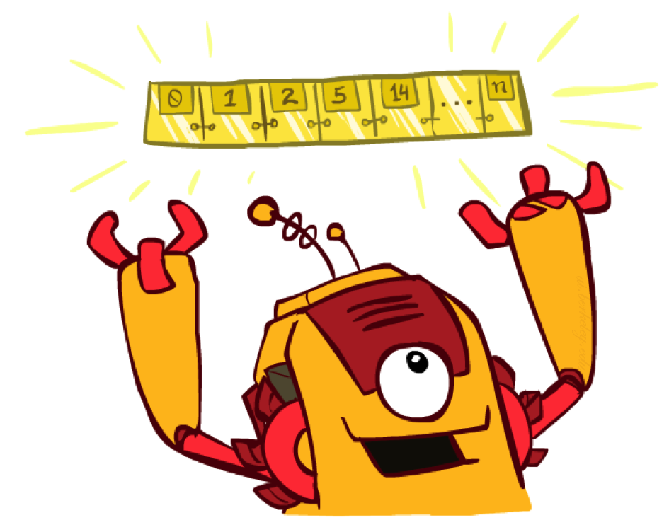
The One Queue
All these search algorithms are the same except for fringe strategies
  Conceptually, all fringes are priority queues (i.e. collections of nodes with attached priorities)
  Practically, for DFS and BFS, you can avoid the log(n) overhead from an actual priority queue, by using stacks and queues
  Can even code one implementation that takes a variable queuing object

Slide 9
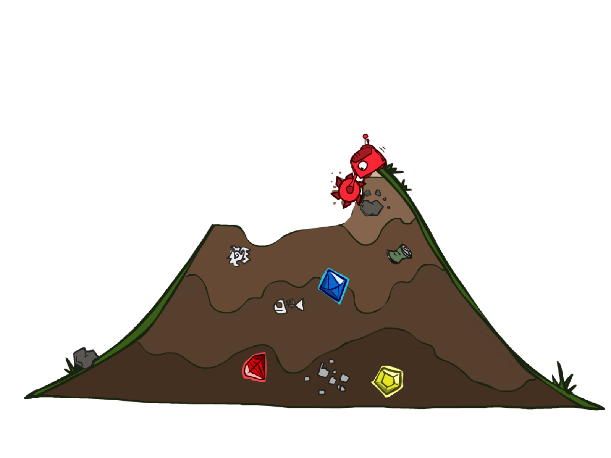
Uninformed Search

Slide 10
Uniform Cost Search
Strategy: expand lowest path cost
The good: UCS is complete and optimal!
The bad:
  Explores options in every “direction”
  No information about goal location
c ≤ 1
…
c ≤ 2
c ≤ 3
Start
Goal

Slide 11

Video of Demo Contours UCS Empty

Slide 12
Video of Demo Contours UCS Pacman Small Maze

Slide 13

Informed Search

Slide 14
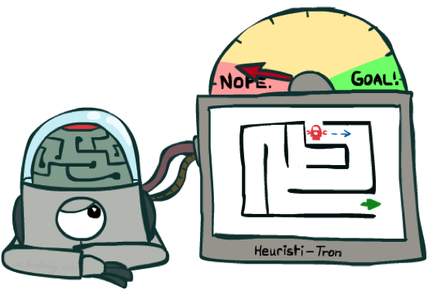
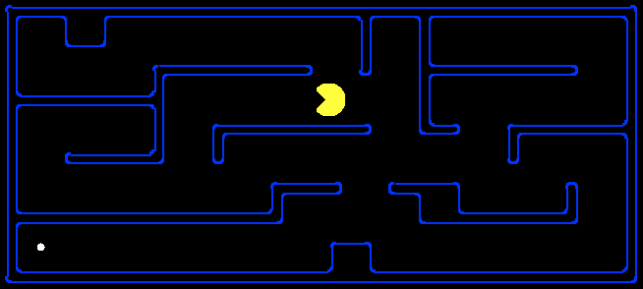
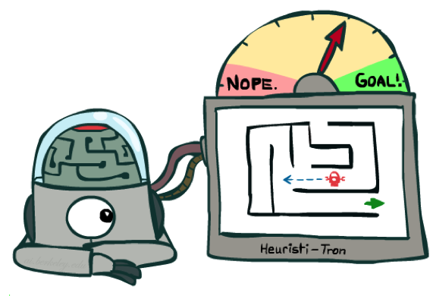
Search Heuristics
A heuristic is:
  A function that estimates how close a state is to a goal
  Designed for a particular search problem
  Examples: Manhattan distance, Euclidean distance for pathing
10
5
11.2

Slide 15
Example: Heuristic Function
h(x)

Slide 16
Example: Heuristic Function
Heuristic: the number of the largest pancake that is still out of place
3
h(x)
4
3
4
3
0
4
4
3
4
4
2
3
Notes:
A* expanded 8100 ; Path cost = 33
UCS expanded 25263 . Path cost = 33
Greedy expanded 10 . Path cost = 41
[0, 7, 5, 3, 2, 1, 4, 6]
(7, 0, 5, 3, 2, 1, 4, 6)
(6, 4, 1, 2, 3, 5, 0, 7)
(3, 2, 1, 4, 6, 5, 0, 7)
(1, 2, 3, 4, 6, 5, 0, 7)
(5, 6, 4, 3, 2, 1, 0, 7)
(6, 5, 4, 3, 2, 1, 0, 7)
(0, 1, 2, 3, 4, 5, 6, 7)

Slide 17
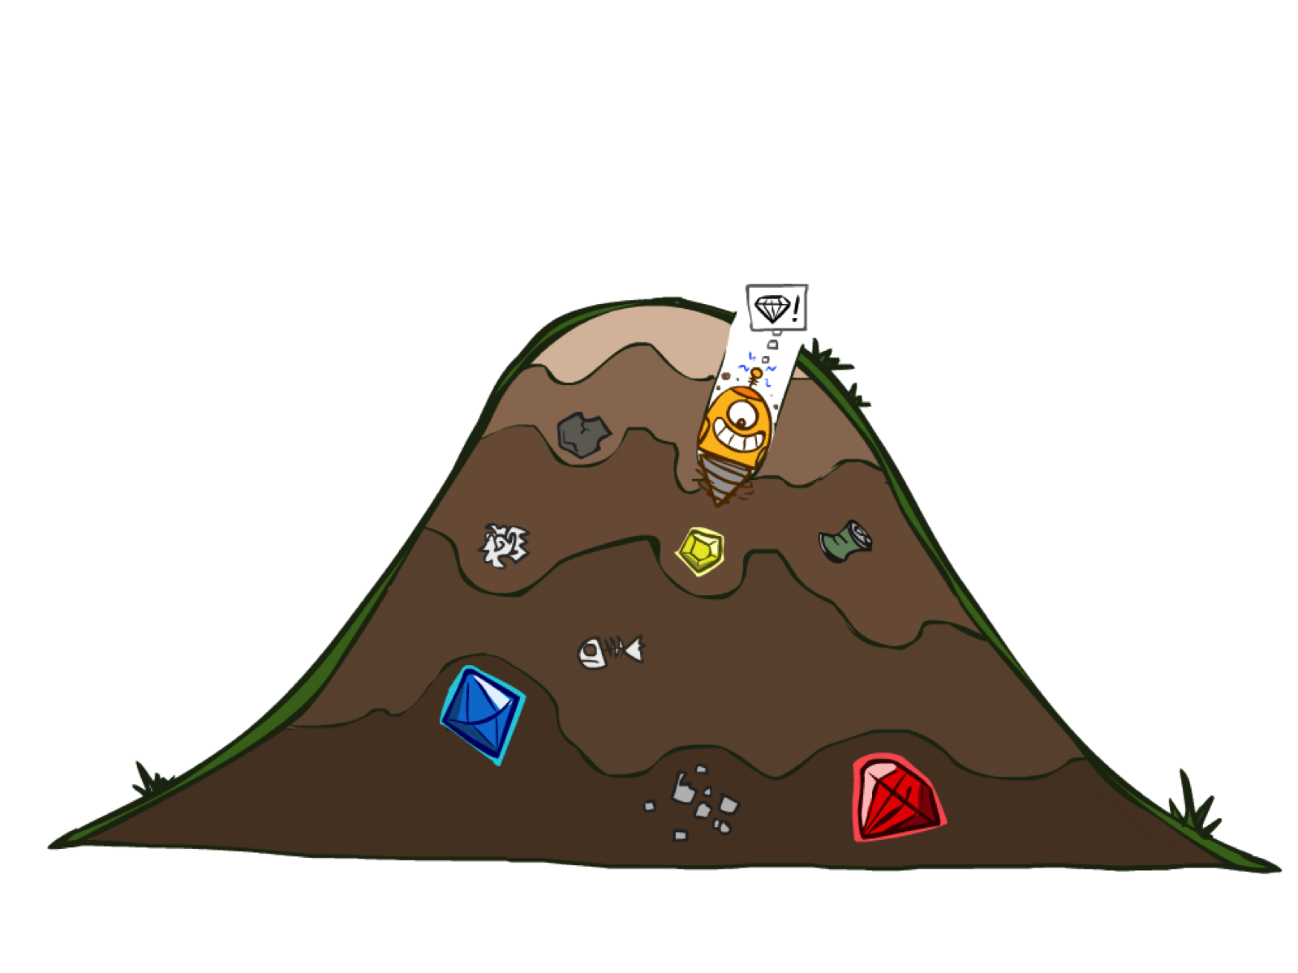
Greedy Search

Slide 18
Example: Heuristic Function
h(x)

Slide 19


Greedy Search
Expand the node that seems closest…
What can go wrong?

Slide 20
Greedy Search
b
Strategy: expand a node that you think is closest to a goal state
  Heuristic: estimate of distance to nearest goal for each state
A common case:
  Best-first takes you straight to the (wrong) goal
Worst-case: like a badly-guided DFS
…
b
…
Notes:
For any search problem, you know the goal. Now, you have an idea of how far away you are from the goal.

Slide 21
Video of Demo Contours Greedy (Empty)

Slide 22
Video of Demo Contours Greedy (Pacman Small Maze)

Slide 23
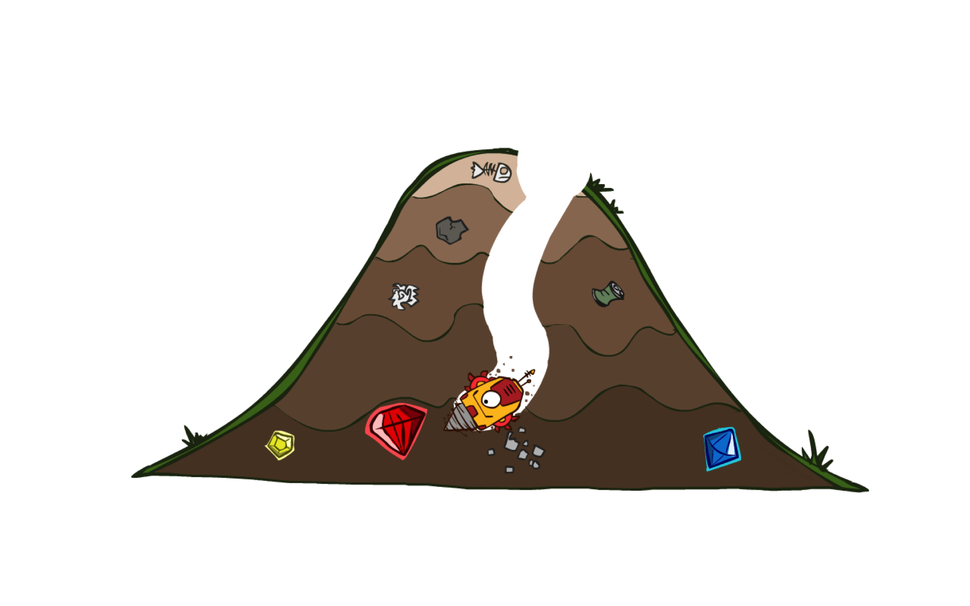
A* Search

Slide 24
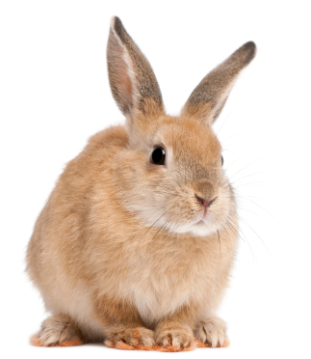
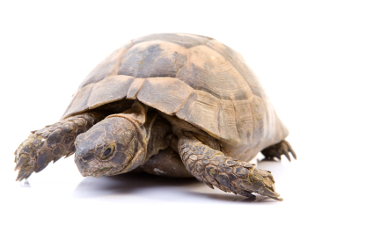

A* Search
UCS
Greedy
A*
Notes:
Notes: these images licensed from iStockphoto for UC Berkeley use.

Slide 25
Combining UCS and Greedy
Uniform-cost orders by path cost, or backward cost g(n)
Greedy orders by goal proximity, or forward cost h(n)
A* Search orders by the sum: f(n) = g(n) + h(n)
8
g = 0 h=6
S
e
h=1
g = 1 h=5
a
1
1
3
2
g = 2 h=6
g = 9 h=1
S
a
d
G
b
d
g = 4 h=2
e
h=6
1
h=5
h=2
h=0
1
g = 3 h=7
g = 6 h=0
g = 10 h=2
c
b
c
G
d
h=7
h=6
g = 12 h=0
G
Example: Teg Grenager

Slide 26
When should A* terminate?
Should we stop when we enqueue a goal?
No: only stop when we dequeue a goal
h = 2
A
2
2
S
h = 3
h = 0
G
2
B
3
h = 1

Slide 27
Is A* Optimal?
h = 6
1
A
3
S
h = 7
G
h = 0
5
What went wrong?
Actual bad goal cost < estimated good goal cost
We need estimates to be less than actual costs!

Slide 28
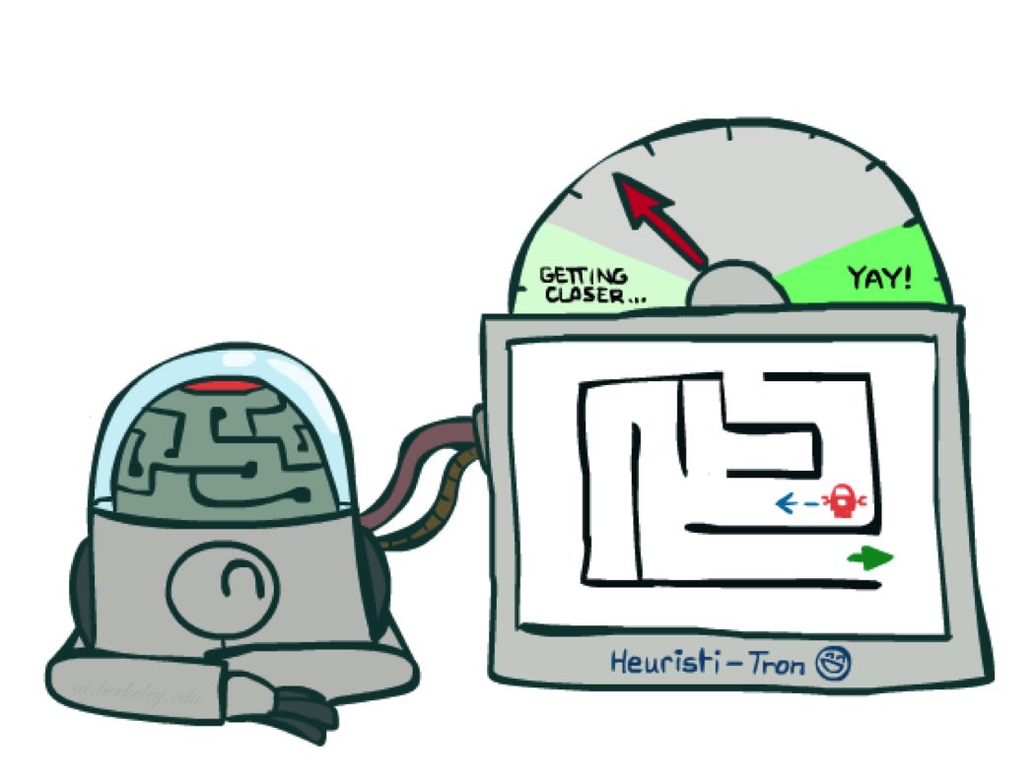
Admissible Heuristics

Slide 29
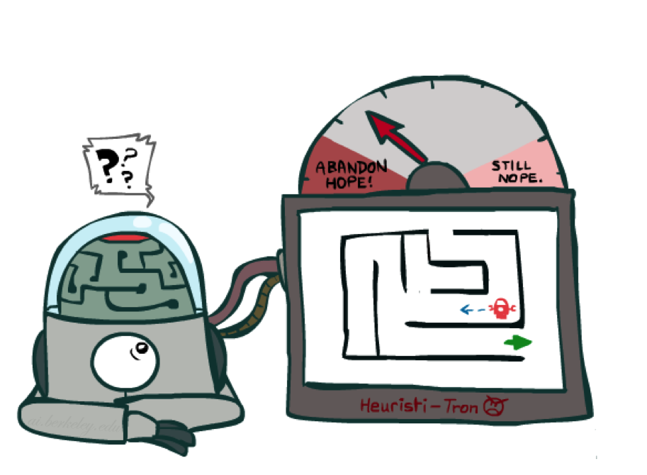
Idea: Admissibility
Inadmissible (pessimistic) heuristics break optimality by trapping good plans on the fringe
Admissible (optimistic) heuristics slow down bad plans but never outweigh true costs

Slide 30
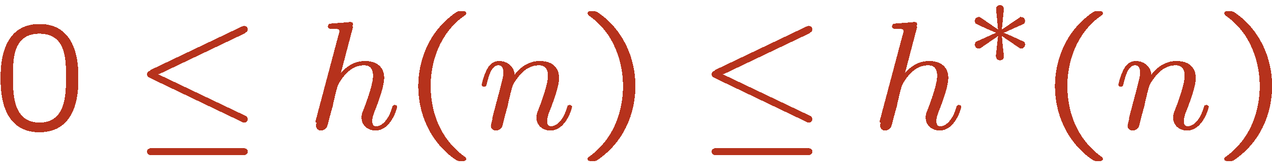
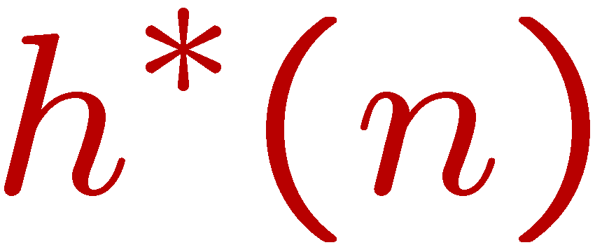
Admissible Heuristics
A heuristic h is admissible (optimistic) if:
where is the true cost to a nearest goal
Examples:
Coming up with admissible heuristics is most of what’s involved in using A* in practice.
4
15

Slide 31

Optimality of A* Tree Search

Slide 32


Optimality of A* Tree Search
Assume:
A is an optimal goal node
B is a suboptimal goal node
h is admissible
Claim:
A will exit the fringe before B
…

Slide 33

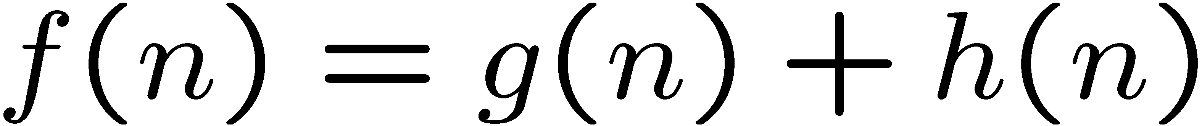
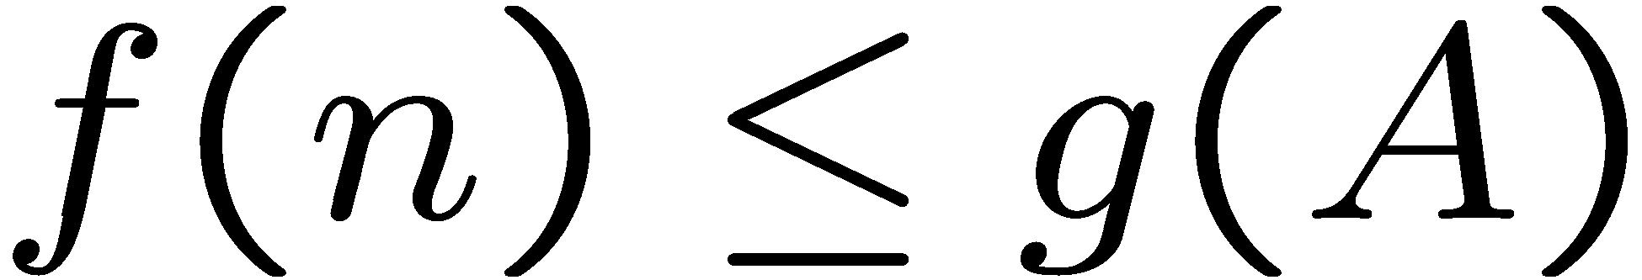
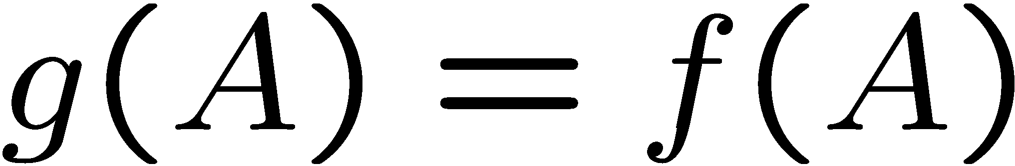
Optimality of A* Tree Search: Blocking
Proof:
Imagine B is on the fringe
Some ancestor n of A is on the fringe, too (maybe A!)
Claim: n will be expanded before B
  f(n) is less or equal to f(A)
…
Definition of f-cost
Admissibility of h
h = 0 at a goal

Slide 34
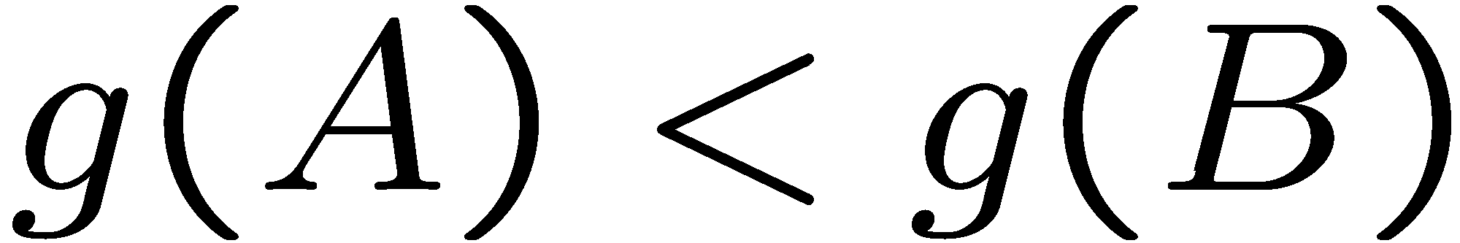
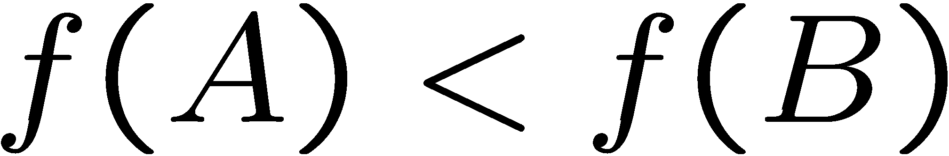
Optimality of A* Tree Search: Blocking
Proof:
Imagine B is on the fringe
Some ancestor n of A is on the fringe, too (maybe A!)
Claim: n will be expanded before B
  f(n) is less or equal to f(A)
  f(A) is less than f(B)
…
B is suboptimal
h = 0 at a goal

Slide 35

Optimality of A* Tree Search: Blocking
Proof:
Imagine B is on the fringe
Some ancestor n of A is on the fringe, too (maybe A!)
Claim: n will be expanded before B
  f(n) is less or equal to f(A)
  f(A) is less than f(B)
  n expands before B
All ancestors of A expand before B
A expands before B
A* search is optimal
…

Slide 36
Properties of A*

Slide 37
Properties of A*
Uniform-Cost
A*
b
b
…
…

Slide 38
UCS vs A* Contours
Uniform-cost expands equally in all “directions”
A* expands mainly toward the goal, but does hedge its bets to ensure optimality
Start
Goal
Start
Goal

Slide 39
Video of Demo Contours (Empty) -- UCS

Slide 40
Video of Demo Contours (Empty) -- Greedy

Slide 41
Video of Demo Contours (Empty) – A*

Slide 42
Video of Demo Contours (Pacman Small Maze) – A*

Slide 43
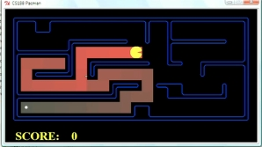
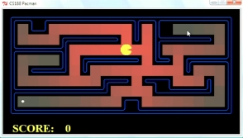
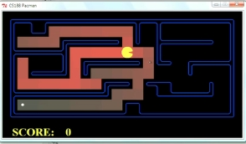
Comparison
Greedy
Uniform Cost
A*

Slide 44
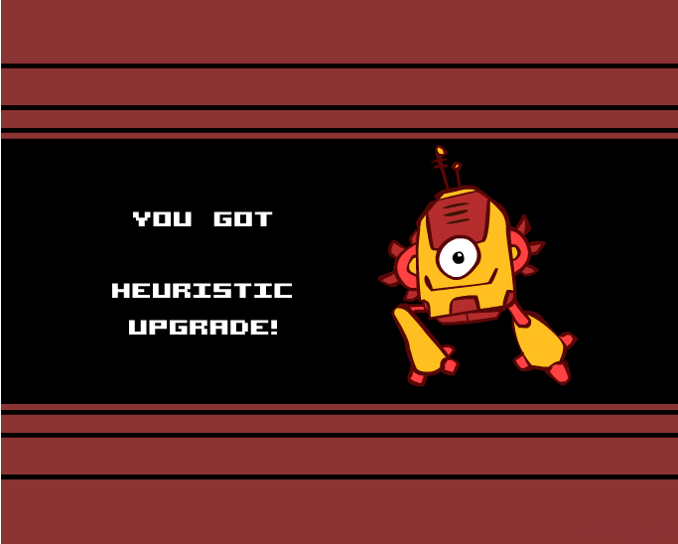
Creating Heuristics

Slide 45
Creating Admissible Heuristics
Most of the work in solving hard search problems optimally is in coming up with admissible heuristics
Often, admissible heuristics are solutions to relaxed problems, where new actions are available
Inadmissible heuristics are often useful too
366
15

Slide 46
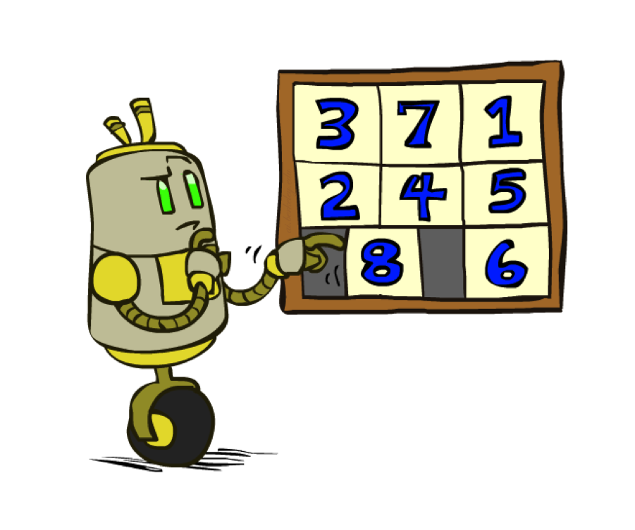
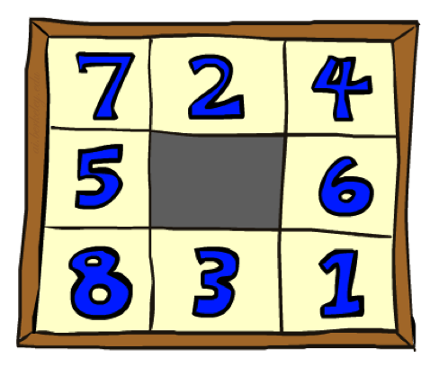
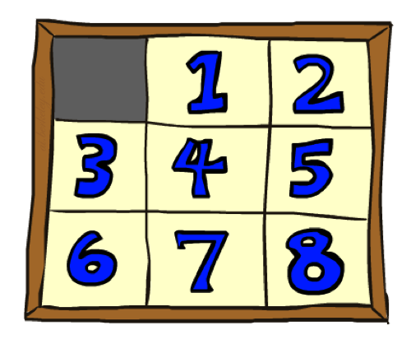
Example: 8 Puzzle
Start State
Actions
Goal State
What are the states?
How many states?
What are the actions?
How many successors from the start state?
What should the costs be?

Slide 47
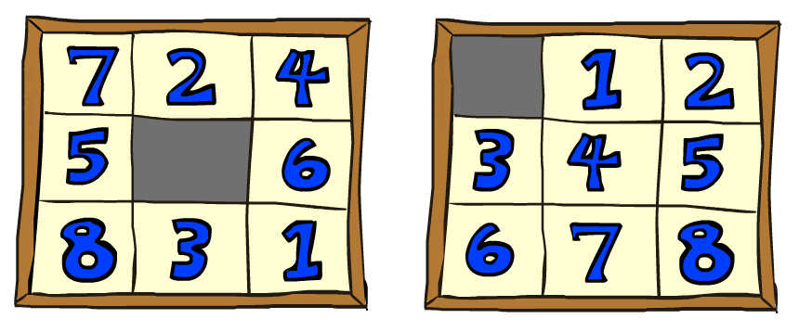
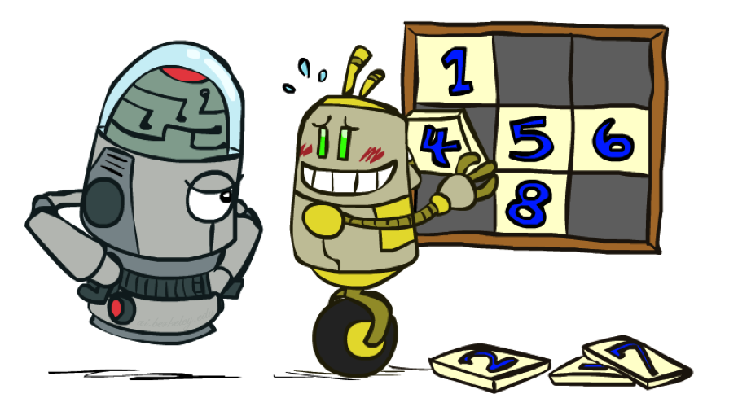
8 Puzzle I
Heuristic: Number of tiles misplaced
Why is it admissible?
h(start) =
This is a relaxed-problem heuristic
8
Start State
Goal State
 | Average nodes expanded when the optimal path has…
 | …4 steps | …8 steps | …12 steps
UCS | 112 | 6,300 | 3.6 x 10⁶
TILES | 13 | 39 | 227
Statistics from Andrew Moore

Slide 48
8 Puzzle II
What if we had an easier 8-puzzle where any tile could slide any direction at any time, ignoring other tiles?
Total Manhattan distance
Why is it admissible?
h(start) =
Start State
Goal State
 | Average nodes expanded when the optimal path has…
 | …4 steps | …8 steps | …12 steps
TILES | 13 | 39 | 227
MANHATTAN | 12 | 25 | 73
3 + 1 + 2 + … = 18

Slide 49
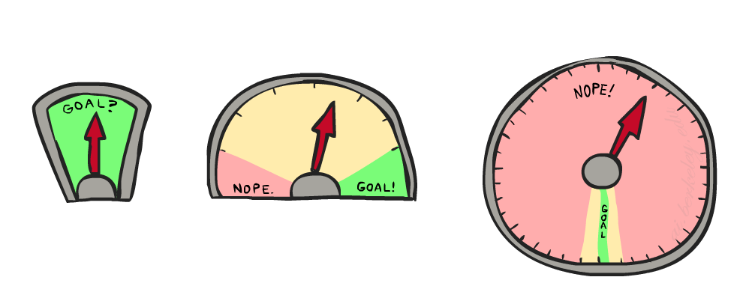
8 Puzzle III
How about using the actual cost as a heuristic?
  Would it be admissible?
  Would we save on nodes expanded?
  What’s wrong with it?
With A*: a trade-off between quality of estimate and work per node
  As heuristics get closer to the true cost, you will expand fewer nodes but usually do more work per node to compute the heuristic itself

Slide 50
Semi-Lattice of Heuristics

Slide 51







Trivial Heuristics, Dominance
Dominance: h_{a} ≥ h_{c} if
Heuristics form a semi-lattice:
  Max of admissible heuristics is admissible
Trivial heuristics
  Bottom of lattice is the zero heuristic (what does this give us?)
  Top of lattice is the exact heuristic
Notes:
Semi-lattice: x <= y <-> x = x ^ y

Slide 52
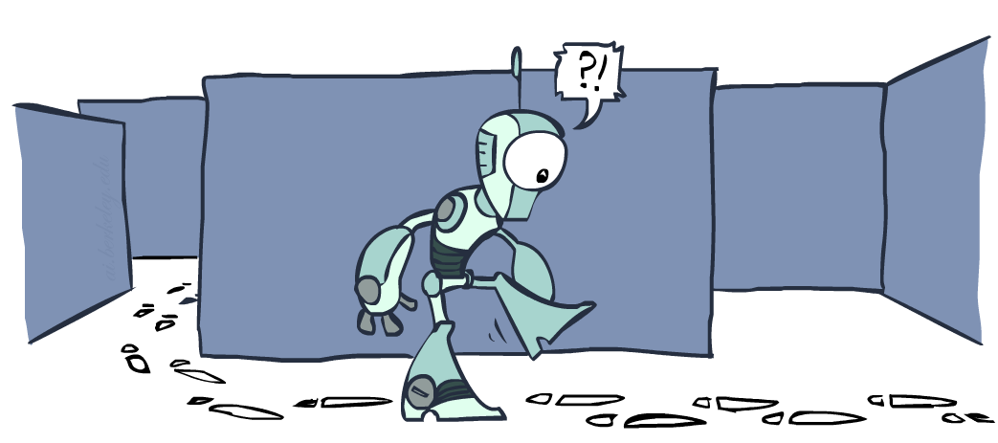
Graph Search

Slide 53
Tree Search: Extra Work!
Failure to detect repeated states can cause exponentially more work.
State Graph
Search Tree

Slide 54
Graph Search
In BFS, for example, we shouldn’t bother expanding the circled nodes (why?)
S
d
e
p
b
c
e
h
r
q
a
a
h
r
p
q
f
p
q
f
q
c
G
q
c
G
a
a

Slide 55
Graph Search
Idea: never expand a state twice
How to implement:
  Tree search + set of expanded states (“closed set”)
  Expand the search tree node-by-node, but…
  Before expanding a node, check to make sure its state has never been expanded before
  If not new, skip it, if new add to closed set
Important: store the closed set as a set, not a list
Can graph search wreck completeness? Why/why not?
How about optimality?

Slide 56
A* Graph Search Gone Wrong?
State space graph
Search tree
A
S (0+2)
1
S
1
C
h=4
A (1+4)
B (1+1)
h=1
h=2
1
2
C (2+1)
C (3+1)
B
3
G (5+0)
G (6+0)
h=1
G
h=0
Closed Set:
S
B
C
A
Notes:
Need heuristic. This is specification of our abstract problem.
Refuse to expand. Only thing left on fringe is bad G.
Admissible, but not optimal.
If we weren’t doing graph, good G would have appeared, won over bad G.
C used up at the wrong time,

Slide 57
Consistency of Heuristics
Main idea: estimated heuristic costs ≤ actual costs
  Admissibility: heuristic cost ≤ actual cost to goal
  h(A) ≤ actual cost from A to G
  Consistency: heuristic “arc” cost ≤ actual cost for each arc
  h(A) – h(C) ≤ cost(A to C)
Consequences of consistency:
  The f value along a path never decreases
  h(A) ≤ cost(A to C) + h(C)
  A* graph search is optimal
A
1
C
h=4
h=1
h=2
3
G

Slide 58
Optimality of A* Graph Search

Slide 59
Optimality
Tree search:
  A* is optimal if heuristic is admissible
  UCS is a special case (h = 0)
Graph search:
  A* optimal if heuristic is consistent
  UCS optimal (h = 0 is consistent)
Consistency implies admissibility
In general, most natural admissible heuristics tend to be consistent, especially if from relaxed problems

Slide 60

A*: Summary

Slide 61

A*: Summary
A* uses both backward costs and (estimates of) forward costs
A* is optimal with admissible / consistent heuristics
Heuristic design is key: often use relaxed problems

Slide 62
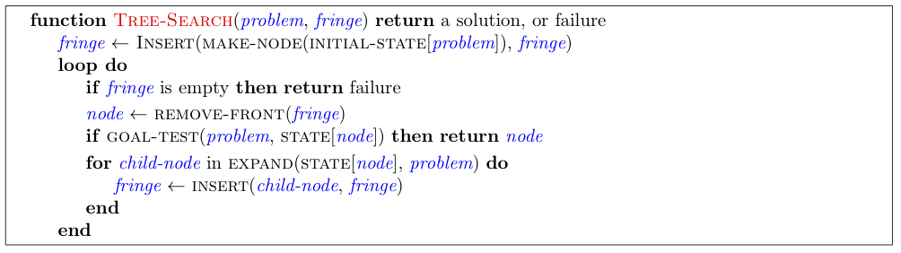
Tree Search Pseudo-Code

Slide 63
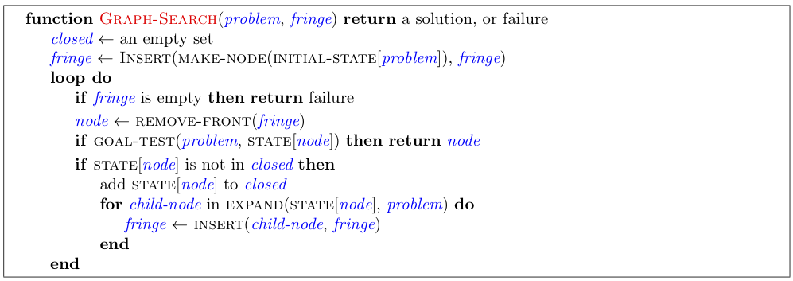
Graph Search Pseudo-Code

