Slide 1
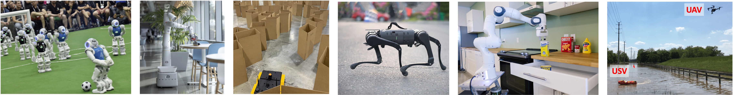
CS 685 Autonomous Robotics
Motion Planning III
Prof. Xuesu Xiao
George Mason University
Slides Credits: Gregory Stein

Slide 2
Balancing UCS and Greedy Search
UCS is optimal, but doesn’t reach the goal as quickly as we’d like
Greedy Search is neither optimal nor complete, but does move in the direction of the goal in a way we’d like to take advantage of (somehow)
How do we get the best of both?

Slide 3
Balancing UCS and Greedy Search:
A Search
UCS is optimal, but doesn’t reach the goal as quickly as we’d like
Greedy Search is neither optimal nor complete, but does move in the direction of the goal in a way we’d like to take advantage of (somehow)
How do we get the best of both?
A Search: combining the cost of the path so far with a heuristic estimate of how far we have left to travel—this is the sum of the path cost from UCS and the heuristic from Greedy Search

Slide 4
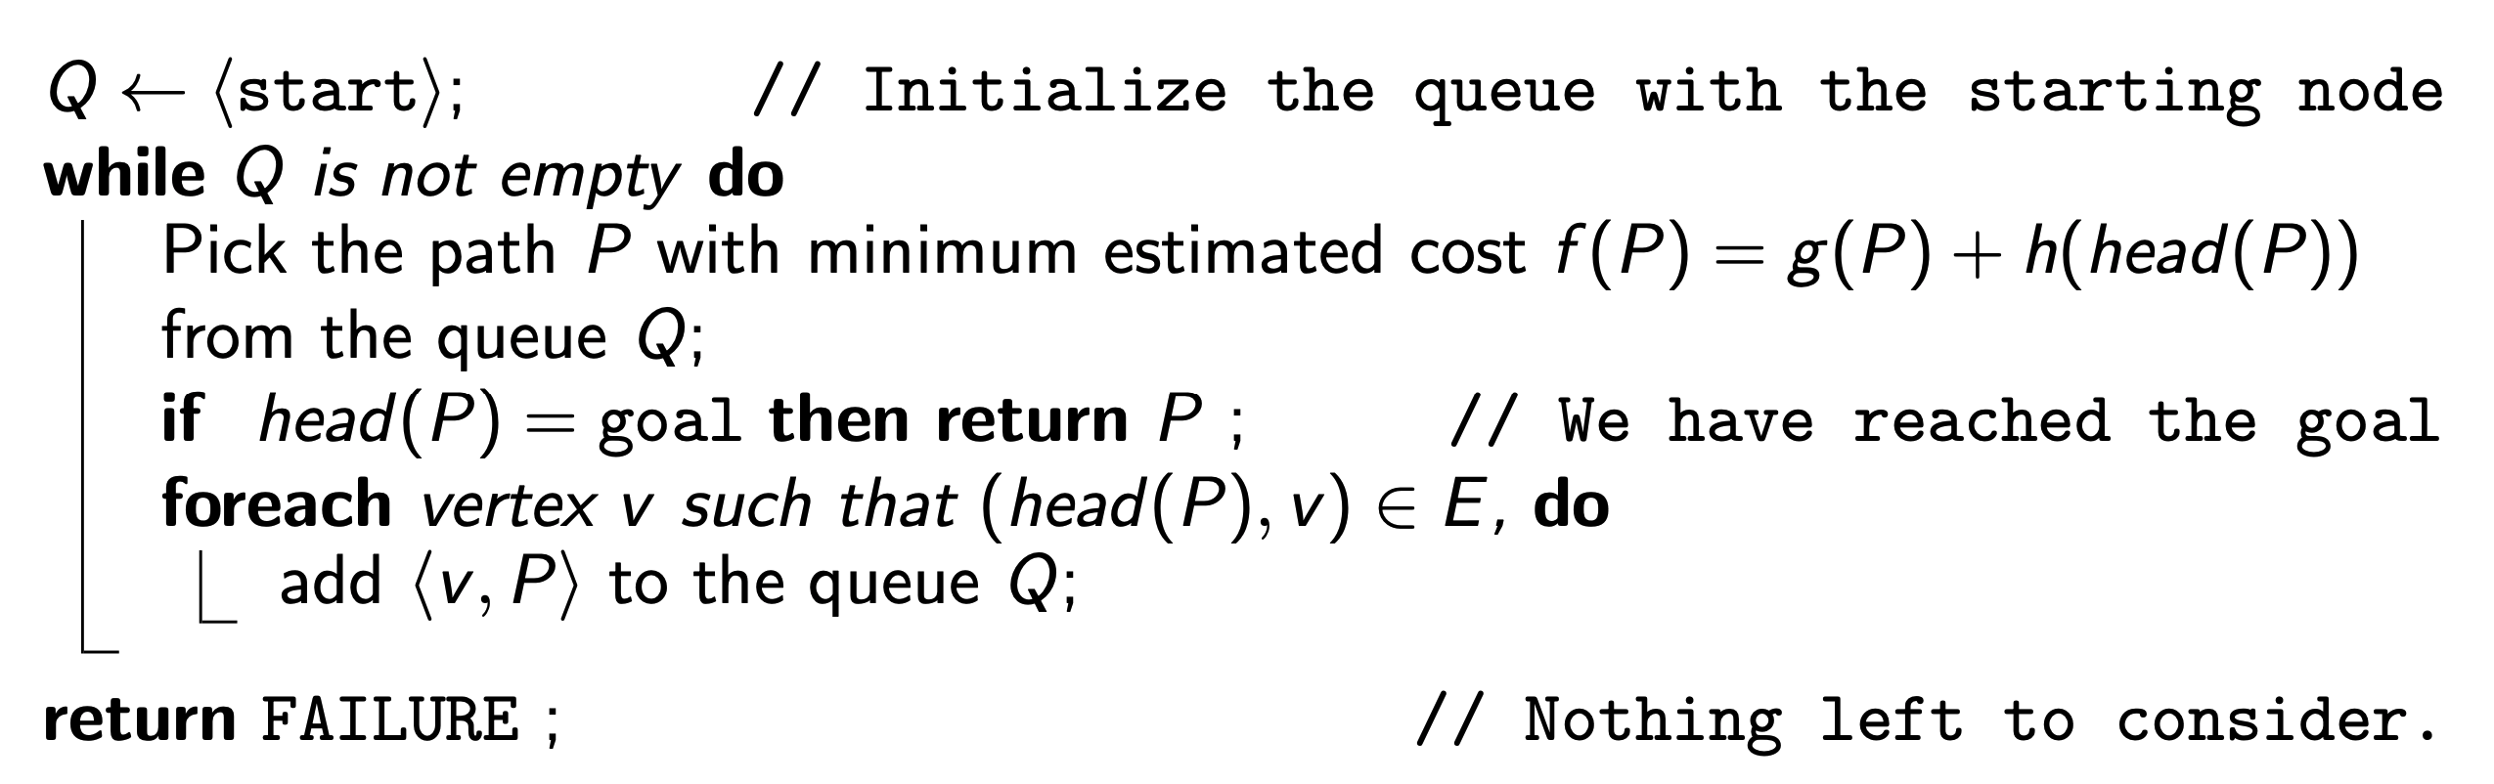
Balancing UCS and Greedy Search:
A Search
UCS is optimal, but doesn’t reach the goal as quickly as we’d like
Greedy Search is neither optimal nor complete, but does move in the direction of the goal in a way we’d like to take advantage of (somehow)
How do we get the best of both?
A Search: combining the cost of the path so far with a heuristic estimate of how far we have left to travel—this is the sum of the path cost from UCS and the heuristic from Greedy Search
From: MIT 16.410

Slide 5
A Search: an example
From: MIT 16.410

Slide 6
A Search: an example
From: MIT 16.410

Slide 7
A Search: an example
From: MIT 16.410

Slide 8
A Search: an example
From: MIT 16.410

Slide 9
A Search: an example
From: MIT 16.410

Slide 10
A Search: some properties
A search is really a “biased” version of UCS.
If the heuristic is zero everywhere, then A == UCS
A search is complete always, but in our example it’s not optimal… What’s gone wrong?
From: MIT 16.410

Slide 11
A* Search
Some heuristics guarantee that the solution will be optimal—such heuristics are called admissible heuristics.
A heuristic must underestimate the cost to reach the goal to be admissible. That’s it!
Question: is h(v) = 0 an admissible heuristic?

Slide 12
A* Search
Some heuristics guarantee that the solution will be optimal—such heuristics are called admissible heuristics.
A heuristic must underestimate the cost to reach the goal to be admissible. That’s it!
Question: is h(v) = 0 an admissible heuristic?
Yes! (This should be unsurprising, since we know that in this case, A* == UCS and UCS is optimal.)

Slide 13
A* Search & Admissible Heuristics
Admissible heuristic: must underestimate the distance to the goal.
Clearly this heuristic function was not admissible. For which nodes is the heuristic an overestimate of distance to the goal?
From: MIT 16.410

Slide 14
A* Search & Admissible Heuristics
Admissible heuristic: must underestimate the distance to the goal.
Clearly this heuristic function was not admissible. For which nodes is the heuristic an overestimate of distance to the goal?
Let’s fix these and go again.
From: MIT 16.410

Slide 15
A* Search: an example
(w/ admissible heuristic)
From: MIT 16.410

Slide 16
A* Search: an example
(w/ admissible heuristic)
From: MIT 16.410

Slide 17
A* Search: an example
(w/ admissible heuristic)
From: MIT 16.410

Slide 18
A* Search: an example
(w/ admissible heuristic)
From: MIT 16.410

Slide 19
A* Search: an example
(w/ admissible heuristic)
From: MIT 16.410

Slide 20
Is A* guaranteed to be optimal?
Some intuition
If we overestimate the distance to the goal: the optimal distance is “pushed down” the queue and we may not discover this error before termination (this is what happened earlier).
If we underestimate the distance to the goal: a sub-optimal path appears too early, but we recover from it eventually as we add more elements to the path (replacing the heuristic)
From: MIT 16.410

Slide 21
Where do admissible heuristics come from?
The best admissible heuristic returns the actual cost to go (the distance from the goal), but that’s the thing we’re trying to find!
Domain-specific knowledge is important:
h(v) = 0 : This always works, but not very useful
h(v) = distance(v, g) : If you are in an environment where the distance between nodes is at least Euclidian distance (e.g., if they are physical locations), then this works great. Very common choice for navigation.
h(v) = ∥v − g∥_{p} : (more general) When the vertices correspond to points in a normed vector space.

Slide 22
Where do admissible heuristics come from?
The best admissible heuristic returns the actual cost to go (the distance from the goal), but that’s the thing we’re trying to find!
Often, a “relaxation” of the problem is a good way to generate a heuristic: you remove a constraint of some kind.
In the case of navigation, removing the obstacles is a type of relaxation, which is why “Euclidian distance to the goal” is a good (admissible) heuristic.

Slide 23
A* Search (as we’ve defined it) is still slow in some cases: we want our visited list back!
We can still remember something. But what?
The basic idea: shortest paths are extensions of shortest sub-paths. [Proof by contradiction: if a shortest path contained a non-shortest sub-path, we could make it shorter by replacing that sub-path with the shorter one.]
Whenever we expand a path, we know that it’s the shortest sub-path. Athe heuristic is admissible, the node being expanded will never have a shorter sub-path to it.
Instead of keeping track of the nodes we’ve visited, we instead keep track of nodes we’ve expanded.

Slide 24
A* Search (as we’ve defined it) is still slow in some cases: we want our visited list back!
We can still remember something. But what?
The basic idea: shortest paths are extensions of shortest sub-paths. [Proof by contradiction: if a shortest path contained a non-shortest sub-path, we could make it shorter by replacing that sub-path with the shorter one.]
Whenever we expand a path, we know that it’s the shortest sub-path. As long as the heuristic is admissible, the node being expanded will never have a shorter sub-path to it.
Instead of keeping track of the nodes we’ve visited, we instead keep track of nodes we’ve expanded.

Slide 25
A* Search + Dynamic Programming:
Keeping track of expanded nodes
We can still remember something. But what?
The basic idea: shortest paths are extensions of shortest sub-paths. [Proof by contradiction: if a shortest path contained a non-shortest sub-path, we could make it shorter by replacing that sub-path with the shorter one.]
Whenever we expand a path, we know that it’s the shortest sub-path. As long as the heuristic is admissible, the node being expanded will never have a shorter sub-path to it.
Instead of keeping track of the nodes we’ve visited, we instead keep track of nodes we’ve expanded.

Slide 26
A* Search
Here’s the old version:
Q <- <start>
while Q is not empty:
Pick path P with minimum estimated cost
f(P) = g(P) + h(head(P)) from the queue Q
if head(P) == goal: return P
else: remove P from Q
foreach neighbor of head(P):
add <v, P> to the queue Q;
return FAILURE;

Slide 27
A* Search + Dynamic Programming: remembering places we’ve visited “sooner”
Here’s the new version:
Q <- <start>; expanded = {}
while Q is not empty:
Pick path P with minimum estimated cost
f(P) = g(P) + h(head(P)) from the queue Q
if head(P) == goal: return P
else: remove P from Q
if head(P) in expanded: continue // pick next path
else: expanded.add(head(P));
foreach neighbor of head(P) not in expanded:
add <v, P> to the queue Q;
return FAILURE;

Slide 28
Motion Planning
Vehicle Dynamics &
Sample-Based Planning

Slide 29
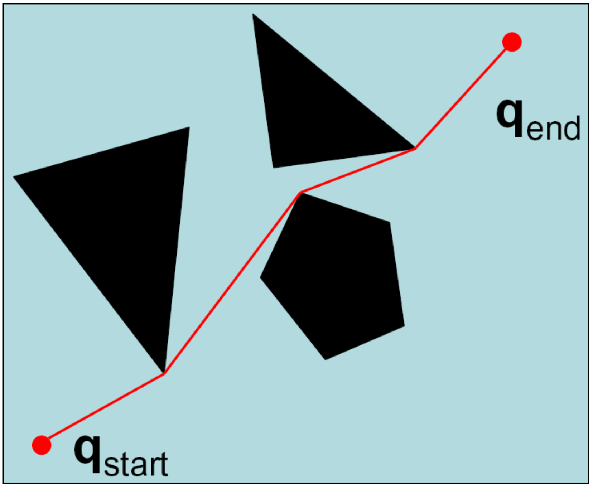
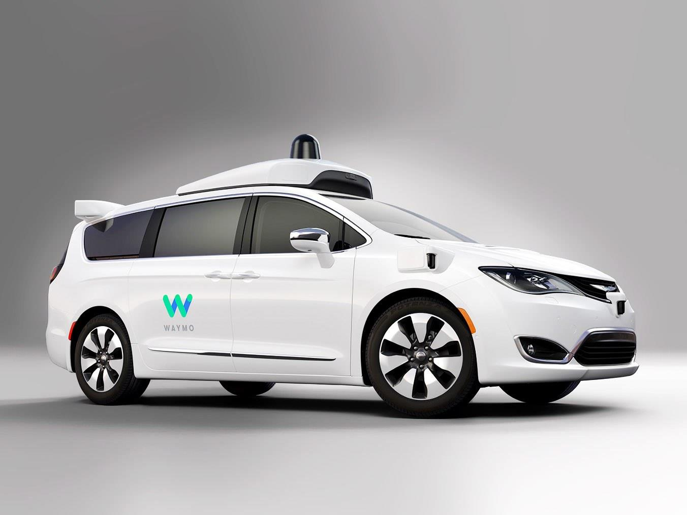
Motivation: There are some limitations of our planning abstractions or representations thus far
Let’s start with planning via a visibility graph.
If I’m a self-driving car, can I follow this path?

Slide 30
Motivation: There are some limitations of our planning abstractions or representations thus far
Let’s start with planning via a visibility graph.
If I’m a self-driving car, can I follow this path?
No! Why not?

Slide 31
Motivation: There are some limitations of our planning abstractions or representations thus far
Let’s start with planning via a visibility graph.
If I’m a self-driving car, can I follow this path?
No! Why not?
Size: The vehicle cannot get infinitesimally close to objects.
Dynamics: The vehicle has a finite turning radius.

Slide 32
Next, we’ll talk about the impact that vehicle dynamics have and how to plan in these high-dimensional spaces.

Slide 33
Reading & Slide Credits
Readings:
Slide Credits (from which many of the reference images have been taken or adapted):
Andrea Censi "Duckietown" Tutorial Resource
Howie Choset — CMU 16-735 Configuration Space
P. Abbeel Berkeley CS287
Howie Choset — 16.735 Sample-based planning

Slide 34
What’s Motion Planning?
Inputs:
Start Pose
Goal Pose
Environment (with obstacles)
Robot/Vehicle/Agent kinematics and dynamics
Output:
Obstacle-free path from the start to the goal
Sounds simple…?

Slide 35
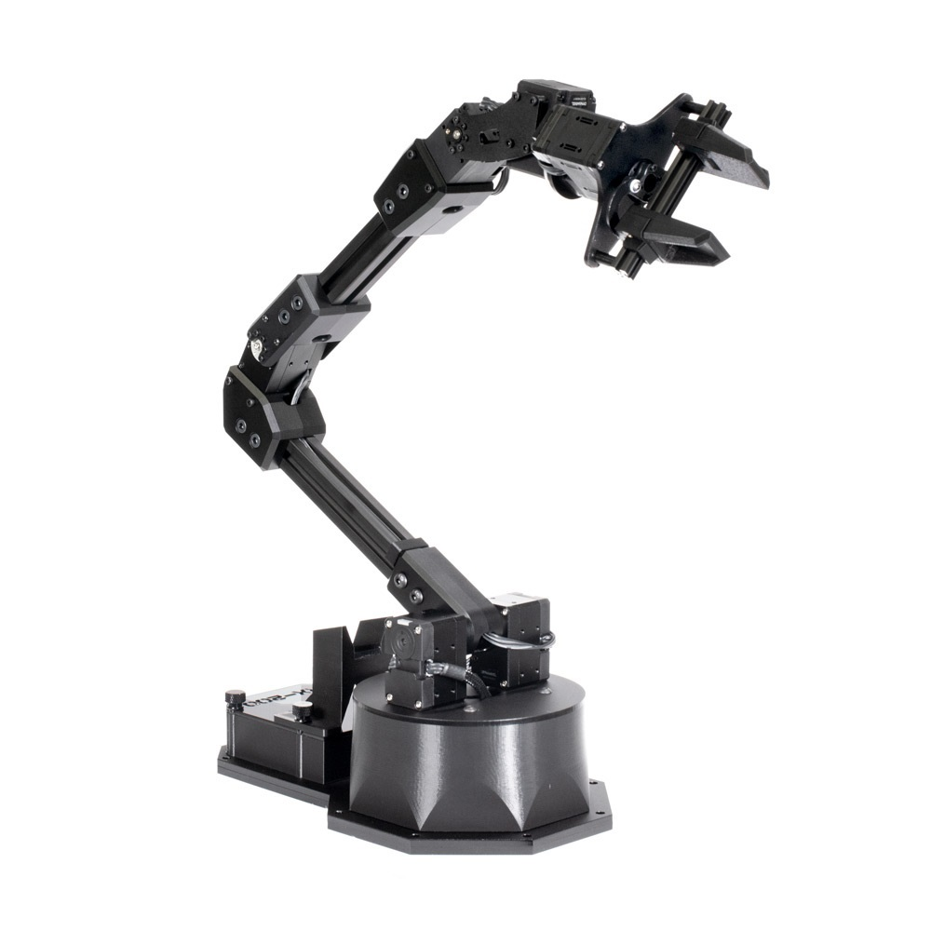
…but first, a discussion of representation
Not all robots have the same size or configurations, so how can we apply the same algorithms if the robots are different?
How can we include size and configuration?
Constraints on an optimization objective? The dynamics and size will limit the types of solutions we can propose.
Transform the problem in a way that it won’t matter

Slide 36
Configuration Space
Handling objects with finite size and different “configurations”
[Many slides and visuals from Howie Choset here.]

Slide 37
If our robot isn’t a point, how do we represent it?

Slide 48
The robot has finite size that we have to think about when navigating.

Slide 49
We can “inflate” objects and “shrink” the size of a robot to a point:

Slide 64
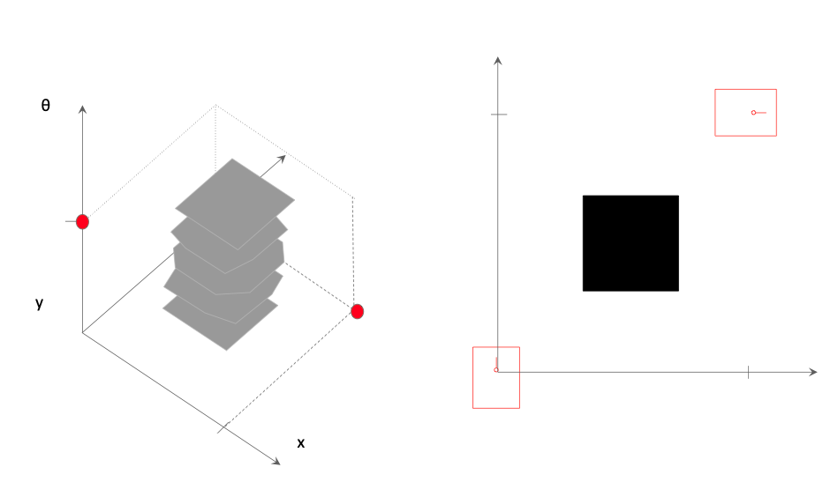
In configuration space, we can plan using a visibility-graph-like approach:

Slide 65
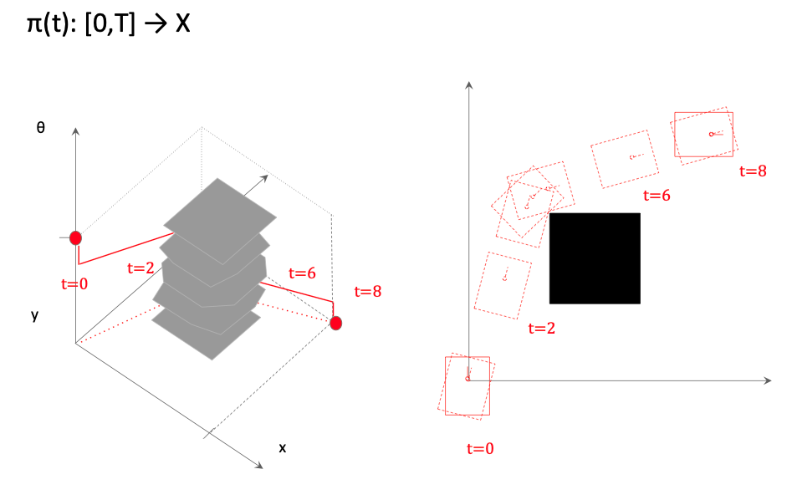
In configuration space, we can plan using a visibility-graph-like approach:

Slide 66
In configuration space, we can plan using a visibility-graph-like approach:

Slide 67
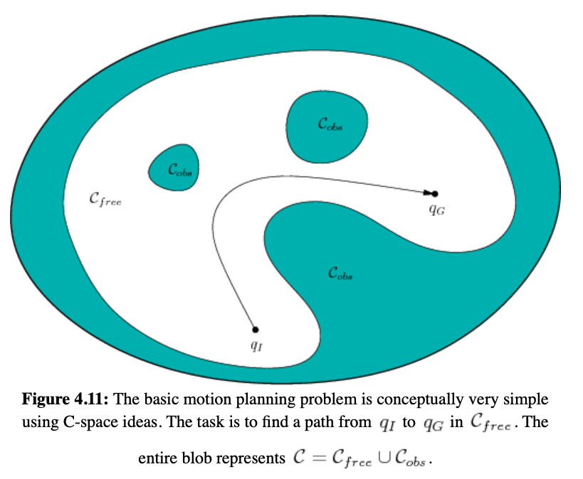
The simplest version of this problem is sometimes called the “Piano Mover’s Problem”
Task: I want to move a Piano through a cluttered home
In general, must be solved in continuous time and space (no discretization) to be optimal. The plan is therefore also continuous.
Source: Lavalle Planning Algorithms

Slide 69
Reminder: some properties of planning algorithms
Completeness: An algorithm is complete if it is guaranteed to find a feasible plan if one exists.
Optimality: That the plan found by the algorithm is guaranteed to be the best (optimal) one.

Slide 70
Reminder: some properties of planning algorithms
Completeness: An algorithm is complete if it is guaranteed to find a feasible plan if one exists.
Optimality: That the plan found by the algorithm is guaranteed to be the best (optimal) one.
Question: Is this new approach to planning in “C-space” complete? Optimal?

Slide 71
Reminder: some properties of planning algorithms
Completeness: An algorithm is complete if it is guaranteed to find a feasible plan if one exists.
Optimality: That the plan found by the algorithm is guaranteed to be the best (optimal) one.
Question: Is this new approach to planning in “C-space” complete? Optimal?
  Yes!

Slide 72
What’s still a problem? Why might we not be able to use this in general?
Computation: as mentioned, visibility graphs don’t generalize “easily” to higher dimensions, and building it can be incredibly expensive. C-space is NP-hard in general

Slide 73
What’s still a problem? Why might we not be able to use this in general?
Computation: as mentioned, visibility graphs don’t generalize “easily” to higher dimensions, and building it can be incredibly expensive. C-space is NP-hard in general
Dynamics! Let’s look at an example:
You’re in a car and you need to move from one parking space to the next one. How do you do it?

Slide 74
What’s still a problem? Why might we not be able to use this in general?
Computation: as mentioned, visibility graphs don’t generalize “easily” to higher dimensions, and building it can be incredibly expensive. C-space is NP-hard in general
Dynamics! Let’s look at an example:
You’re in a car and you need to move from one parking space to the next one. How do you do it?
You can’t simply move along the x-direction.
The car is limited in how it can move through C-space.

Slide 75
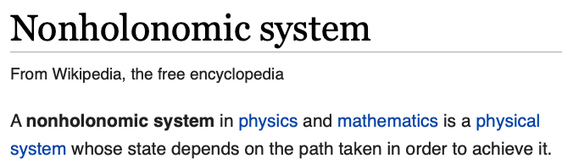
Also: Nonholonomic Dynamics

Slide 76
Motion Planning under Differential Constraints
This is an extension of the “Piano Mover’s Problem” with added differential constraints on the movement of the agent and the actions it can take.
You can’t simply move along the x-direction.
The car is limited in how it can move through C-space.

Slide 77
Two-point boundary value problems [BVPs]
(another name for this idea)
Task: travel from a start region to a goal region while (1) satisfying differential constraints and (2) avoiding obstacles.
Remember: the start and goal are in C-space; may include orientation.
We’ll mostly think of these “BVPs” as obstacle-free planning problems, for reasons that will become clear later today.

