Slide 1
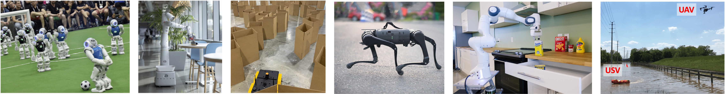
CS 685 Autonomous Robotics
Robot Vision I
Prof. Xuesu Xiao
George Mason University
Slides Credits: Gregory Stein

Slide 2
Cameras and
Two-View Geometry

Slide 3
Motivation: robots need to see the world
Cameras are how we detect the 3D world, but images are 2D.
If we’re to understand the 3D world from images, we need to understand how a camera turns a 3D world into a 2D image so that we can invert the process.

Slide 4
Camera Models

Slide 5
Reading & Slide Credits
Slide Credits (from which most of these slides are either directly taken or adapted)
Cornell Tech Computer Vision Course (Noah Snavely)
CMU Computer Vision Course

Slide 6
Any camera starts with a sensor
CCD Sensor
(or similar)

Slide 7

Any camera starts with a sensor
The World
CCD Sensor
(or similar)

Slide 8
Any camera starts with a sensor
Light rays come from the world and are recorded on the sensor.
The World
CCD Sensor
(or similar)

Slide 9
Bare-sensor imaging: where the sensor collects all light rays with no aperture
What will this image look like?
The World
CCD Sensor
(or similar)

Slide 10
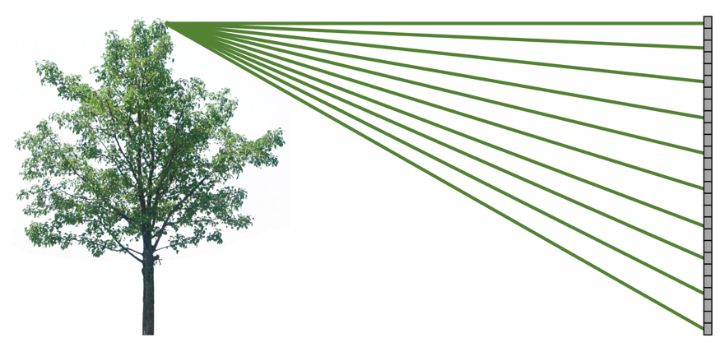
Bare-sensor imaging: where the sensor collects all light rays with no aperture
The World
CCD Sensor
(or similar)

Slide 11
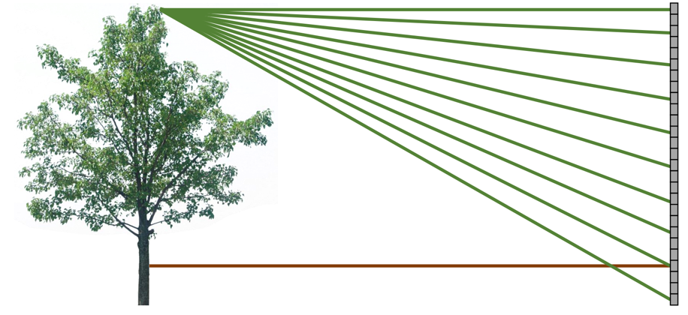
Bare-sensor imaging: where the sensor collects all light rays with no aperture
All scene points contribute.
The World
CCD Sensor
(or similar)

Slide 12
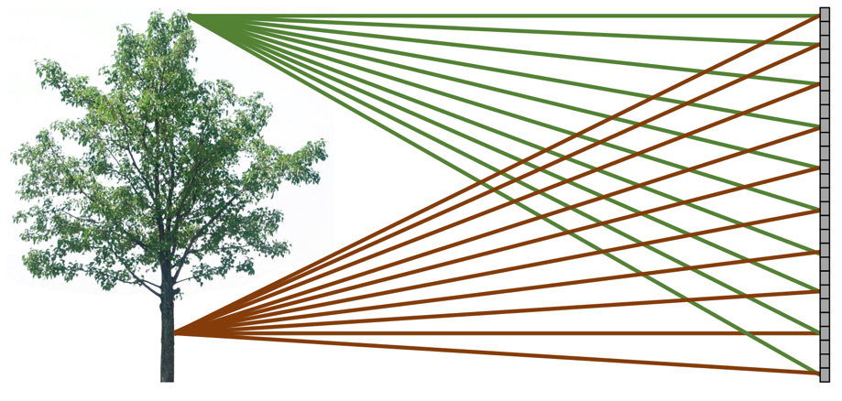
Bare-sensor imaging: where the sensor collects all light rays with no aperture
All scene points contribute.
The World
What will this image look like?
CCD Sensor
(or similar)

Slide 13

Bare-sensor imaging: where the sensor collects all light rays with no aperture
All scene points contribute.
The image is rather blurry

Slide 14
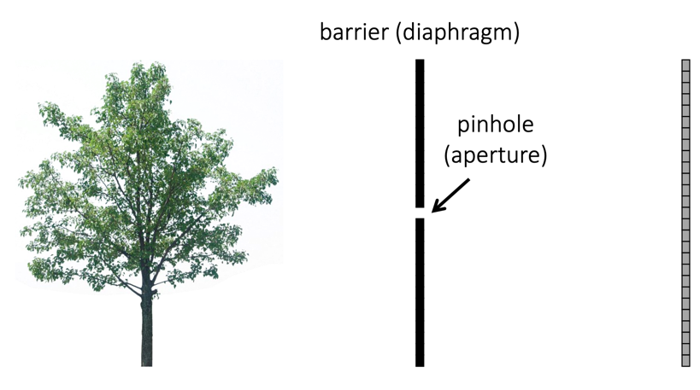
What happens if we block some of the light rays?

Slide 15
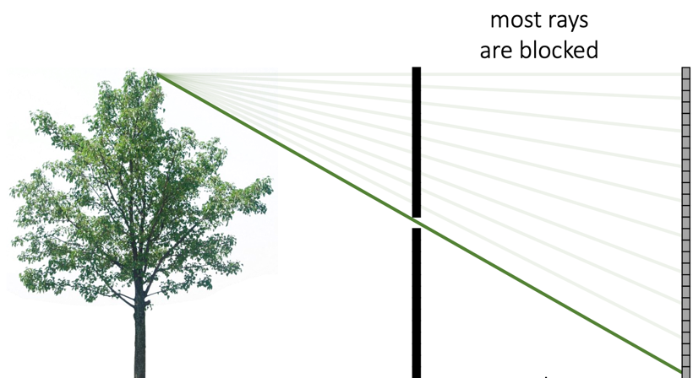
What happens if we block some of the light rays?

Slide 16
Pinhole Imaging

Slide 17
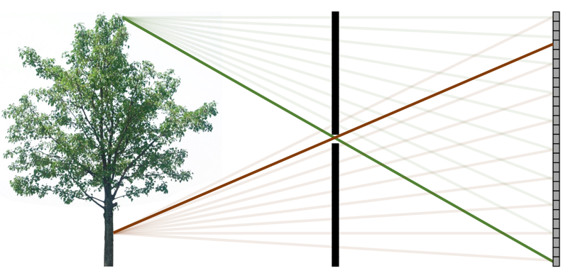
Pinhole Imaging
Each scene point only (approximately) contributes to one pixel.
What will this image look like?

Slide 18
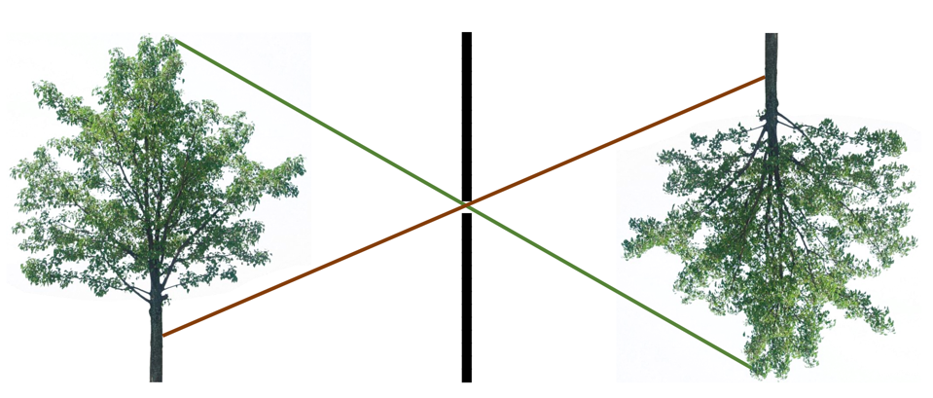
Pinhole Imaging
The pinhole camera results in a copy (one that is inverted and scaled) of the input scene.

Slide 19
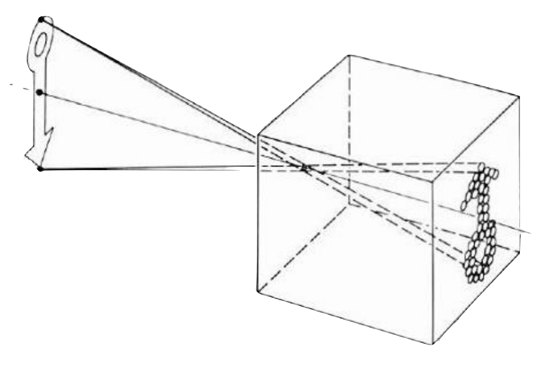
Pinhole camera a.k.a. camera obscura

Slide 20
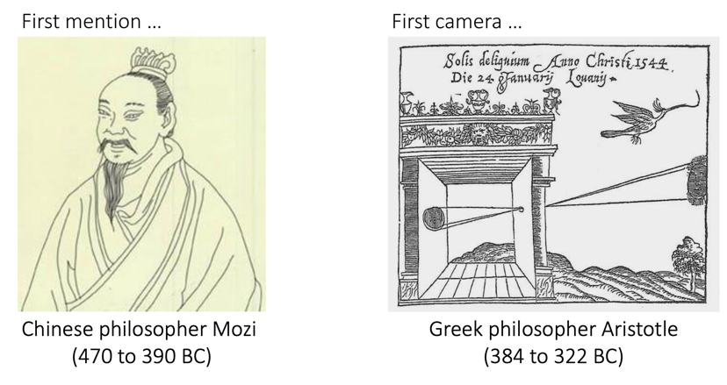
Pinhole camera a.k.a. camera obscura

Slide 21
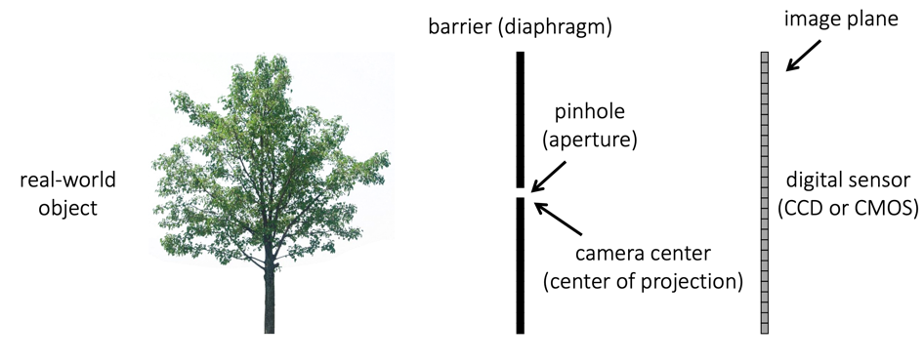
Pinhole camera definitions

Slide 22
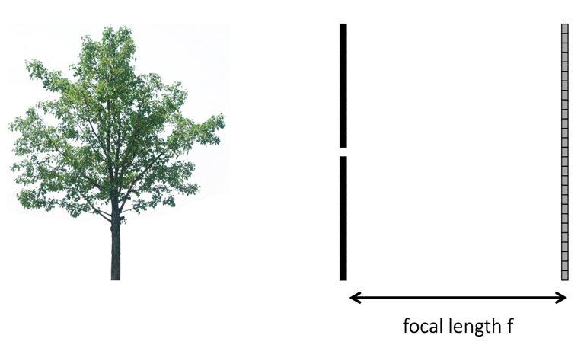
Focal Length

Slide 23
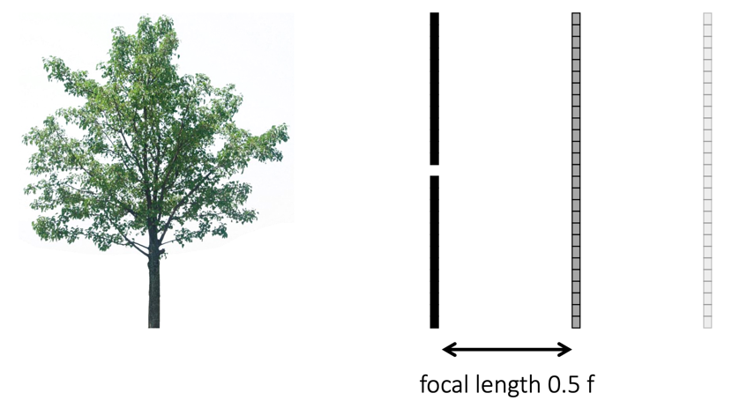
Focal Length
What happens when we change the focal length?

Slide 24
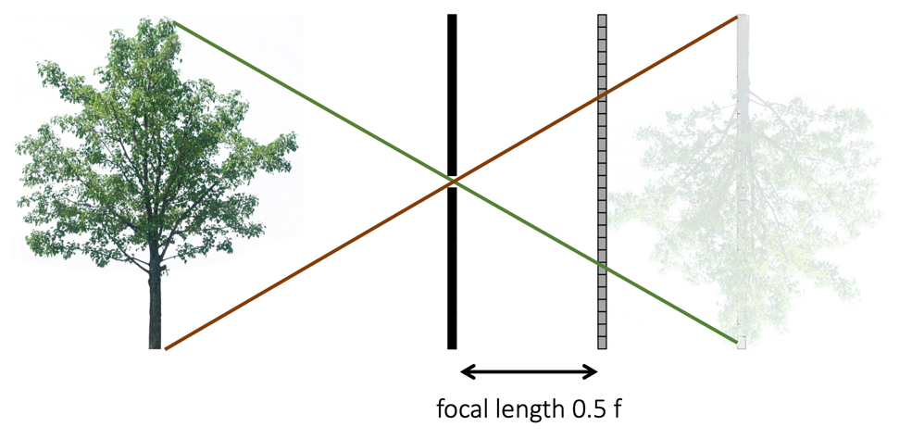
Focal Length
What happens when we change the focal length?

Slide 25
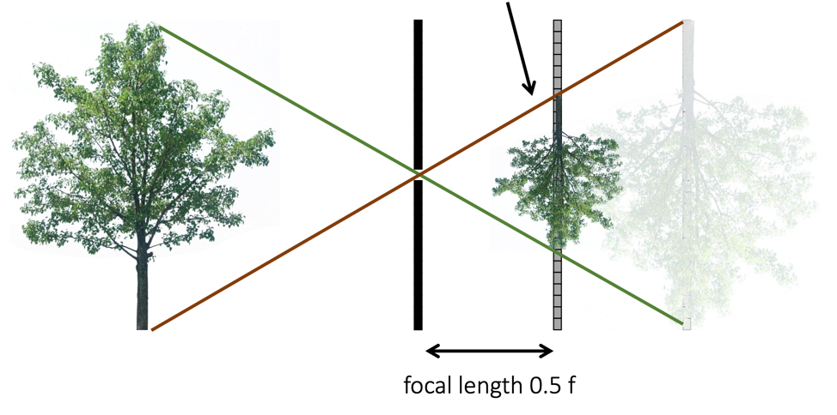
Focal Length
What happens when we change the focal length?
The object is half the size

Slide 26
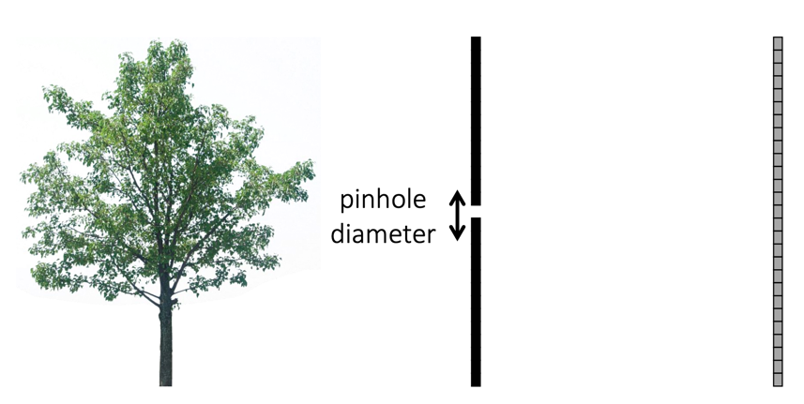
Pinhole Diameter
What happens when we change the pinhole diameter?
(Ideally, it’s infinitesimally small, but that’s not really possible)

Slide 27
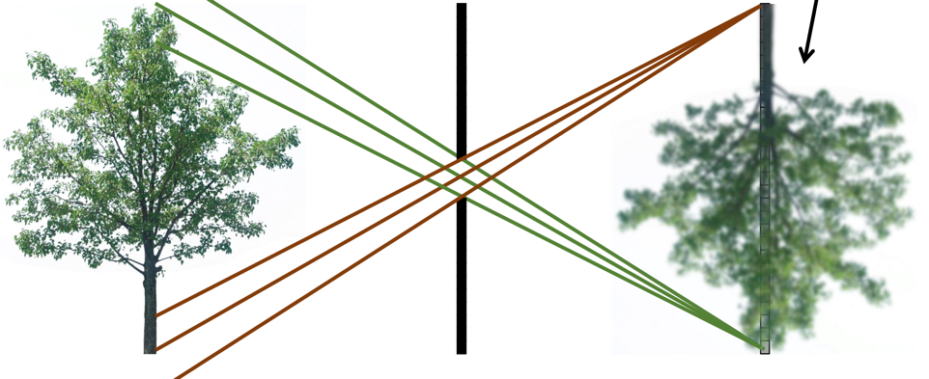
Pinhole Diameter
What happens when we change the pinhole diameter?
Bigger Pinhole => blurrier projected object / image

Slide 28

Pinhole Diameter
What happens when we change the pinhole diameter?
Bigger Pinhole => blurrier projected object / image
If the pinhole is infinitely large, this becomes bare sensor imaging again

Slide 29
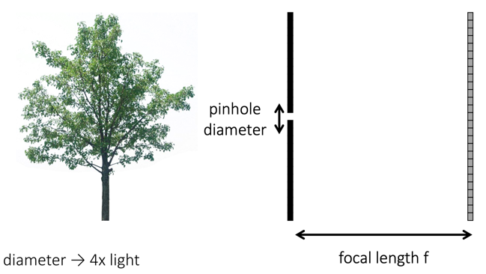
Pinhole Diameter
What about light efficiency?

Slide 30
Pinhole Diameter
What about light efficiency?
2x pinhole diameter => 4x light
2x focal length => ¼x light

Slide 31
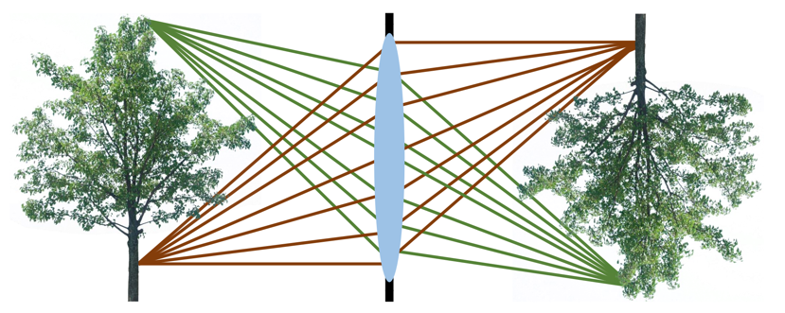
A lens redirects incident rays, allowing us to collect more light

Slide 32
A lens redirects incident rays, allowing us to collect more light
How does the lens map incident rays to the sensor?

Slide 33
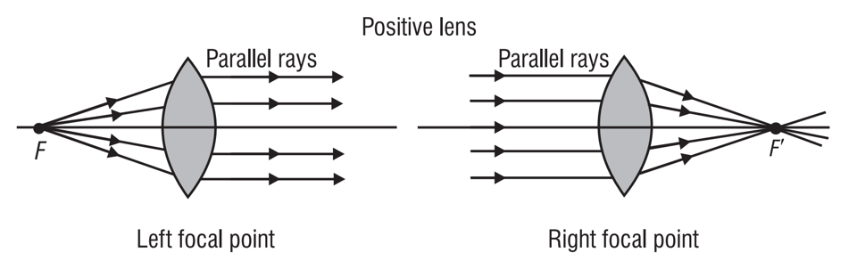
An ideal lens is defined by its focal distance
An ideal lens maps parallel rays such that they point towards the “focus”.
Basic Geometric Optics, Pedrotti

Slide 34
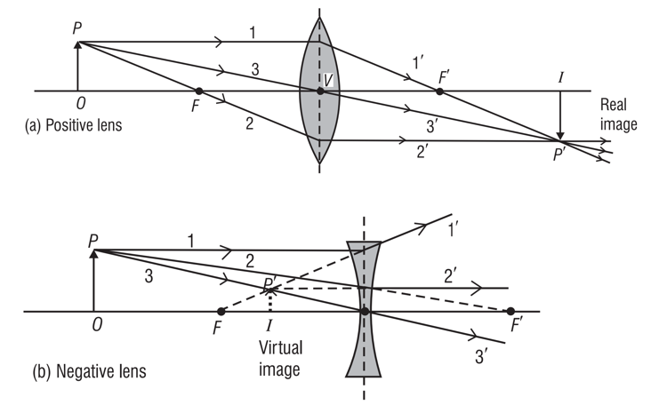
We can figure out how far an image will be made by tracing rays through the foci
Basic Geometric Optics, Pedrotti

Slide 35
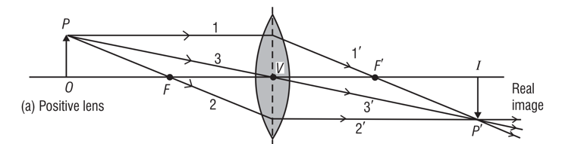
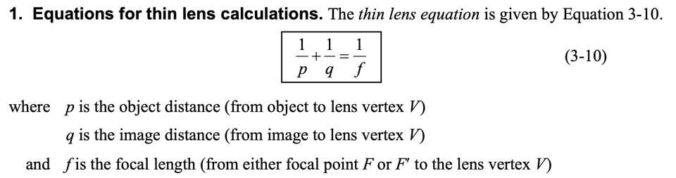
We can figure out how far an image will be made by tracing rays through the foci
Basic Geometric Optics, Pedrotti

Slide 36
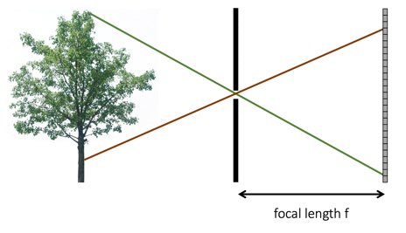
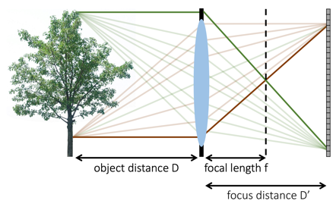
The definition of “focal length” differs between the pinhole and lens cameras
It is more specific to refer to the “aperture sensor distance” rather than ”focal length”

Slide 37
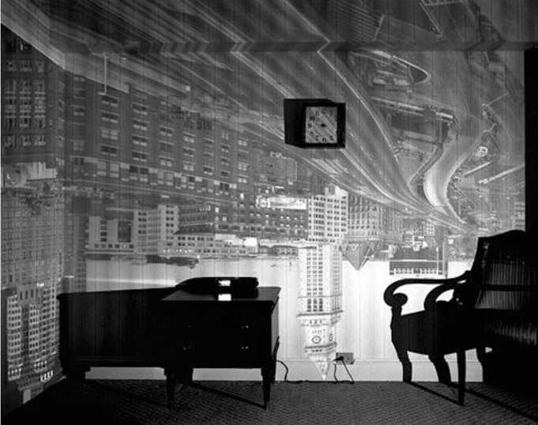
Accidental Pinholes

Slide 38
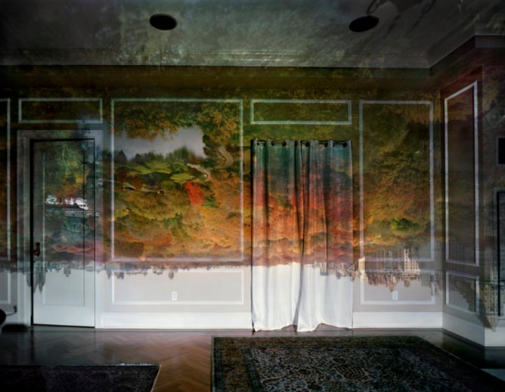
Accidental Pinholes

Slide 39
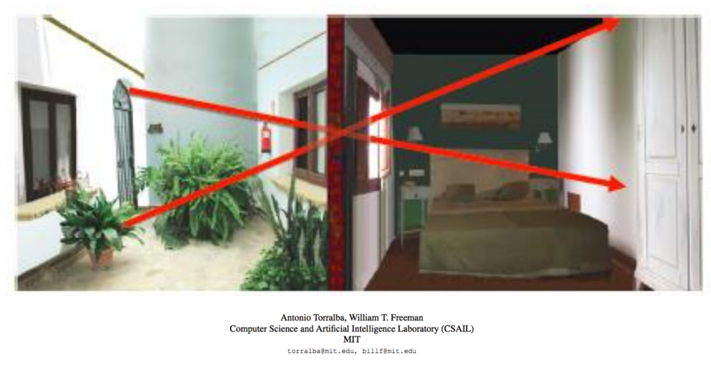
Accidental Pinholes

Slide 40
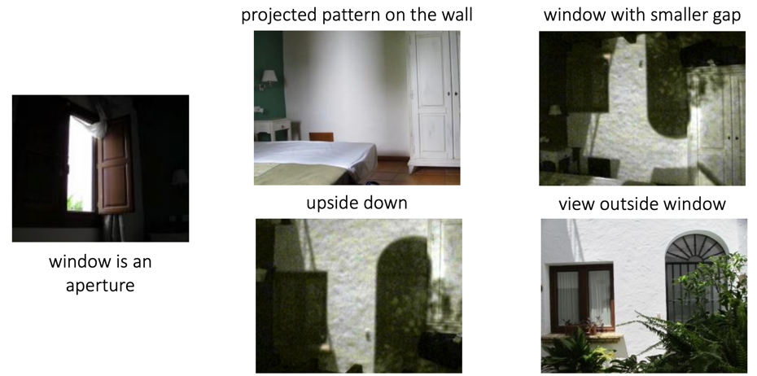
Accidental Pinholes

Slide 41
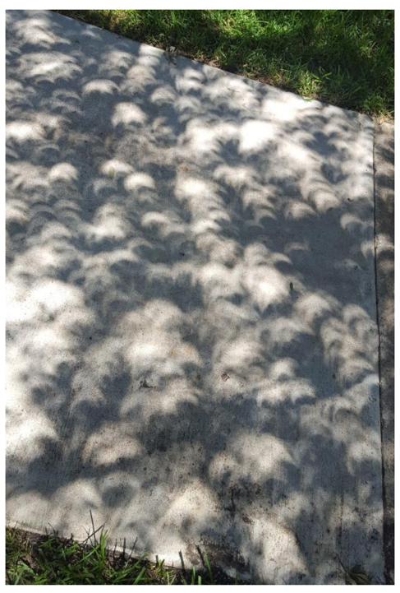
Accidental Pinholes
What’s going on here?

Slide 42
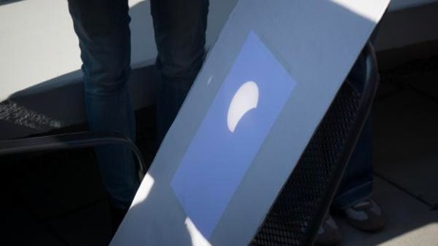
Pinhole Cameras for an Eclipse
https://www.timeanddate.com/eclipse/make-pinhole-projector.html

Slide 43
The Camera Matrix

Slide 44
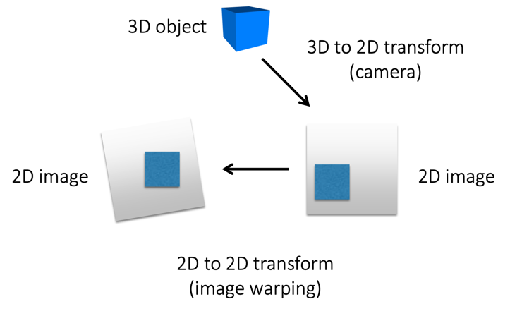
We can think of a camera as a type of coordinate transform
The camera maps the 3D world to a 2D image:

Slide 45
We can think of a camera as a type of coordinate transform
The camera maps the 3D world to a 2D image:

Slide 46
We can think of a camera as a type of coordinate transform
The camera maps the 3D world to a 2D image:
Camera
Matrix
World Point
Image Point

Slide 47
We can think of a camera as a type of coordinate transform
The camera maps the 3D world to a 2D image:
What are the dimensions of each of these terms?
(Hint: We need to use homogeneous coordinates to support translations.)
Camera
Matrix
World Point
Image Point

Slide 48
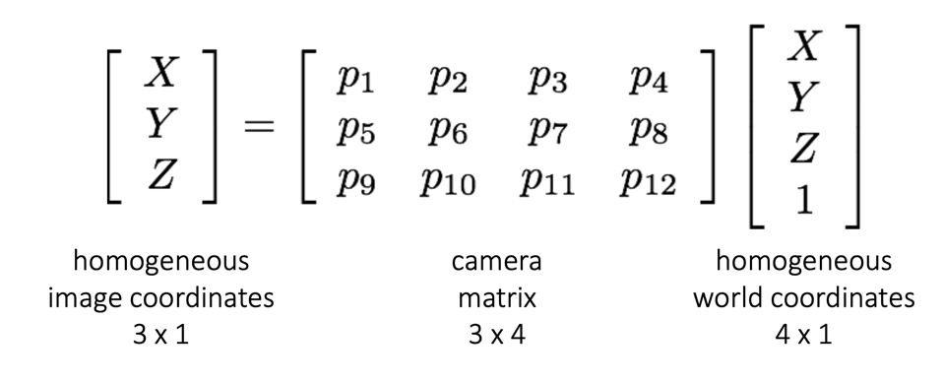
We can think of a camera as a type of coordinate transform
The camera maps the 3D world to a 2D image:

Slide 49
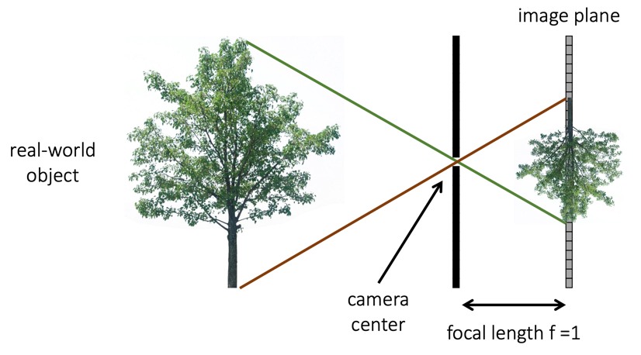
Let’s revisit the pinhole camera (f=1)

Slide 50
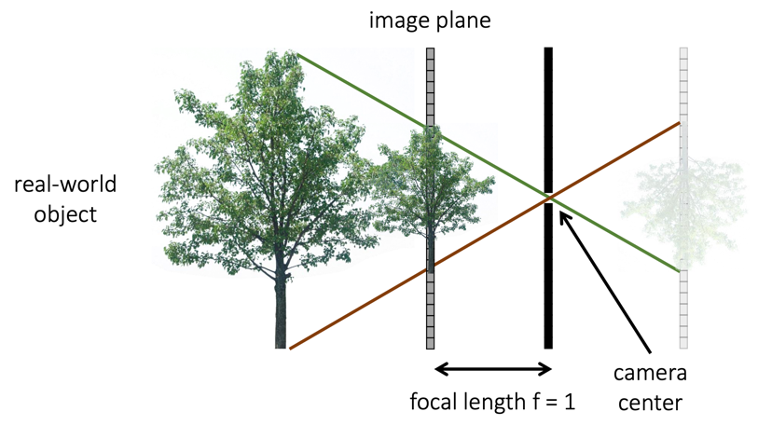
Let’s revisit the pinhole camera (f=1) and rearrange the scene

Slide 51
Let’s revisit the pinhole camera (f=1) and rearrange the scene
We can use this example to figure out what the camera matrix looks like.

Slide 52
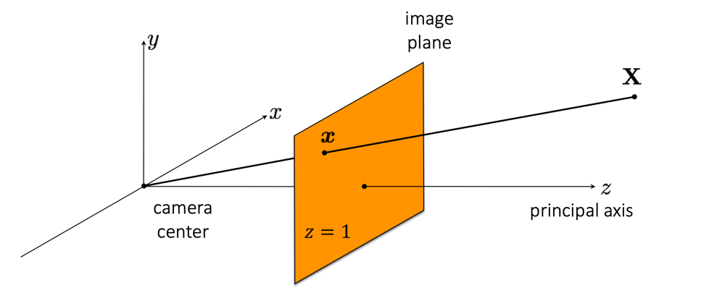
What is the equation for image coordinate x in terms of world coordinate X

Slide 53
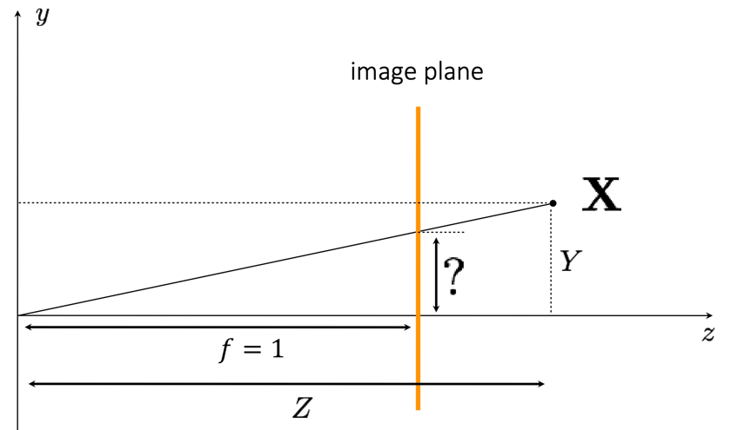
What is the equation for image coordinate x in terms of world coordinate X

Slide 54

What is the equation for image coordinate x in terms of world coordinate X

Slide 55
What is the equation for image coordinate x in terms of world coordinate X
So what does the camera matrix look like for this example?

Slide 56
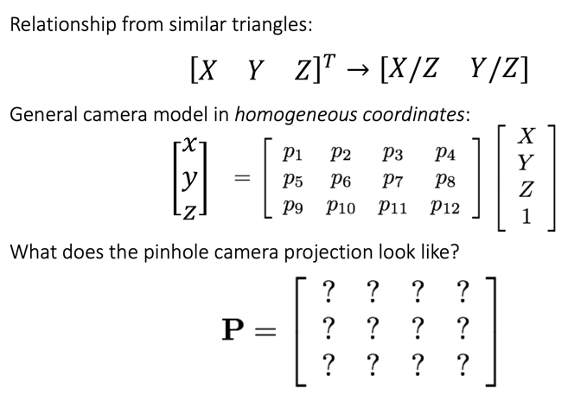
The Pinhole Camera Matrix (f=1)

Slide 57
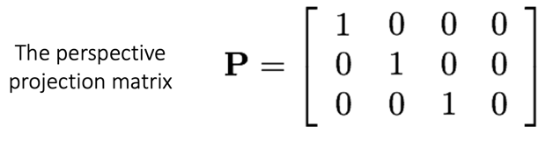
The Pinhole Camera Matrix (f=1)

Slide 58

The Pinhole Camera Matrix (f=1)

Slide 59
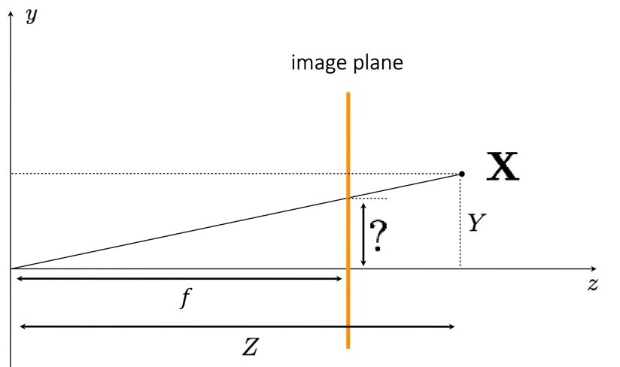
What is the equation for image coordinate x in terms of world coordinate X
Arbitrary focal length.

Slide 60

What is the equation for image coordinate x in terms of world coordinate X
Arbitrary focal length.

Slide 61
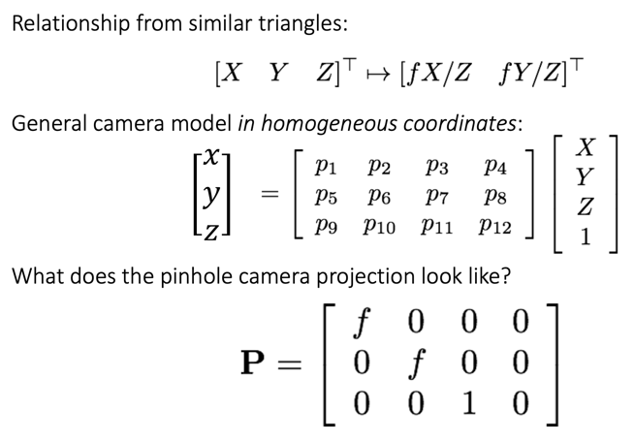
The Pinhole Camera Matrix

Slide 62
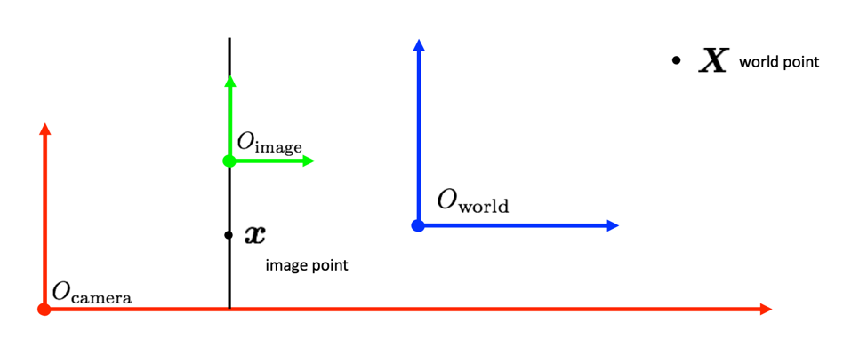
In general, the camera, the image, and the world have different origins

Slide 63
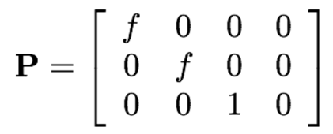
In general, the camera, the image, and the world have different origins
How can we incorporate this into the Camera Matrix?

Slide 64
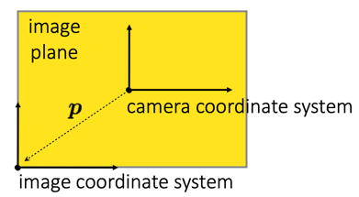
Let’s start by thinking about the relative shift between the camera and image
The difference in origin is a translation (possible when using homogeneous coordinates)

Slide 65
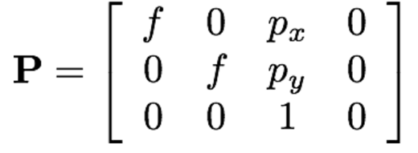
Let’s start by thinking about the relative shift between the camera and image
The difference in origin is a translation (possible when using homogeneous coordinates)
We include the elements of this shift vector in the camera projection matrix.

Slide 66
We can decompose the camera matrix into different components

Slide 67
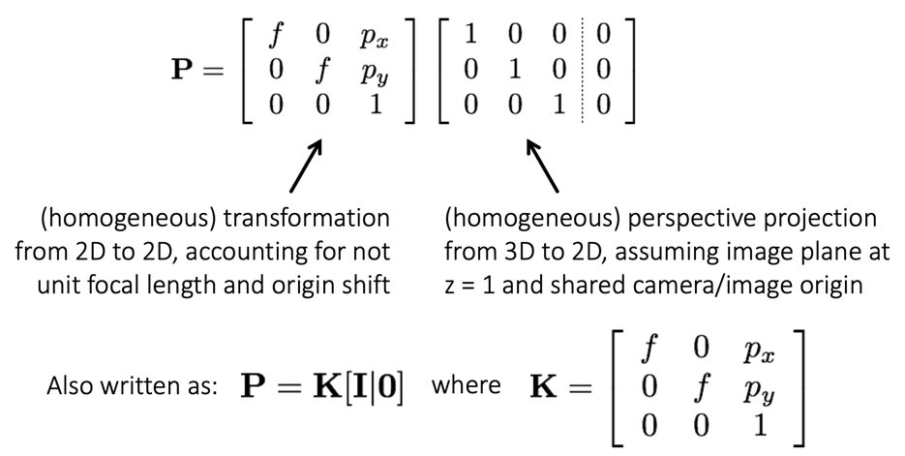
We can decompose the camera matrix into different components

Slide 68
We can decompose the camera matrix into different components

Slide 69
We can decompose the camera matrix into different components

Slide 70
In general, the camera, the image, and the world have different origins

Slide 71
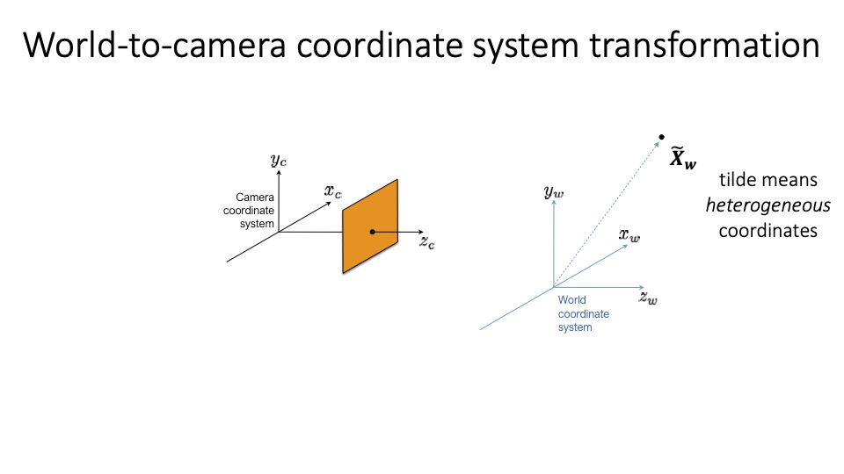

Slide 72
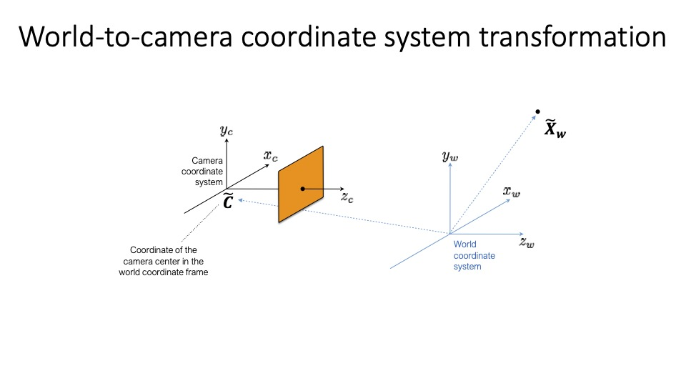

Slide 73
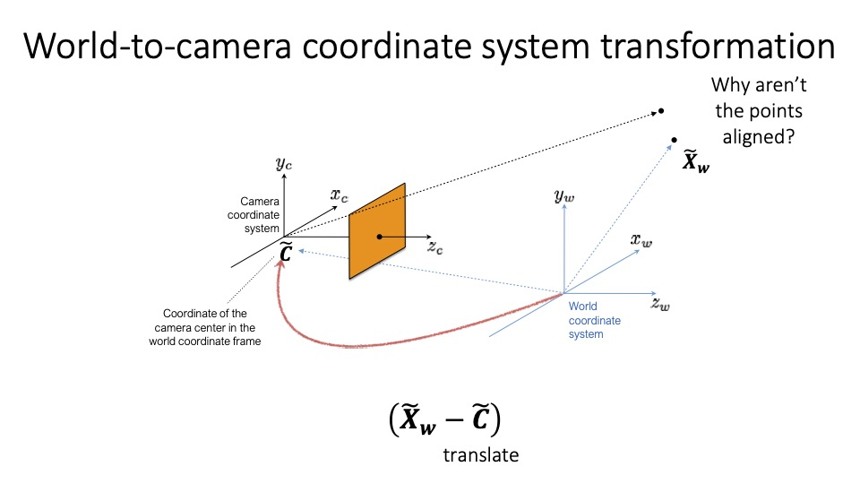

Slide 74
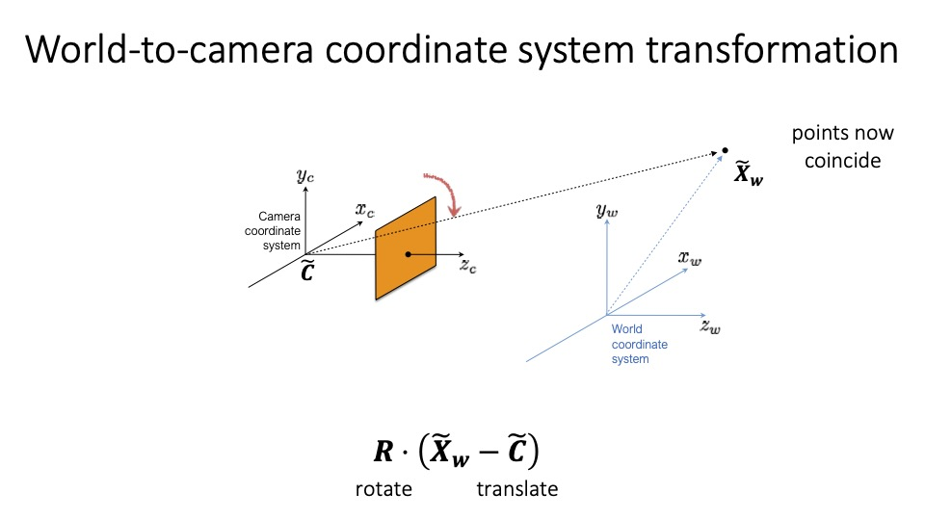

Slide 75

The World-to-Camera Transform
In heterogeneous coordinates, our transform looks like:
What does this look like in homogeneous coordinates?

Slide 76

The World-to-Camera Transform
In heterogeneous coordinates, our transform looks like:
What does this look like in homogeneous coordinates?

Slide 77

Camera Projection Matrix
Putting it all together
We already derived a transformation from the camera coordinates to the image coordinates:

Slide 78

Camera Projection Matrix
Putting it all together
We already derived a transformation from the camera coordinates to the image coordinates:
Now, we have derived the relationship between the world and the camera:

Slide 79


Camera Projection Matrix
Putting it all together
This can be written as a single transform:
where:

Slide 80
Camera Projection Matrix
Putting it all together
This can be written as a single transform:
where:

Slide 81

Camera Projection Matrix
Putting it all together
This can be written as a single transform:
where:

Slide 82

General Pinhole Camera Matrix

Slide 83

General Pinhole Camera Matrix

Slide 84
Perspective and
Perspective Distortion

Slide 85

All the cameras we have seen so far have perspective distortion

Slide 86

Perspective and Forced Perspective

Slide 87

The Ames Room Illusion

Slide 88

The Ames Room Illusion (Forced Perspective)

Slide 89


Slide 90


Slide 91


Slide 92


Slide 93

Perspective Distortion

Slide 94

Perspective Distortion

