Slide 1
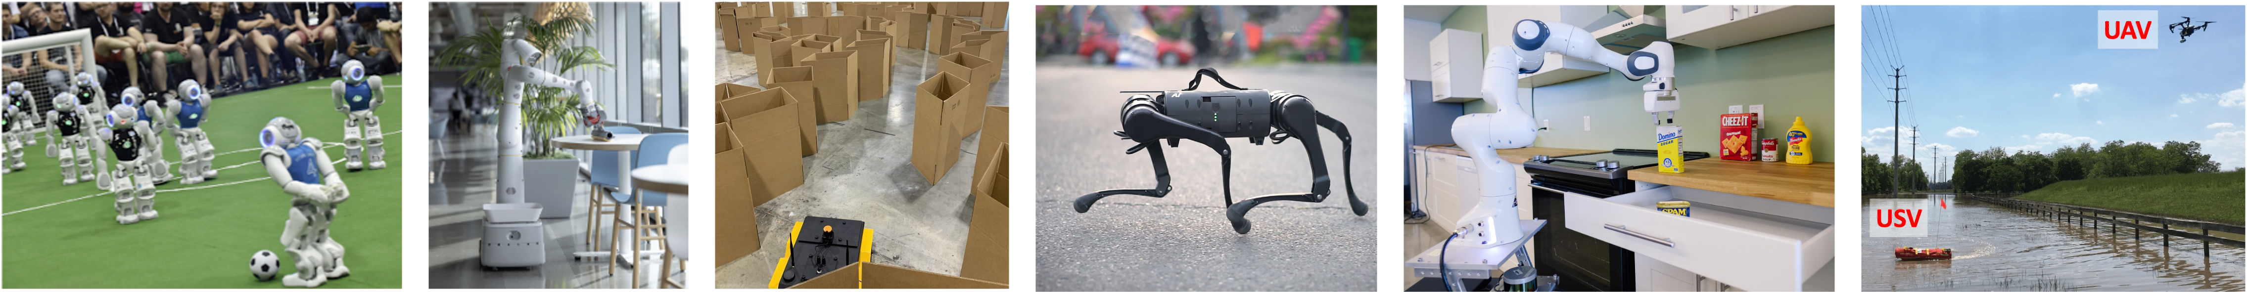
CS 685 Autonomous Robotics
Robot Vision IV
Prof. Xuesu Xiao
George Mason University
Slides Credits: Gregory Stein

Slide 2
Bag of Words Methods
How can we aggregate many sparse features and their descriptors to relate an image to others (and other semantic information)?

Slide 3
Motivation: what if we want semantic information from images?

Slide 4
Motivation: what if we want semantic information from images? Object Detection

Slide 5
Motivation: what if we want semantic information from images? Landmark/Place Recognition

Slide 6
Motivation: what if we want semantic information from images? Semantic Segmentation

Slide 7
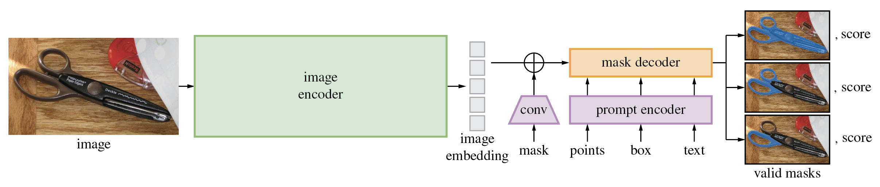
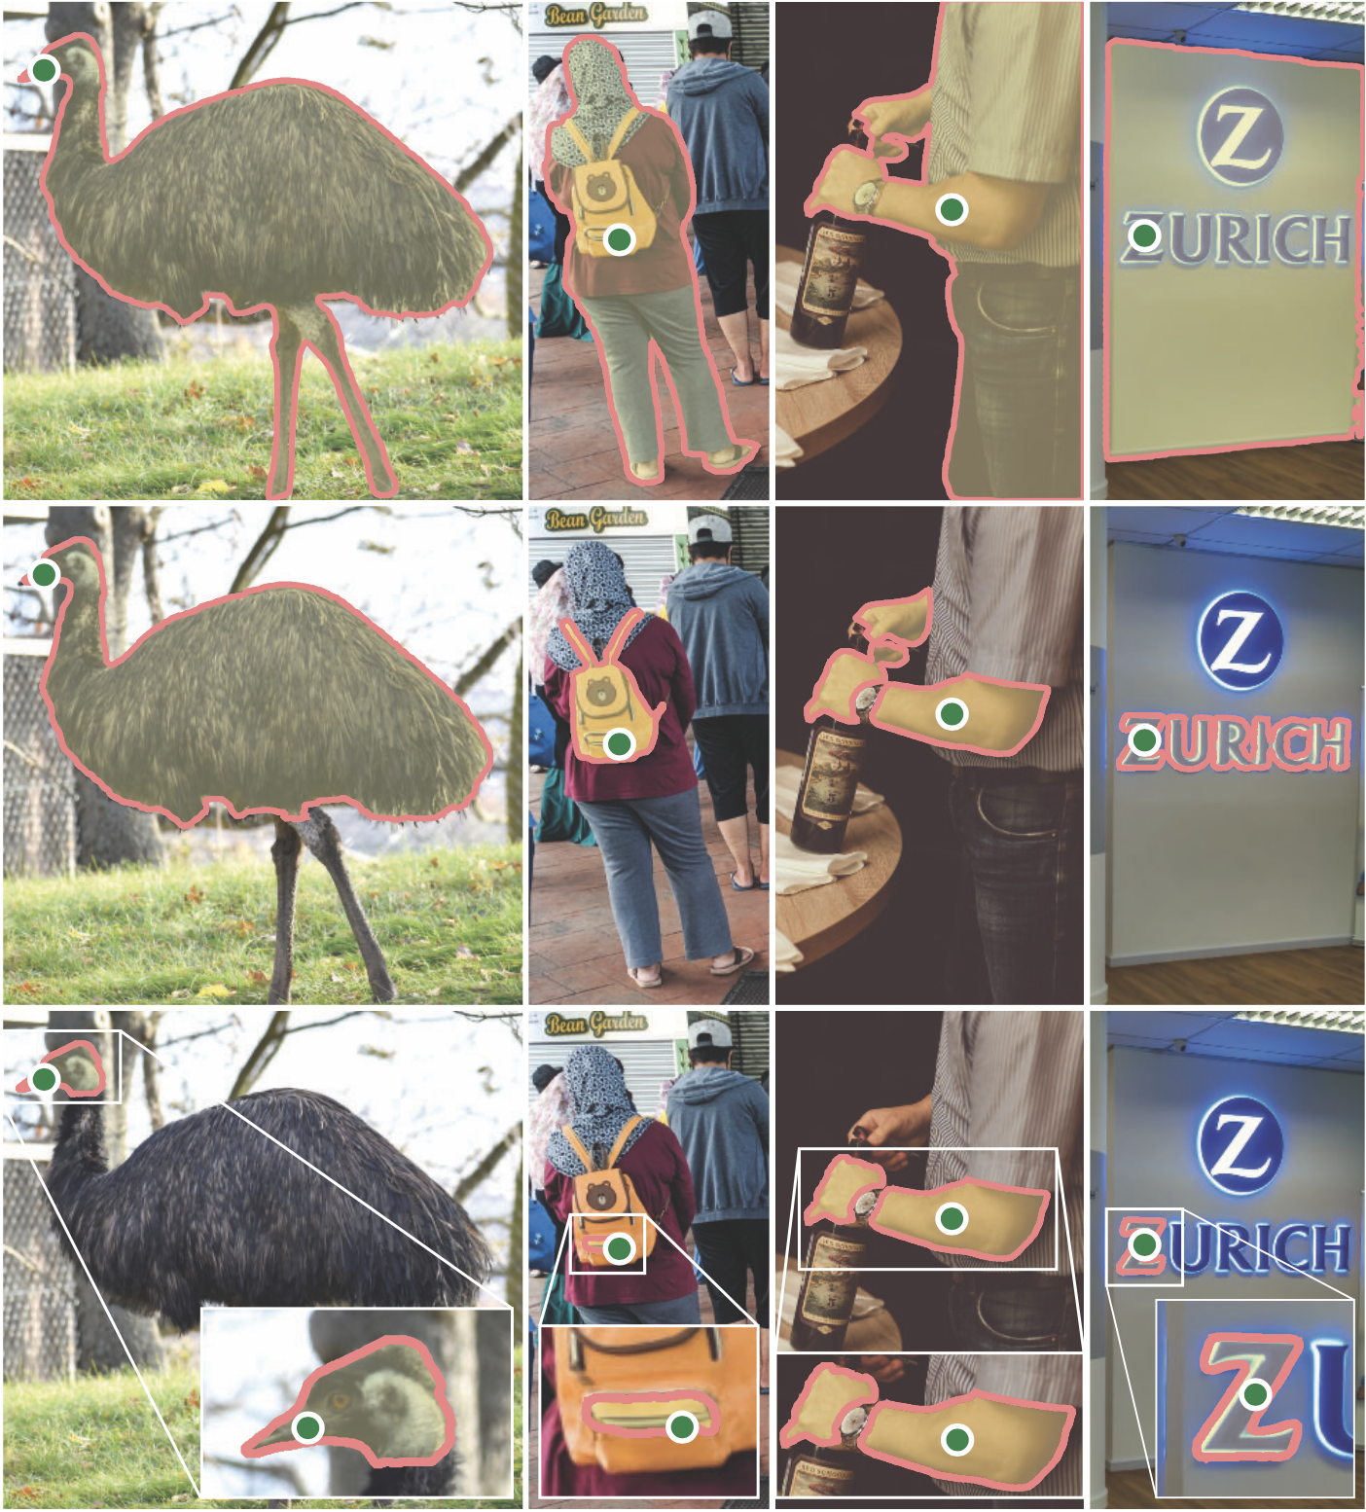
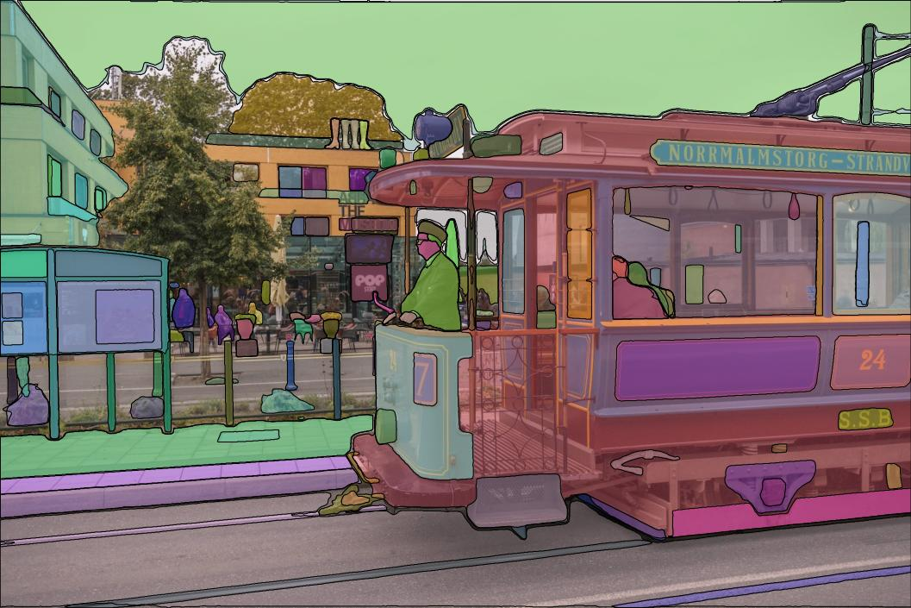
Motivation: what if we want semantic information from images? Semantic Segmentation
Meta AI’s recent Segment Anything work: https://segment-anything.com/

Slide 8
Motivation: what if we want semantic information from images? Semantic Segmentation

Slide 9
Motivation: what if we want semantic information from images? Image Classification

Slide 10
Motivation: what if we want semantic information from images? other…

Slide 11
We’ve used sparse features to match two images already…
How can we use them to identify semantic information in one image against a database?
Today we’ll be talking about some other approaches to solving how our understanding of “classical” (non-neural-network) object detection techniques can help us to understand the design of end-to-end approaches.

Slide 12
We’ve used sparse features to match two images already…
How can we use them to identify semantic information in one image against a database?
Next, we’ll be talking about some other approaches to solving these tasks, and seeing how our understanding of “classical” (non-neural-network) object detection techniques can help us to understand the design of end-to-end approaches.

Slide 13
Reading & Slide Credits
Slide Credits (from which most of these slides are either directly taken or adapted)
-Szeliski, Chapter 14
CMU Computer Vision Course
Penn State Grad Computer Vision Class
Papers:
Deformable Parts Model, Felzenswalb, Girshick, McAllester & Ramanan (2010), You Only Look Once, All About VLAD, NetVLAD, more…

Slide 14
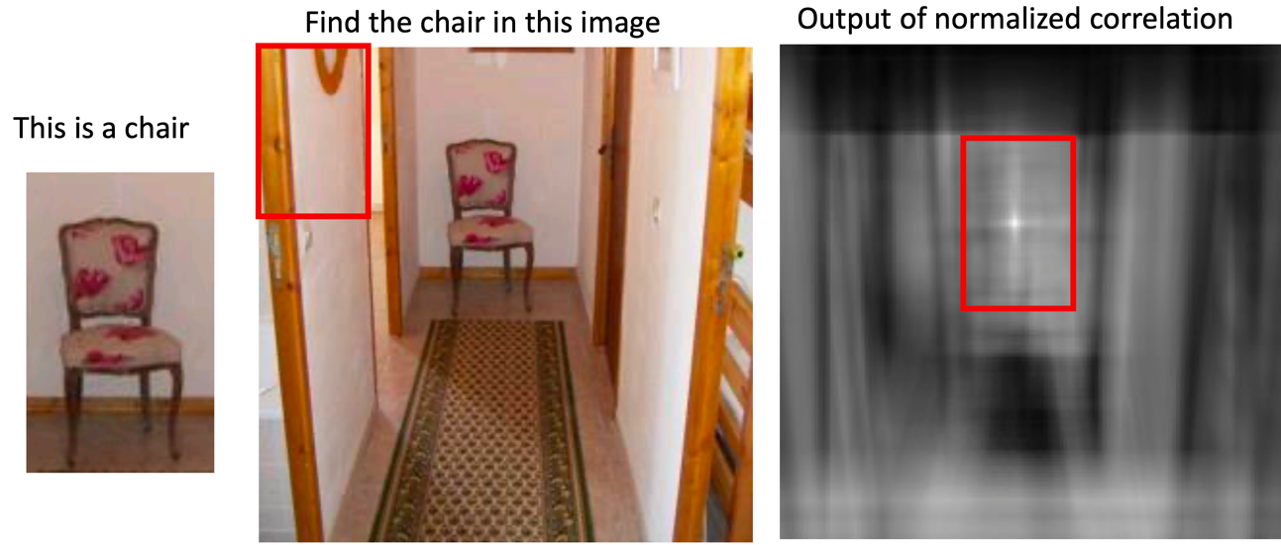
So why is object detection hard?
Patch matching works for limited scenarios:

Slide 15
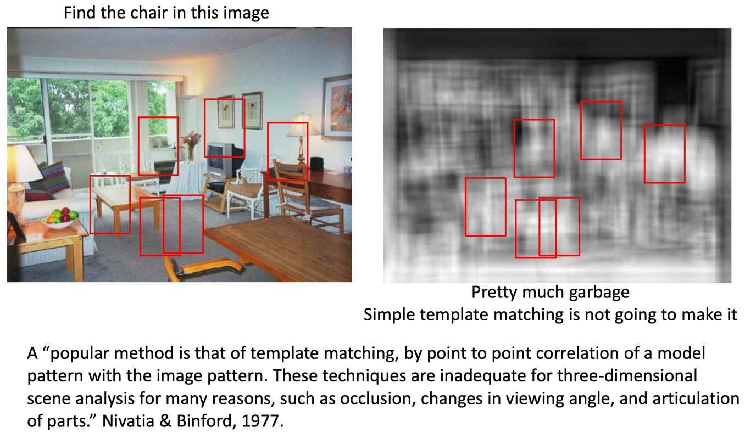
So why is object detection hard?
…but fails in others

Slide 16
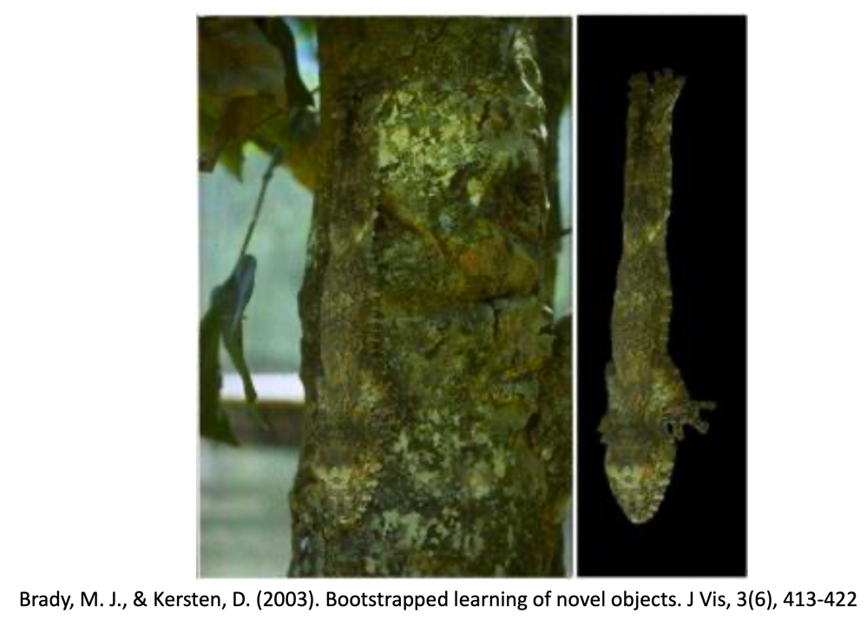
So why is object detection hard?
Not every “object” wants to be found:

Slide 17
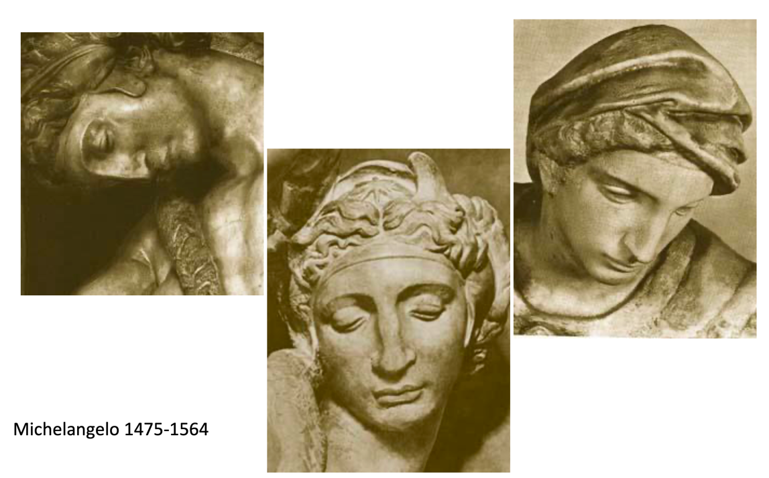
So why is object detection hard?
Changes in viewpoint

Slide 18
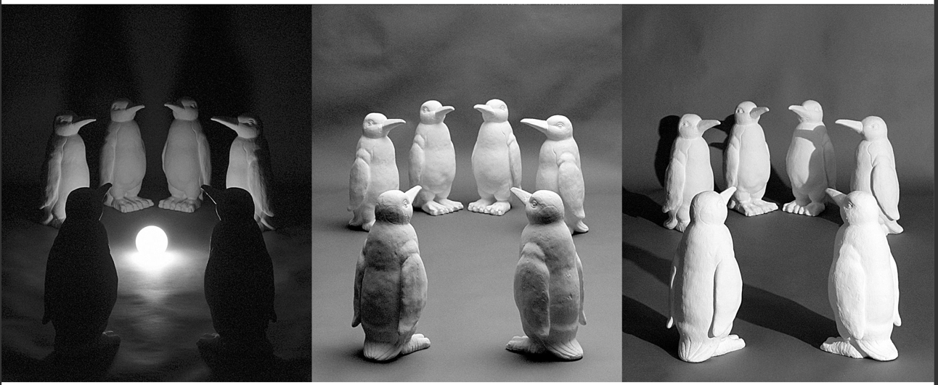
So why is object detection hard?
Changes in lighting

Slide 19
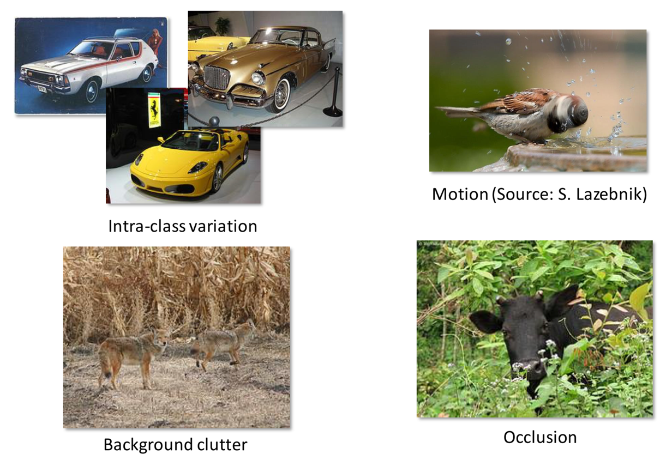
Why is Object Detection so challenging?

Slide 20
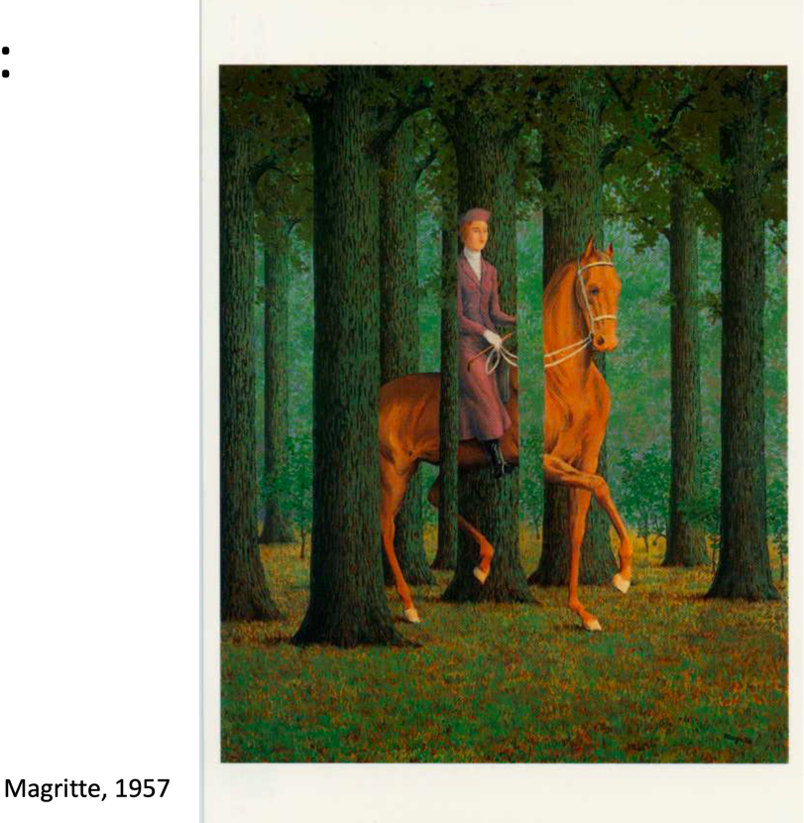
Why is Object Detection so challenging?
Also… nonsense like this doesn’t help:
…so what do we do?
(and we will talk about deep learning later, so besides that)

Slide 21
The data-driven approach to object detection
We’ll assume that we have access to some dataset of labeled images. We can use those to tune the parameters of a model that will be able to detect objects in new images.

Slide 22
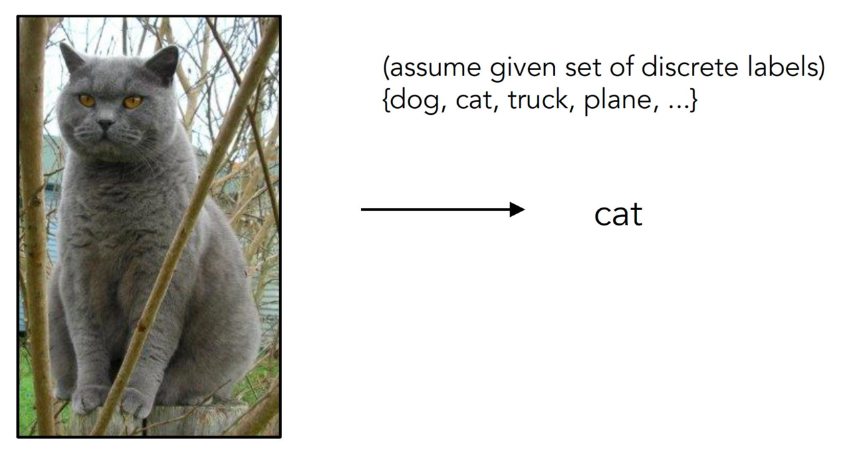
The data-driven approach to object detection
We’ll assume that we have access to some dataset of labeled images. We can use those to tune the parameters of a model that will be able to detect objects in new images.

Slide 23
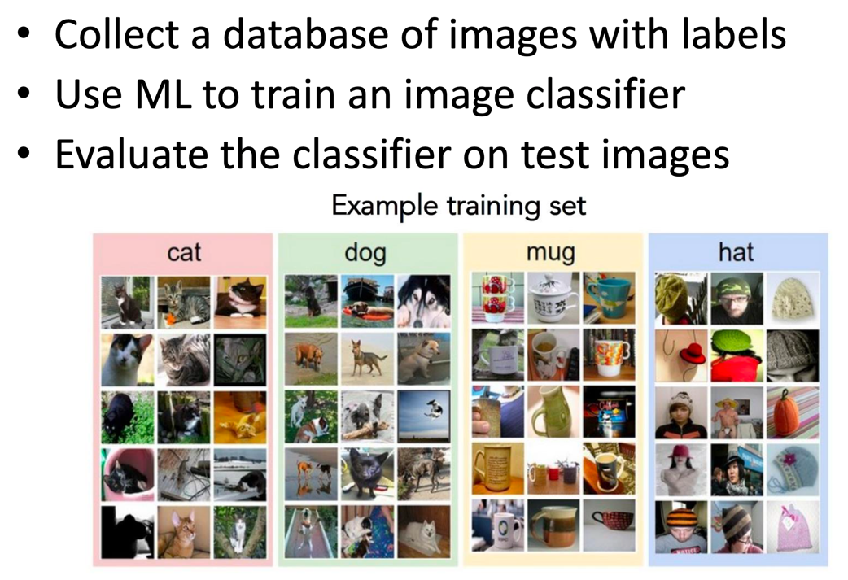
The data-driven approach to object detection

Slide 24
Bag of Words
What is a visual word?

Slide 25
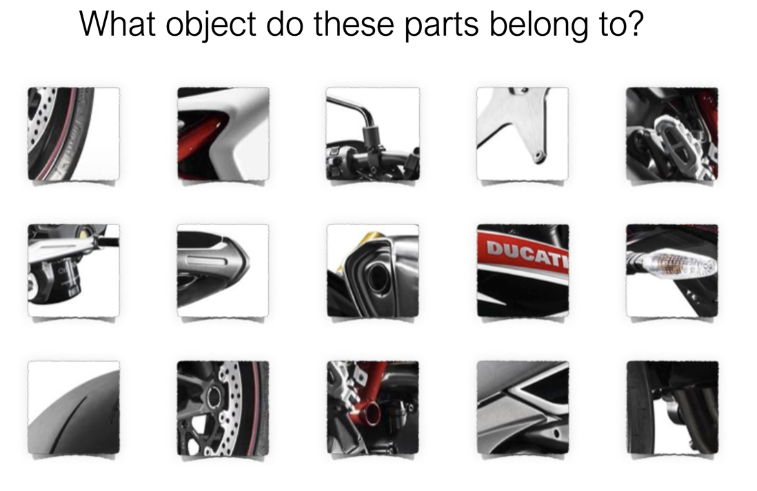
Any thoughts?

Slide 27
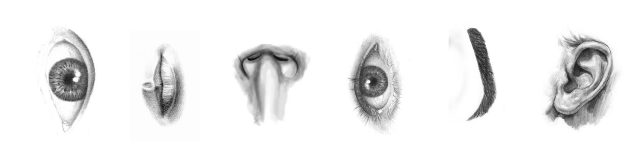
(not so crazy) assumption: spatial location of local features can be ignored
If we see any of these, the image is somewhat likely to contain a face (and we can assume they’ll be arranged “correctly”):

Slide 28
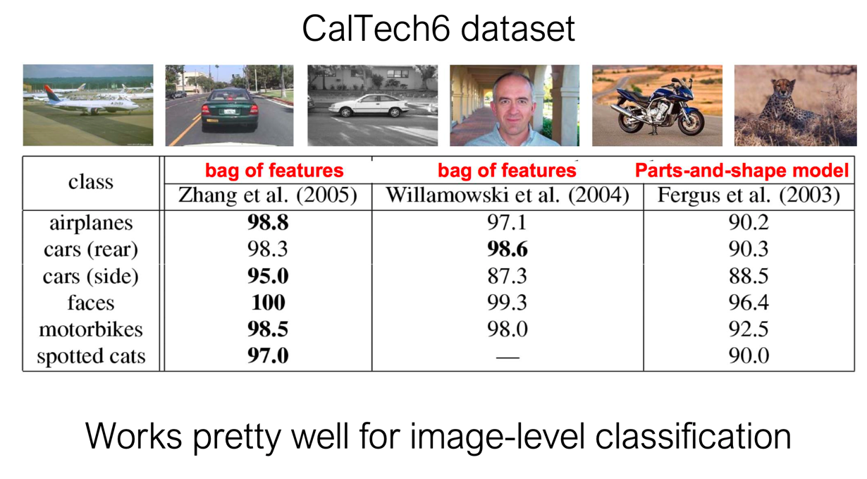
This worked for a while on “small” datasets

Slide 29
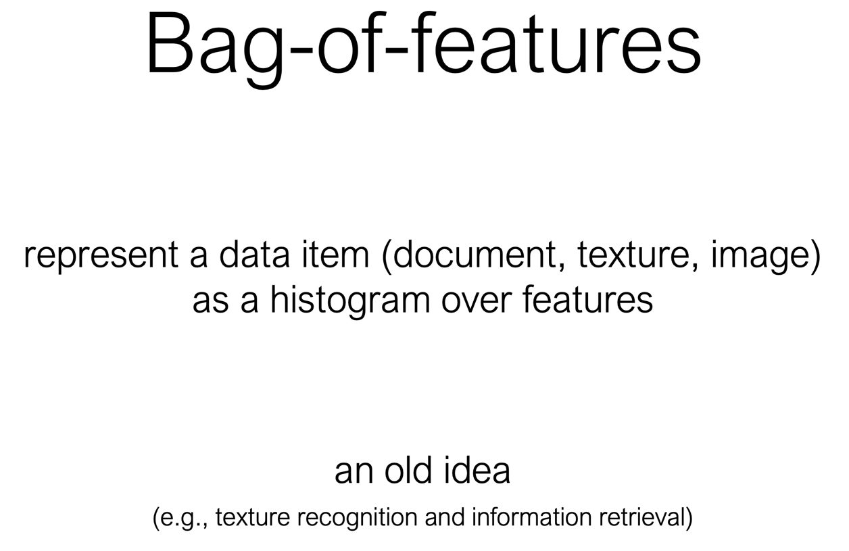
So… what’s the “Bag of Words” model?

Slide 30
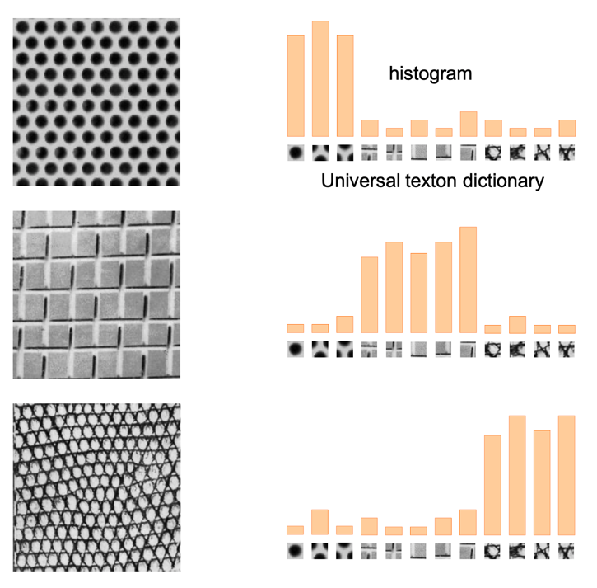
Texture Recognition

Slide 31
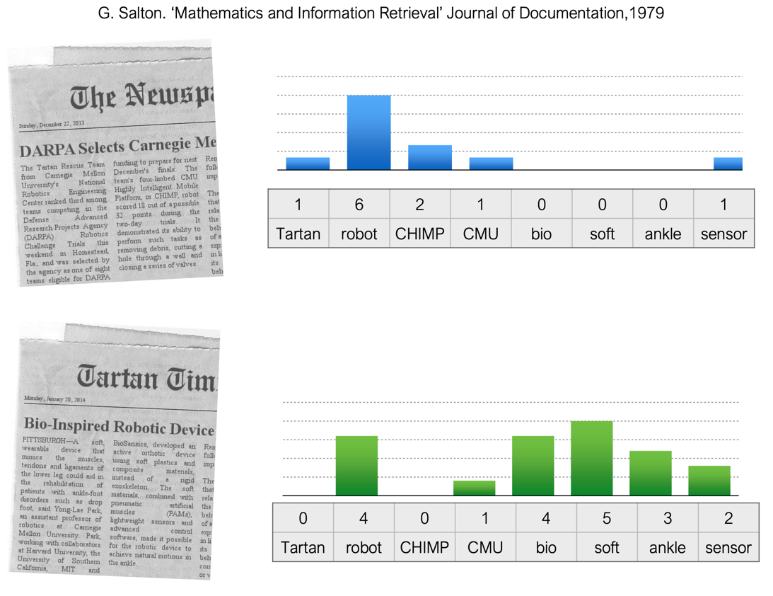
Bag of Words as a vector space model

Slide 35
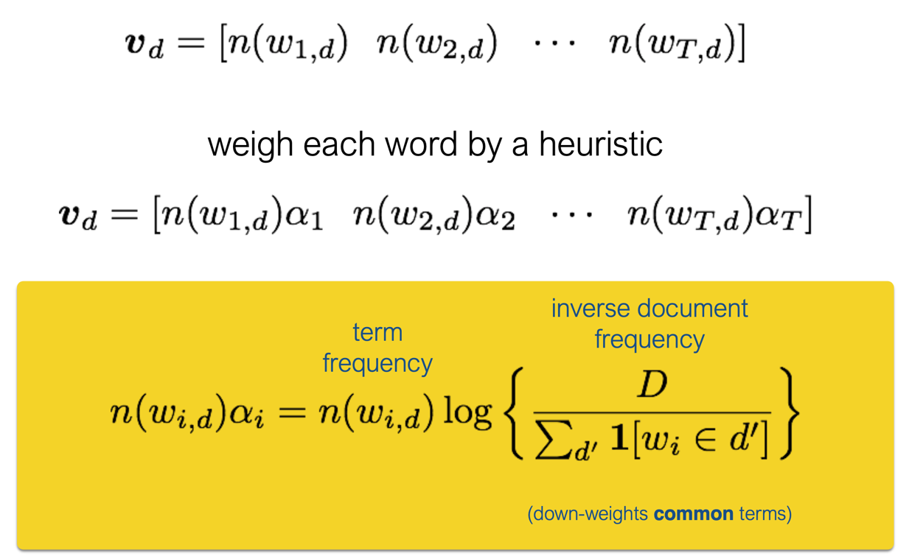
TF-IDF:
Term Frequency Inverse Document Frequency

Slide 36
So how do we use the “Bag of Words” model for images?

Slide 37
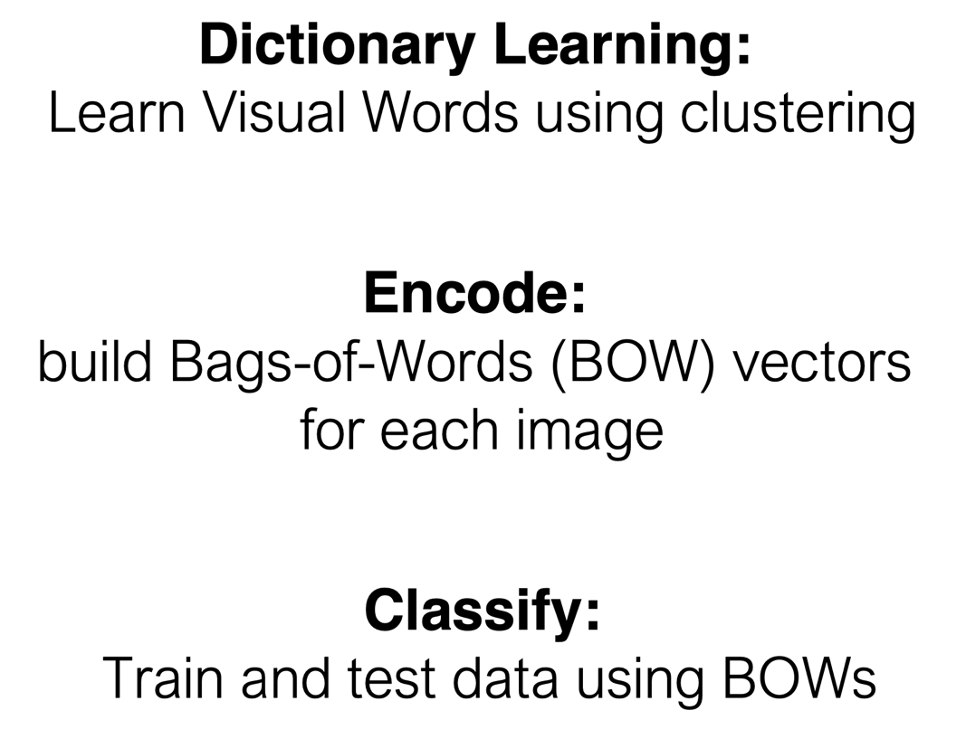
BoW pipeline:

Slide 40
How do we select features?

Slide 41
Dense SIFT is a not-uncommon choice
Compute the SIFT descriptor over a regular grid of image patches.
This is a pretty reasonable choice for whole-image classification.
What are the dimensions of the output?
Input, an image (broken into 16x16 pixel chunks)
Output (for each chunk): is a 128 dimensional feature vector.
There’s lots of variation on this idea; we have an array of descriptors for every location in the image.

Slide 42
Dense SIFT is a not-uncommon choice
Compute the SIFT descriptor over a regular grid of image patches.
This is a pretty reasonable choice for whole-image classification.
What are the dimensions of the output?
Input, an image (broken into 16x16 pixel chunks)
Output (for each chunk): is a 128 dimensional feature vector.
There’s lots of variation on this idea; we have an array of descriptors for every location in the image.

Slide 43
Also:
Histogram of Oriented Gradients
From VLFeat: HOG decomposes an image into small squared cells, computes an histogram of oriented gradients in each cell, normalizes the result using a block-wise pattern, and return a descriptor for each cell.

Slide 44
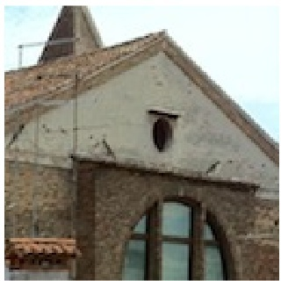
Also:
Histogram of Oriented Gradients
From VLFeat: HOG decomposes an image into small squared cells, computes an histogram of oriented gradients in each cell, normalizes the result using a block-wise pattern, and return a descriptor for each cell.

Slide 45
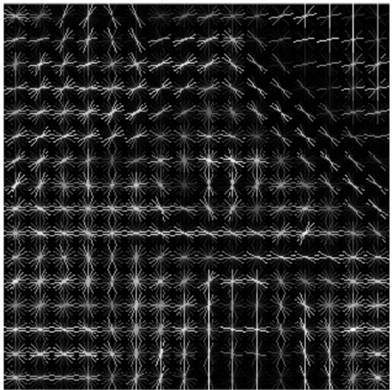
Also:
Histogram of Oriented Gradients
From VLFeat: HOG decomposes an image into small squared cells, computes an histogram of oriented gradients in each cell, normalizes the result using a block-wise pattern, and return a descriptor for each cell.

Slide 46
How do we select features?

Slide 47
How do we select features?

Slide 48
How do we select features?
What do we do with these features once we have them?

Slide 49
How do we select features?
What do we do with these features once we have them?
We want to make a dictionary, where we can ”look up” visual words

Slide 50
How do we learn our dictionary?

Slide 51
How do we learn our dictionary?

Slide 52
How do we learn our dictionary?

Slide 53
How do we learn our dictionary?

Slide 54
K-means Clustering

Slide 61
From what data should I learn the dictionary?
Dictionary can be learned on separate training set
Provided the training set is sufficiently representative, the dictionary will be “universal”

Slide 71
Or maybe even a neural net…?

Slide 72
An Interlude on Classifiers
Well… classifiers that are not neural networks

Slide 73
K-nearest Neighbors

Slide 74
K-nearest Neighbors

Slide 75
K-nearest Neighbors

Slide 76
K-nearest Neighbors

Slide 77
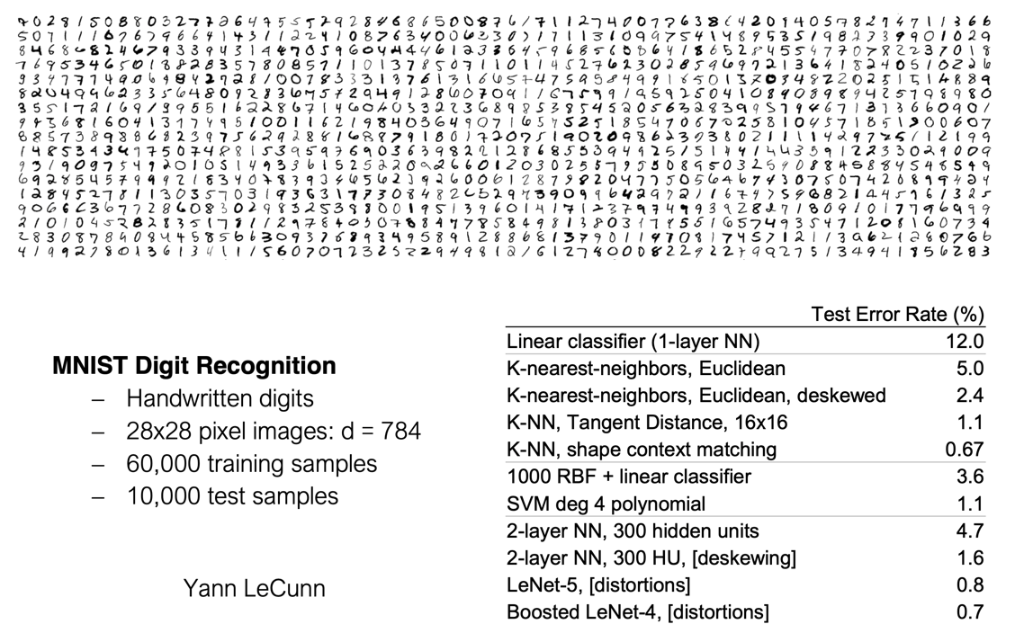
Nearest neighbor classification can be (surprisingly) effective

Slide 78
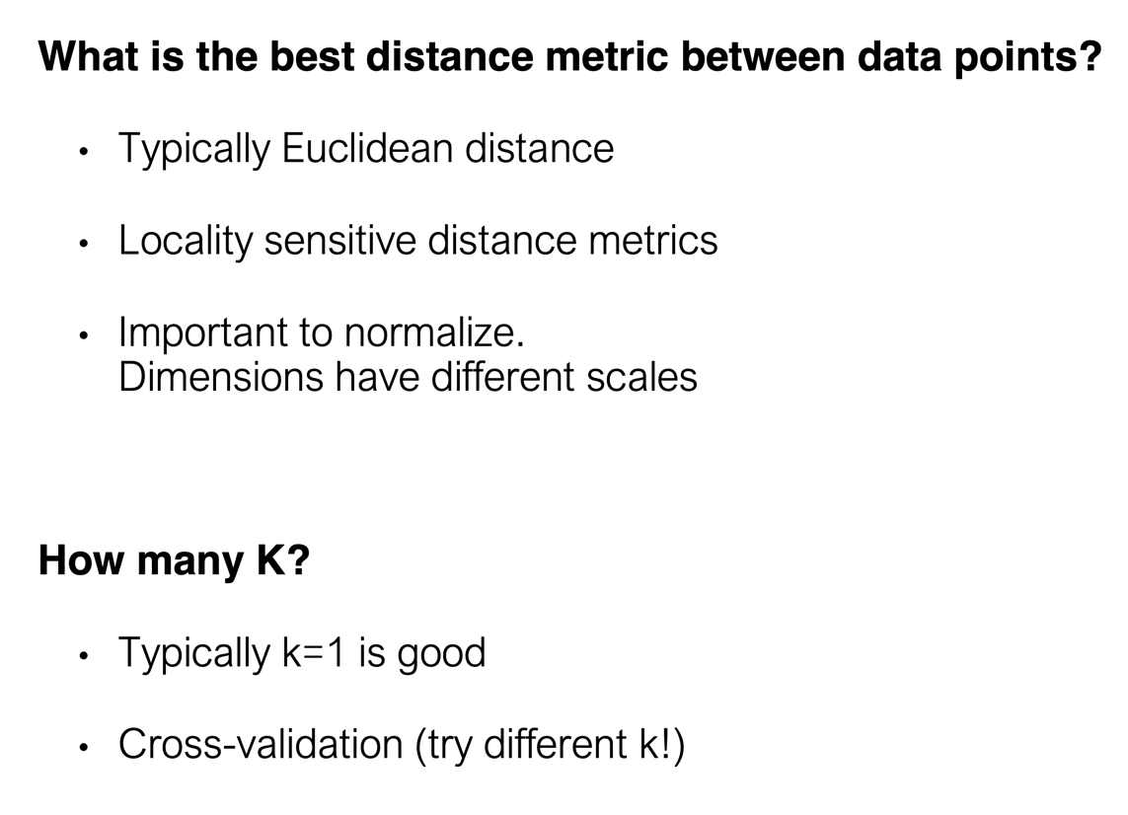
K-nearest Neighbors

Slide 79
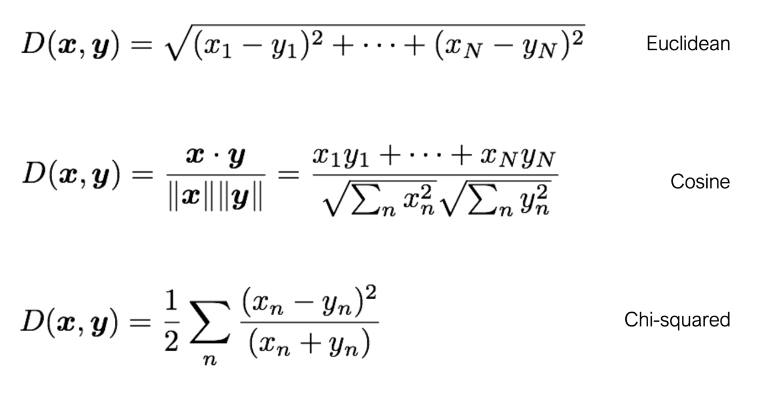
K-nearest Neighbors: Some distance metrics

Slide 80
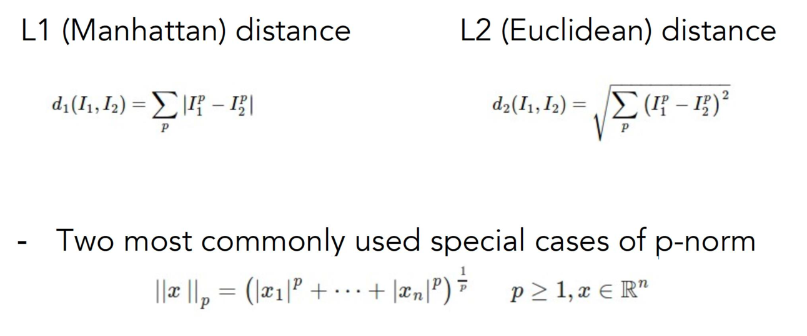
K-nearest Neighbors: Some distance metrics

Slide 81
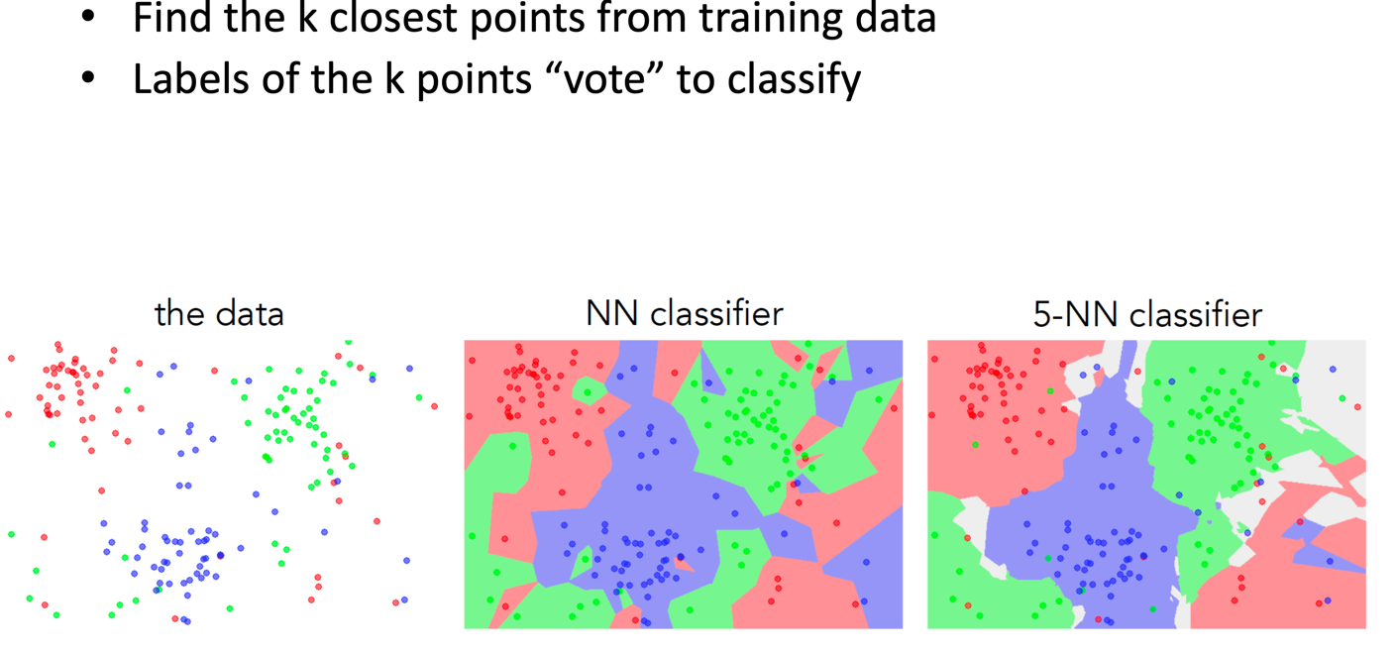
K-nearest Neighbors

Slide 82
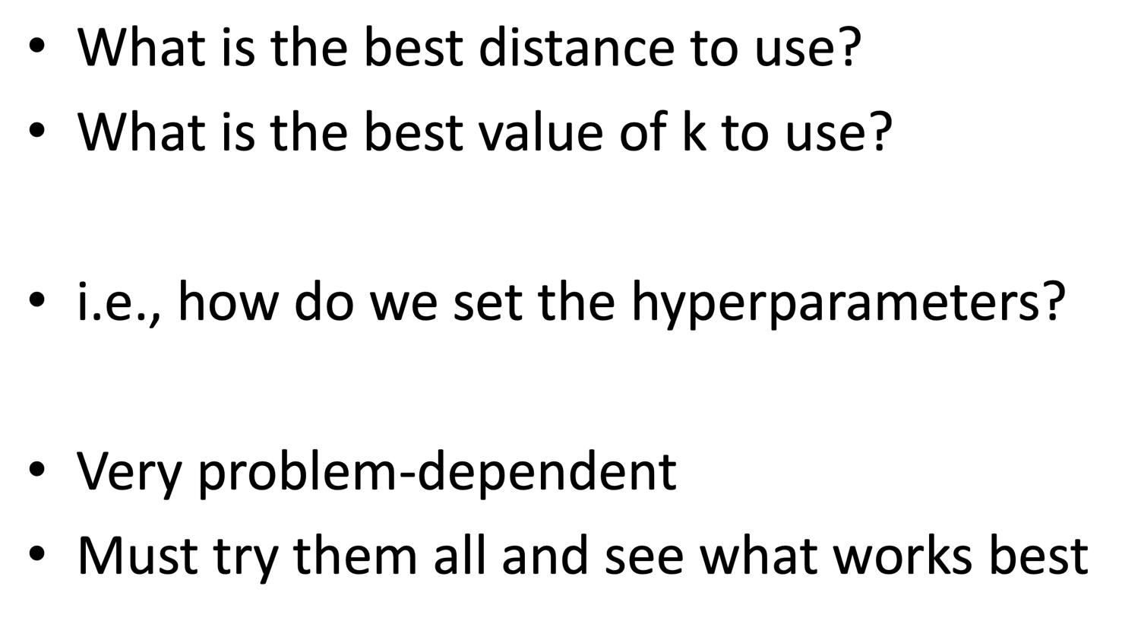
Choosing Hyperparameters

Slide 83
Choosing Hyperparameters

Slide 84
Choosing Hyperparameters

Slide 85
Choosing Hyperparameters

Slide 86
Choosing Hyperparameters

Slide 87
Choosing Hyperparameters

Slide 88
K Nearest Neighbors is fast at train-time, but slower at test-time:

Slide 89
Another approach: Naïve Bayes

Slide 90
Another approach: Naïve Bayes

Slide 91
Another approach: Naïve Bayes

Slide 92
Another approach: Naïve Bayes

Slide 96
Assumes conditional independence! This is the “naïve” part of naïve bayes!

Slide 97
Computing this is easy! It’s just the ratio of times a certain “word” appeared in documents of class z

Slide 100
Another approach: Support Vector Machine (SVM)
A “fun” historical note: SVM’s were mostly responsible for the last downfall of neural networks in the early/mid- 90’s.
SVM’s worked pretty well “out-of-the-box” so many in industry stopped trying to get neural networks to work on their data.

Slide 101
Remember: distance of a line to the origin

Slide 102
Remember: distance of a line to the origin

Slide 103
Let’s separate this data. What’s the “best” w?

Slide 104
Let’s separate this data. What’s the “best” w?

Slide 105
Let’s separate this data. What’s the “best” w?

Slide 106
Let’s separate this data. What’s the “best” w?

Slide 107
Let’s separate this data. What’s the “best” w?

Slide 108
Let’s separate this data. What’s the “best” w?

Slide 109
Let’s separate this data. What’s the “best” w?

Slide 110
Let’s separate this data. What’s the “best” w?

Slide 114
There is also a “soft margin” extension of SVM (probably the most popular)

Slide 115
There is also a “soft margin” extension of SVM (probably the most popular)

Slide 116
There is also a “soft margin” extension of SVM (probably the most popular)

Slide 117
There is also a “soft margin” extension of SVM (probably the most popular)

Slide 118
What else can we do with Bag of Words models?

Slide 119
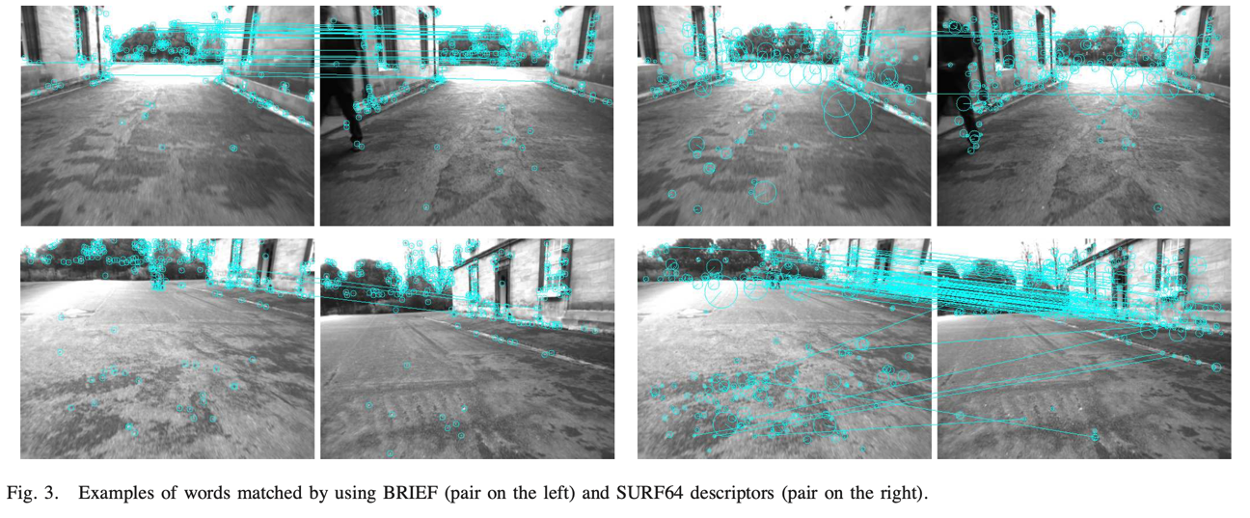
Place Detection
Why not? We can treat it like image classification
…except instead of classes, we match against every other image and threshold by a score.
DBoW2: http://doriangalvez.com/papers/GalvezTRO12.pdf

Slide 120
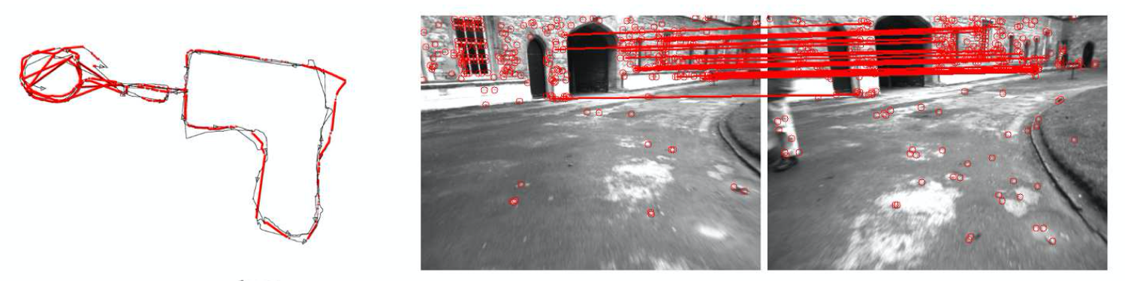
Place Detection
Why not? We can treat it like image classification
…except instead of classes, we match against every other image and threshold by a score.
One can also reject ”detections” with geometric means (via Epipolar geometry) to reduce false-positives (VERY important when using this for “loop closures” in SLAM).
http://webdiis.unizar.es/~dorian/papers/IROS2011_Galvez.pdf

Slide 121
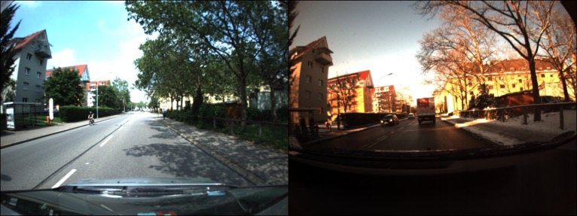
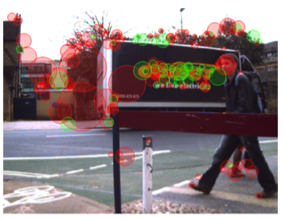
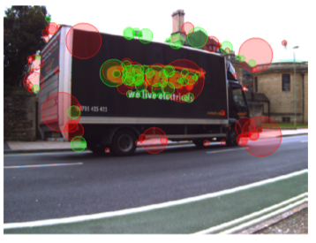
What challenges limit non-learned features + descriptors
Changes in weather or lighting.
For tasks like localization, lighting may change dramatically over time.
Some features are poor.
Skydio filters by semantic class; objects in the scene may move.
[1] Freiburg Across Seasons Dataset [2] FAB-MAP

